Slide 1
Health Impact Assessment: Helping health agencies reach across sectors to solve today’s public health challenges NACCHO July, 2010 Memphis, TN
Aaron Wernham, M.D., M.S. Director | The Health Impact Project
901 E Street, NW, Washington, D.C. 2004
p: 202.540.6346
e: awernham@pewtrusts.org
www.healthimpactproject.org
Notes:
Outline:
Introduction:
The need for HIA: SDH data, but the SDH are created by a myriad of decisions made every day at the local, state, federal level, with little or no input from public health.
Many decisions – like building a new freeway or redeveloping an urban neighborhood – have important health effects but health would not normally be a part of the planning process.
Case examples: a couple of standard examples
Range of practice: intro to Health Impact Project, list of projects
Definition of HIA
Questions:
Standards of Evidence in impact assessment vs science
Impact assessment as a deliberative tool
Impact assessment as a participatory, stakeholder engagement method
How decisions are made:
Common assumptions include quantitative, scientific, and cost
Reality: technological limits, economics, political priorities
Conclusion: advocacy in HIA – how to do good science, advocate for health-based decisions and

Slide 2
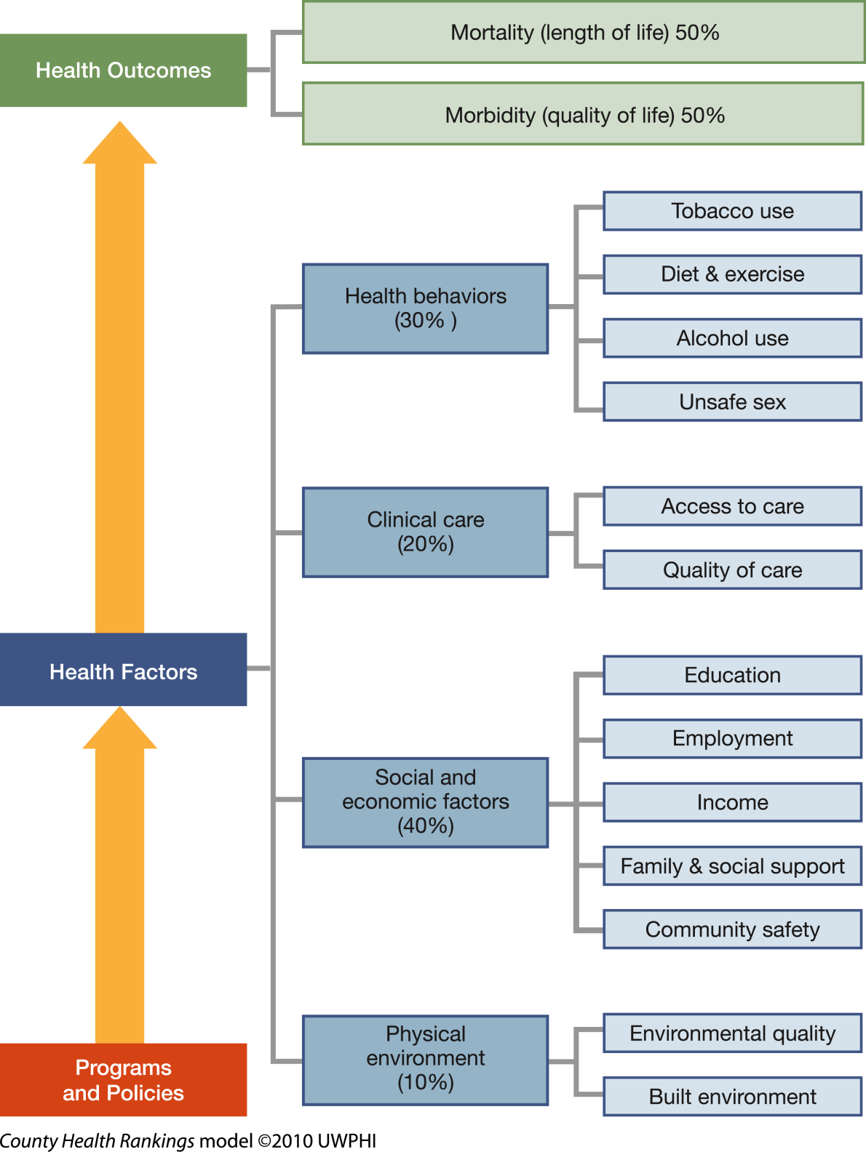
County Health Rankings
RWJF and University of Wisconsin Madison: www.countyhealthrankings.org/about-project/background
Notes:
This is the model used in the recently released County Health Rankings. It is but one example of the increasingly prevalent focus on the broad range of social, economic and environmental factors – that is, factors outside an individuals’ ability to control through behavior change – that underlie many illnesses and health disparities.

Slide 3
Growing focus on non-health policies…
"(The) toxic combination of bad policies, economics, and politics is, in large measure, responsible for the fact that a majority of people in the world do not enjoy the good health that is biologically possible.”
WHO Commission on Social Determinants of Health, 2009

Slide 4
Growing focus on non-health policies, but…
No common language:
transportation engineers don’t understand health data.
public health professionals don’t understand the constraints and limitations of the planning process
Few formal requirements
No standard forums where health works with other sectors
No funding for new public health activities
“Going out on a limb:”
Public health is science-driven, and policy and planning are governed by many other considerations: economics, politics, technology, deadlines, etc …

Slide 5
Health Impact Assessment
A combination of procedures, methods and tools that systematically judges the potential effects of a policy, programme or project on the health of a population and the distribution of those effects within the population. HIA identifies appropriate actions to manage those effects.
(IAIA, 2006)
Bottom line: a staged process that makes judgments based on scientific data and public input, and develops solutions through close collaboration with the stakeholders and entity making the decision.
Notes:
HIA defines health broadly. They are a flexible approach for translating public health data into practical recommendations that decision makers can use to ensure that their policies contribute to healthy communities. Health Impact Assessments:
Acknowledge the trade-offs and potential costs and benefits of various choices, and outline opportunities to maximize health gains, minimize adverse effects and improve health for everyone in the affected community;
View health from a broad perspective, taking into account a wide range of environmental factors, such as housing conditions, roadway safety, and social and economic variables;
Consider whether there are subgroups within an affected population that may be more vulnerable to a given impact;
Promote civic engagement by engaging community members and other stakeholder groups who will be affected by a decision; and
Present an impartial, science-based appraisal of the risks, benefits, trade-offs and alternatives involved in the decision.
Look across the entire spectrum of factors, such as economy, housing, employment, environmental conditions, and social factors that drive community health.

Slide 6
The HIA Process
Screening –is HIA feasible and likely to add value?
Scoping – determine the important health effects, affected populations, available evidence, etc
Assessment – analyze baseline conditions and likely health effects
Recommendations – develop health-based recs and a feasible plan for implementing them
Reporting – disseminate the report to the public, stakeholders, solicit input
Monitoring and Evaluation -- monitor results of HIA, monitor health outcomes; evaluate results of HIA

Slide 7
HIA as an iterative process
Assess
Manage impacts
Monitor
Adaptive Management
Monitor
Adjust Mgmt
Reassess

Slide 8
Analytical Framework
Proposed policy, project, program | Determinants of health | Health outcomes
Broad framework: considers multiple determinants and dimensions of health
Focuses on an active decision
Considers direct, indirect, and cumulative pathways
Both qualitative and quantitative methods used, as is expert opinion

Slide 9
Assessment in HIA Looking at the evidence and using judgment
Social, economic, environmental impacts
Baseline conditions, health inequities
Literature Review, modeling
Public input
Predicted Health Effects

Slide 10
The Health Impact Project: A collaboration of the Robert Wood Johnson Foundation and The Pew Charitable Trusts
Overall Objective:
To promote and support the use of HIA as a tool to ensure that decisions in non-health sectors, whether at the local, state, tribal, or federal level, are made with health in mind.
Visit www.healthimpactproject.org

Slide 11
Thank you

Slide 12
Health Impact Assessment International context
Canada: pioneered integrated HIA/EIA. Still intermittent practice, both within and outside EIA
Individual European nations:
wide range of laws, practice
broad applications in policy and land-use common
variety of governance structures
Australia and New Zealand: very well developed practice, variety of government supports and some mandates. Practice includes HIA/EIA and standalone HIA.
EU: mandated use of HIA for all EU policies
Thailand: strong HIA requirements; community control.
Ghana: establishing HIA program

Slide 13
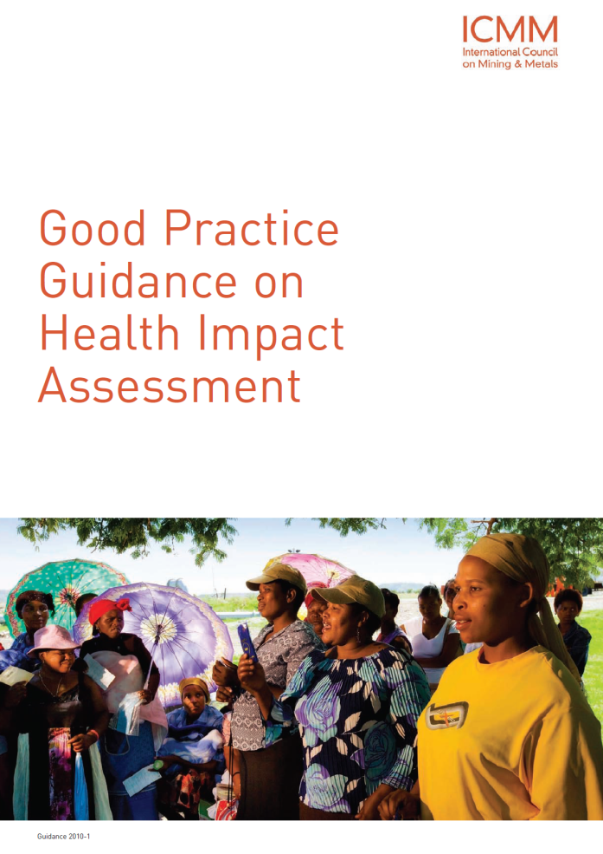
Health Impact Assessment Development lending and international business
World Bank and IFC: part of evaluation standards for large development loans
(IFC Guidance Note 4: http://www.ifc.org/ifcext/enviro.nsf/Content/GuidanceNotes)
Equator Principles: ratified by the
majority of large lending banks
worldwide,
Multinational Corporations: eg Shell,
Chevron, large mining companies:

Slide 14
Completed HIAs in the United States (2008)
1999–2009 (N = 58)
WA 4
MT 1
MN 5
OR 2
MI 1
PA 1
MA 2
OH 1
NJ 1
CO 2
CA 25
MD 1
TX 1
GA 4
FL 1
AK 6
Notes:
Although we know of 64 HIA-type projects, only 48 have been totally completed.
As for the others:
6 HIAs are in progress
4 are not actually HIAs (yet, but could eventually be so we are tracking them)
2 are HIA “checklists” and not HIA projects/programs/policies
2 HIAs were cancelled
2 HIAs have an unknown status- we have abstracts for the “Injury Liability Protection for Physical Activity” out of Los Angeles, but there have been no reports published. The status of the Tacoma/Pierce County South Hill Neighborhood Plan HIA is also unknown. The contact information we have for people associated with the project (Rick Porso and Beth Glynn) no longer work. Arthur or Andy, do you know anything about these two projects?
Also, Andy, I only have 3 HIAs in Minnesota and Alaska, but your map listed 4…

Slide 15
HIA Practice in the U.S. Current numbers -- estimated
Completed HIAs: 85 (approx., likely higher)
HIAs in progress: 30 that we know about
No mandates outside environmental impact assessment
Despite mandates, little consideration of health in EIA
Several laws introduced at local, state, federal level
Please let us know about your HIA work! http://www.healthimpactproject.org/hia_submit

Slide 16
Local Health Department HIAs
Sector/Topic | Counties/Projects
Land Use/Planning | SFDPH – dozens – many topics
Redevelopment projects | Derby, CO – neighborhood redevelopment
Comp plans, growth plans | Billings, MO; Humboldt, CA – growth plans; Ingham, MI; Columbus, OH – sector plans
Transportation | Decatur, GA -- transportation plan; Clark County, WA -- highway; King County, WA – bridge; Multnomah County, OR – hwy/bridge
Oil and Gas | North Slope Borough, AK (in federal EIS) Garfield County, CO
Energy | Green River tri-county, KY – coal-fired power plants

Slide 17
Proposals from 43 States

Slide 18
The Health Impact Project 220 proposals – 12 funded
Coal Gasification Plants: Green River Health Department will do an HIA of 3 proposed “clean coal” plants in KY
State Cap-and-Trade regulations: CA DPH -- HIA to inform rulemaking for California’s carbon cap and trade policy
3. Agriculture Policy: Kohala Center, a nonprofit in HI, will do an HIA to inform HI County’s A non-profit would engage in a county agricultural plan that will shape the local economy, land use patterns, and diet.
Wilshire Transportation Corridor, LA: LA DPH and UCLA will do an HIA of planned transportation corridor in LA
Farm to School Legislation: a non-profit in OR will do an HIA to inform deliberations on a farm to school bill.

Slide 19
The Health Impact Project CFP Funded Projects
State Budget Process: New Hampshire Center for Public Policy will address the NH budget
Transit Oriented Development:
ISAIAH (a faith-based coalition) will use HIA to address planning decisions on a light-rail project in the Twin Cities.
TSU will use HIA to look at a proposal for TOD
Waste-fired power plant: Mass. Dept of Public Health will do an HIA of a proposed biomass power plant in an economically depressed area of Springfield, MA
Farm to School legislation: an OR non-profit public health group will undertake and HIA of proposed legislation to fund farm to school programs

Slide 20
The Health Impact Project: Tools to help LHDs
Using existing regulations, policies, and standards that support the use of HIA?
Review existing legal constructs that may support the inclusion of health – zoning laws, growth plans, regulatory impact analysis, etc.
Getting started: how to find the best opportunities for HIA?
Cross-sector toolkit – finding the planning, policy, program and project-related decisions most likely to affect health; starting inter-agency collaborations

Slide 21
What makes HIA a good tool to address such a wide range of decision-making?
Is there more to it than just assessing impacts, making recommendations, and writing a report?
A new way to engage: brings public health professionals, community stakeholders, planners, developers, and decision-makers to the table, with a focus on practical, realistic solutions.
Address public concerns early and directly
Ensure that public health
input and recommendations
are sensitive to the political,
regulatory, and economic
context.

Slide 22
Discussion?

