Slide 1
Against all Odds Transforming challenges into opportunities using the HIA recommendation development process
National Health Impact Assessment Meeting 2015
Debarati “Mimi” Majumdar Narayan, PhD
Catalyze Research and Consulting

Slide 2
background
Proposed plan:
Redevelopment of 296 units and their surrounding complex at the Coffelt-Lamoreaux Public Housing
Health Indicators:
Access to Healthy Food
Access to Physical Activity
Access to Safe Streets and Affordable Transportation
Healthy and Safe Housing
Social Cohesion
Demographic | Data
Total residents | 709
Female residents | 63%
Children (under 18) | 58%
Latino | 74%
Single parent families with children | 71%
Median Household Income | $9,985

Slide 3
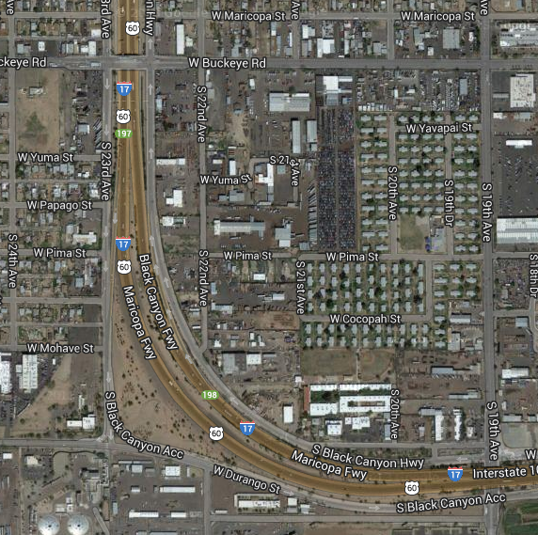

Slide 4
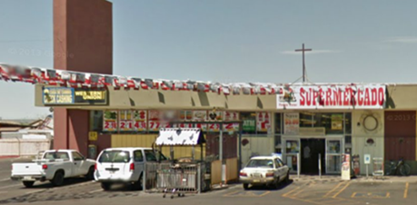
WIC vendor
Unaffordable fresh fruits and vegetables
Poor quality produce
Unaffordable basic stables (milk, eggs etc.)
Mostly packaged, processed food
Highest profit product- alcohol
Closest affordable, healthy food store is 2.3 miles away
FOOD
findings

Slide 5
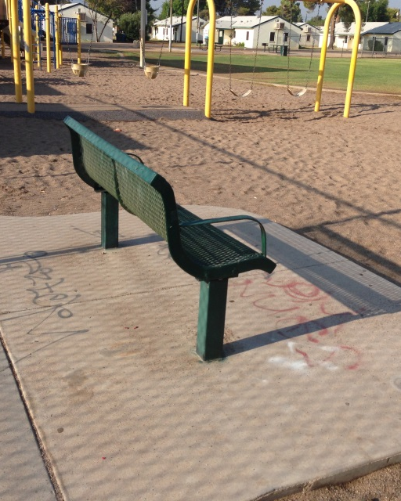
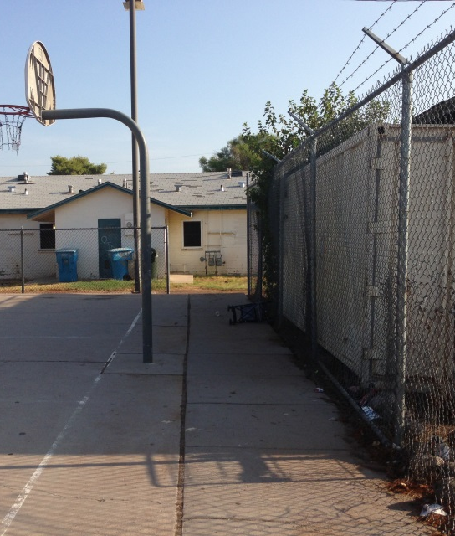
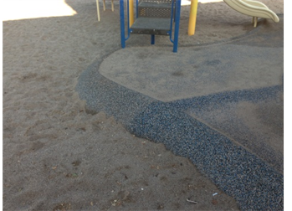
RECREATION
findings
Playground equipment broken, locked or not to code
Tagging and trash
Limited shade
Basketball court in disrepair
Notes:
More about challenges – additional slides with images

Slide 6
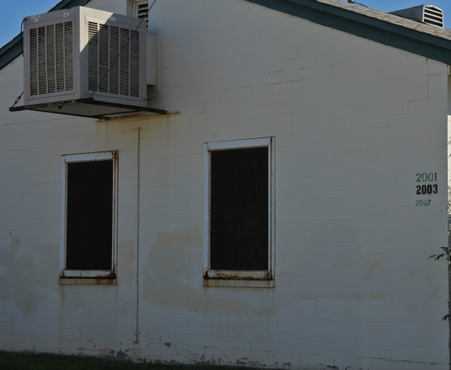
HOUSING
findings
Housing units aging and in a state of disrepair
Poor indoor and outdoor air quality;
Inoperable windows
Insufficient cooling
Inadequate # of bathrooms in larger units
Vermin infestation in units
Inadequate lighting on exterior of units

Slide 7
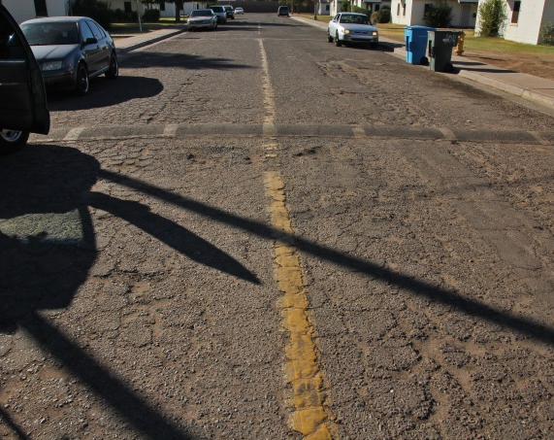
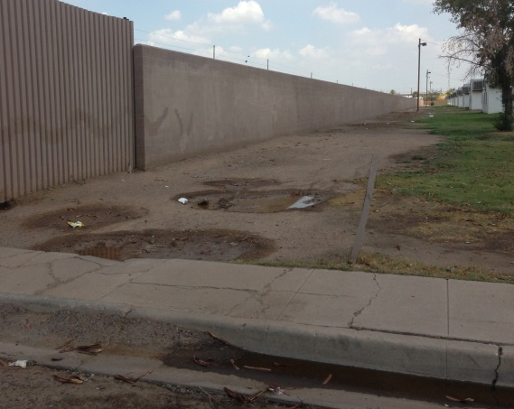
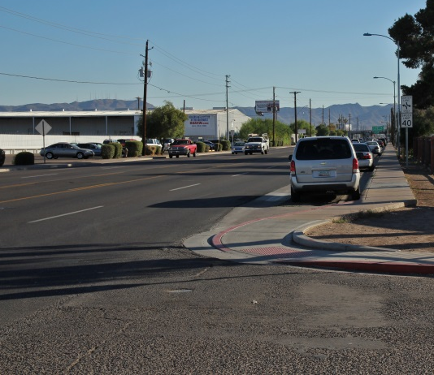
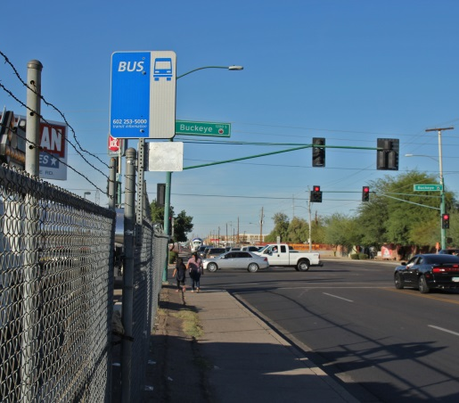
Interior streets in disrepair; sidewalks not ADA compliant
Inadequate shade/lighting on site
Site teeming with rodents, stray dogs, mosquitoes
findings
STREETS & TRANSPORTATION
High speed traffic on streets around site; limited crosswalks; uneven sidewalks
Unshaded public transportation stops; trash; limited routes
Notes:
More about challenges – additional slides with images

Slide 8
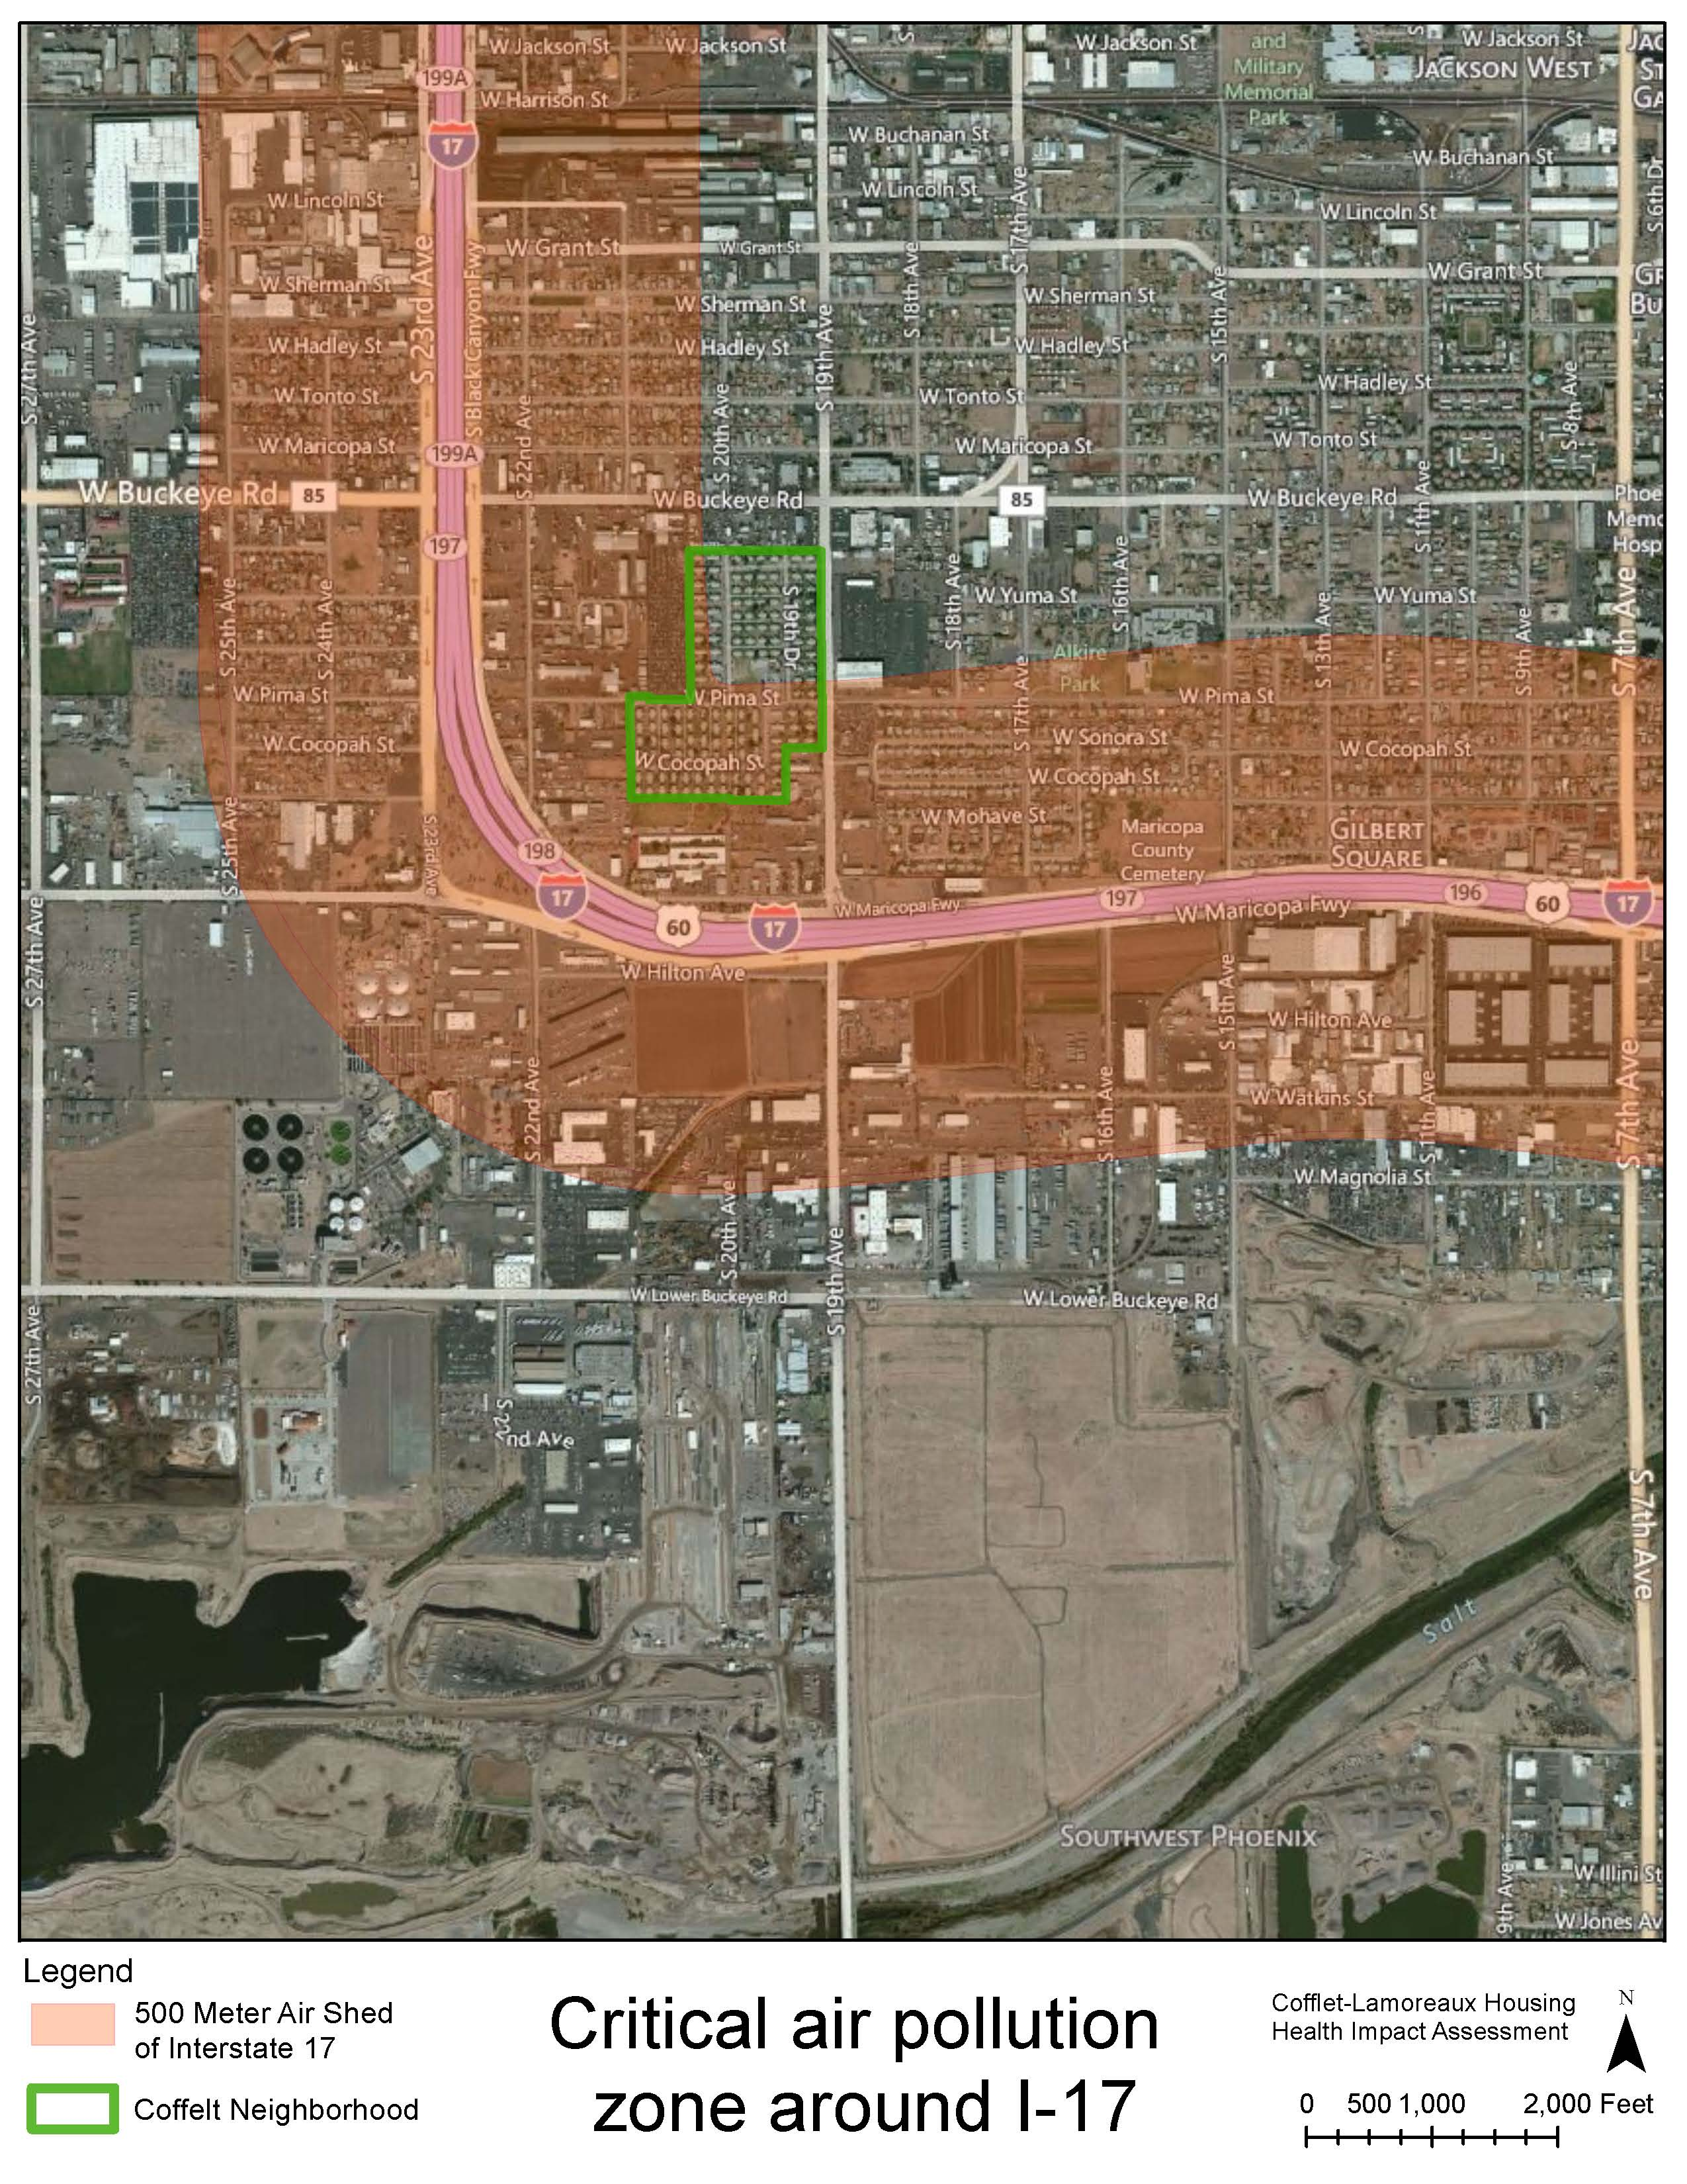
ENVIRONMENTAL
findings
Notes:
More than 50% of the community within the 500m air shed with highest pollutant levels
School at 118m
51% of kids at the school diagnosed with asthma

Slide 9
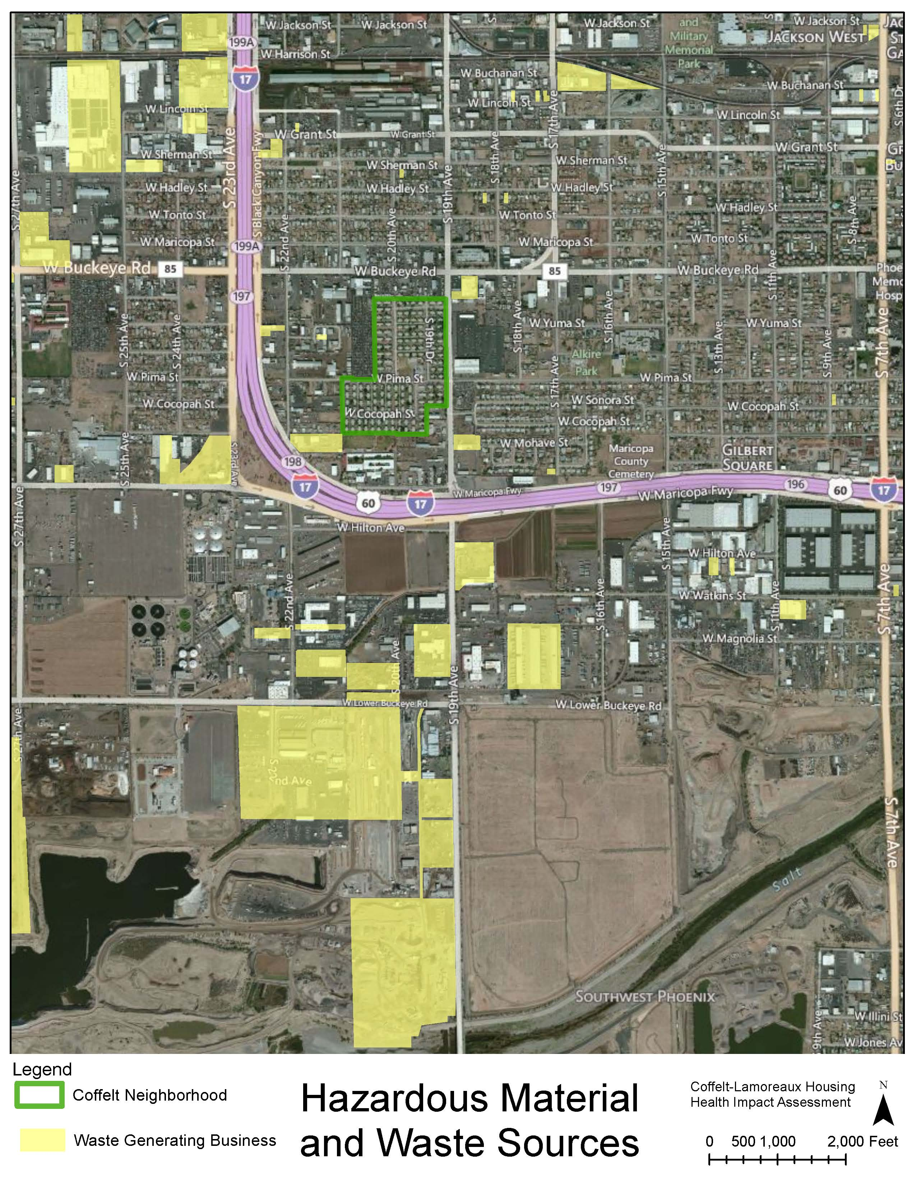
ENVIRONMENTAL
findings

Slide 10
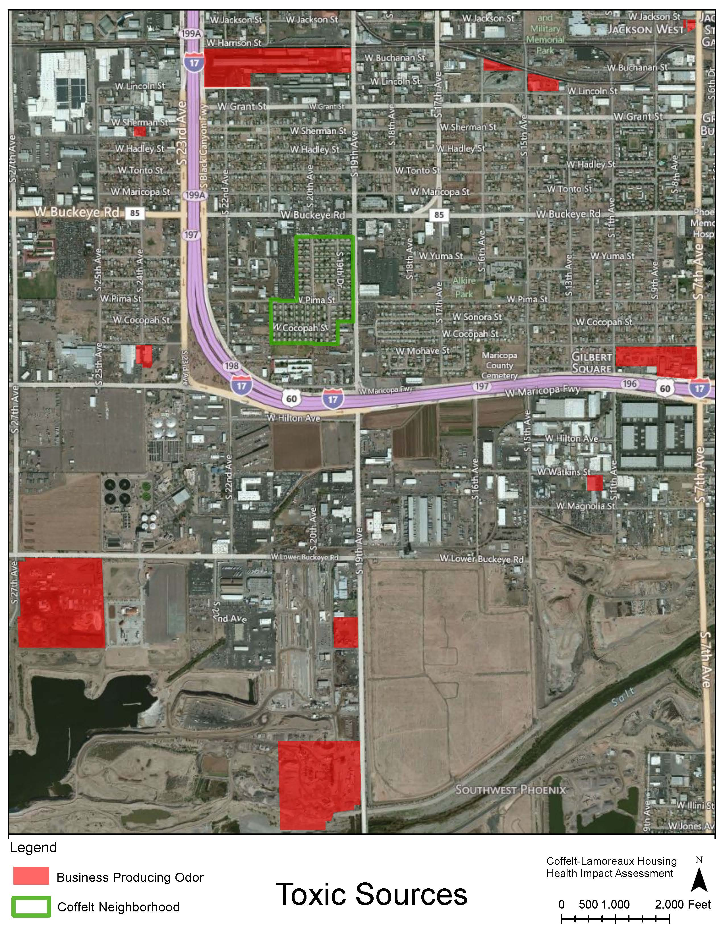
ENVIRONMENTAL
findings
Notes:
Sources of toxic waste

Slide 11
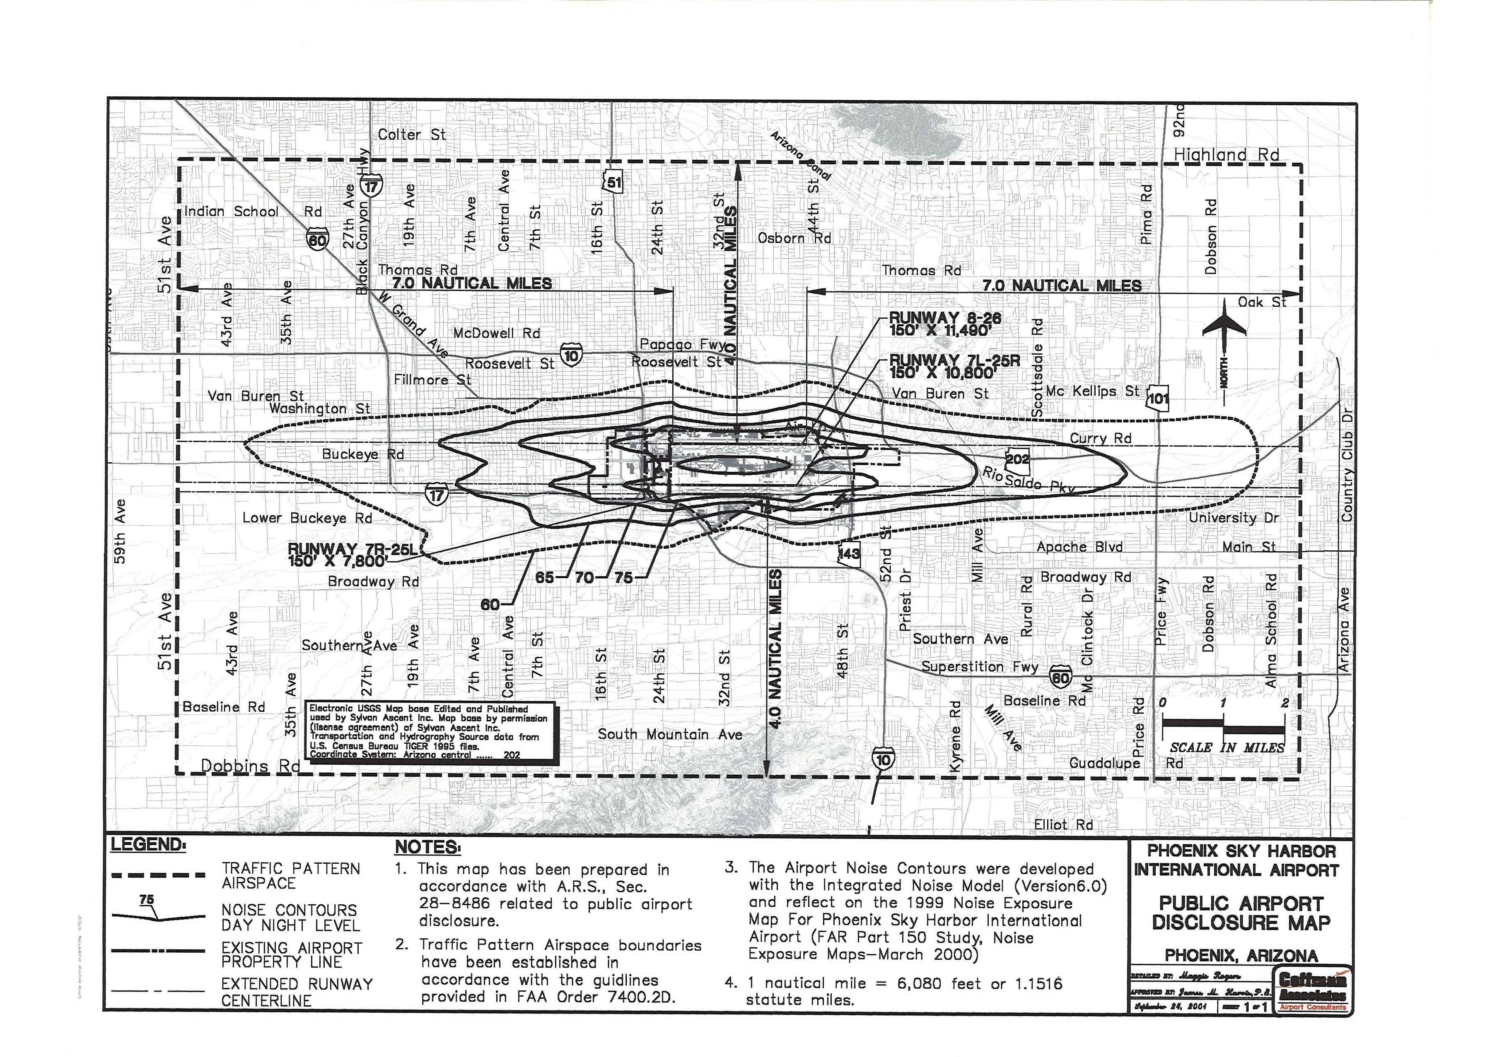
Notes:
Located in flight path
between 60 and 65 DNL (day-night noise levels) contours

Slide 12
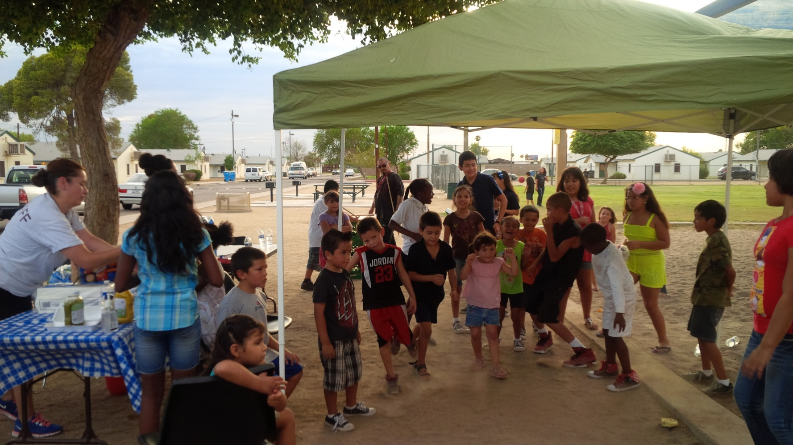
SOCIAL COHESION
findings
Lack of social cohesion
Limited social activities

Slide 13
recommendations
Public housing residents
County Housing Authority
Local CDC
Local School District
Health Expert
City of Phoenix Streets Department
City of Phoenix Parks and Recreation
Negotiation
Environmental Expert
Local Businesses
Developer’s Team

Slide 14
recommendations
Recommendation meetings
food + recreation + housing
environmental issues + streets/transportation + social cohesion
#1
#2
Fearless transparency
Residents as experts
Square configuration
50% of meeting time - discussion of findings and impacts
Dual facilitation
Technical and language translators
Plenty of food and beverage!
61
Notes:
Describe meeting process in detail
players
communication
Ground Rules
Setup
Negotiation

Slide 15
recommendations
Install well-insulated HVAC systems.
Increase # of bathrooms to 2 for 3 & 4 bedroom units.
Replace doors and windows.
Use high quality, energy efficient appliances.
Install adequate lighting on the exterior wall of units.
Install a porous fencing on front & back of each unit.
Introduce parking in close proximity to units.
Improve landscaping - add trees and other vegetation to improve air quality and mitigate urban heat island effect.
Rebuild irrigation system to afford the use of SRP water.
Improve lighting throughout site by ensuring that all lights are dawn-to-dusk lights in good working condition.
Construct a block wall along the Coffelt boundary where adjacent to industrial uses bordering the housing.
Design site to provide effective water drainage system to help minimize mosquito breeding areas.

Slide 16
recommendations
Install well-insulated HVAC systems.
Increase # of bathrooms to 2 for 3 & 4 bedroom units.
Replace doors and windows.
Use high quality, energy efficient appliances.
Install adequate lighting on the exterior wall of units.
Install a porous fencing on front & back of each unit.
Introduce parking in close proximity to units.
Improve landscaping - add trees and other vegetation to improve air quality and mitigate urban heat island effect.
Rebuild irrigation system to afford the use of SRP water.
Improve lighting throughout site by ensuring that all lights are dawn-to-dusk lights in good working condition.
Construct a block wall along the Coffelt boundary where adjacent to industrial uses bordering the housing.
Design site to provide effective water drainage system to help minimize mosquito breeding areas.

Slide 17
recommendations
Complete streets for street adjacent to housing property.
Repairs and improvements on streets within the property.
Introduce healthy food options: community garden, school gardening program, mobile vending
Upgrade/repair existing park.
Control the population of dogs and vermin by involving Maricopa County Vector Control.
Communication between Housing Authority, developer and Coffelt residents about redevelopment process.
Form Community Council.
Build identity.

Slide 18
recommendations
Complete streets for street adjacent to housing property.
Repairs and improvements on streets within the property.
Introduce healthy food options: community garden, school gardening program, mobile vending.
Upgrade/repair existing park
Control the population of dogs and vermin by involving Maricopa County Vector Control.
Communication between Housing Authority, developer and Coffelt residents about redevelopment process.
Form Community Council.
Build identity.

Slide 19
recommendations
Public housing residents
County Housing Authority
Local CDC
Local School District
City of Phoenix Streets Department
City of Phoenix Parks and Recreation
Feedback Loop
Local Businesses
Developer’s Team
Notes:
Feedback loop - critical

Slide 20
recommendations
Public housing residents
County Housing Authority
Local CDC
Local School District
City of Phoenix Streets Department
City of Phoenix Parks and Recreation
Feedback Loop
Local Businesses
Developer’s Team

Slide 21
recommendations
Public housing residents
County Housing Authority
Local CDC
Local School District
City of Phoenix Streets Department
City of Phoenix Parks and Recreation
Feedback Loop
Local Businesses
Developer’s Team

Slide 22
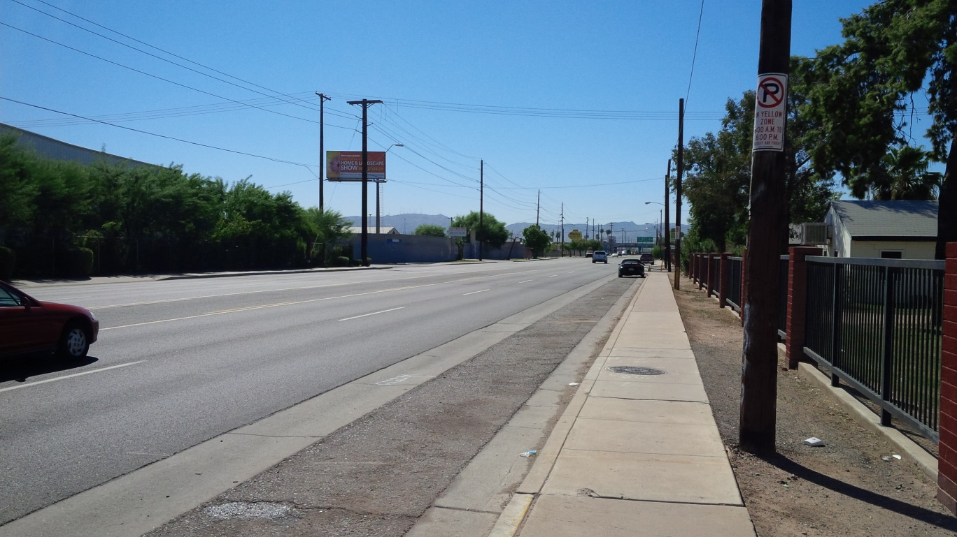

Slide 23
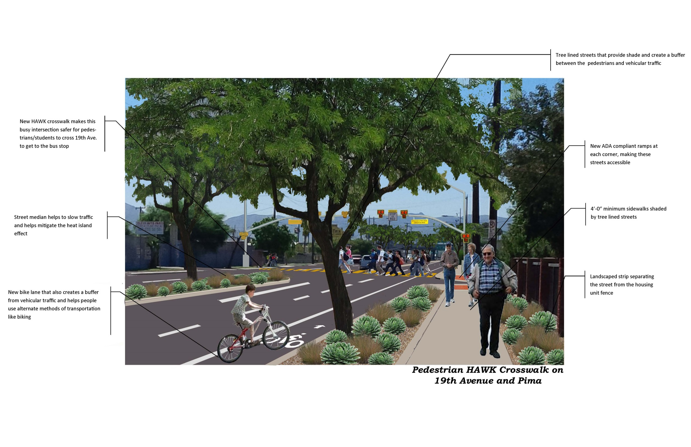

Slide 24
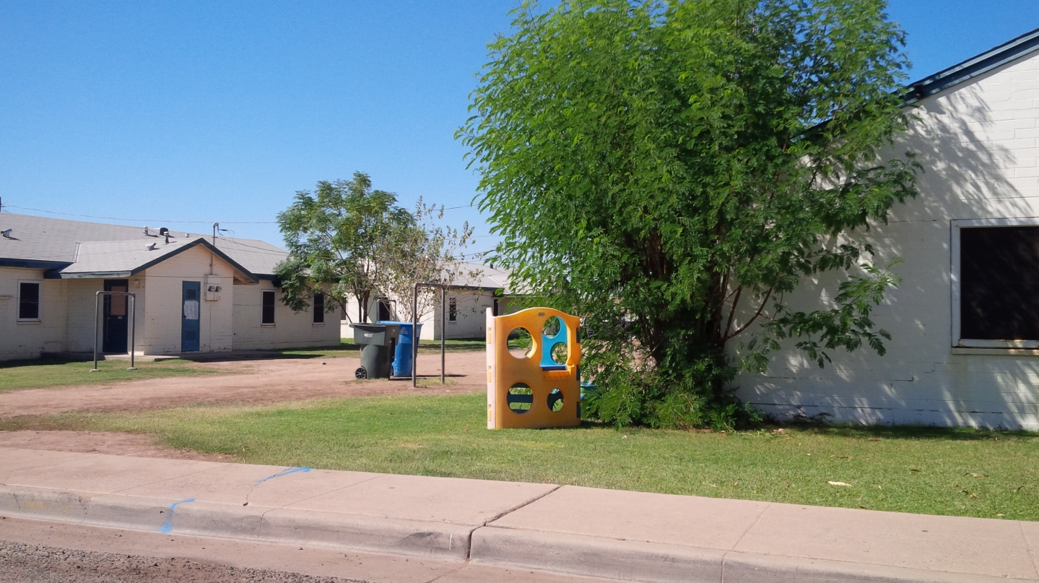

Slide 25
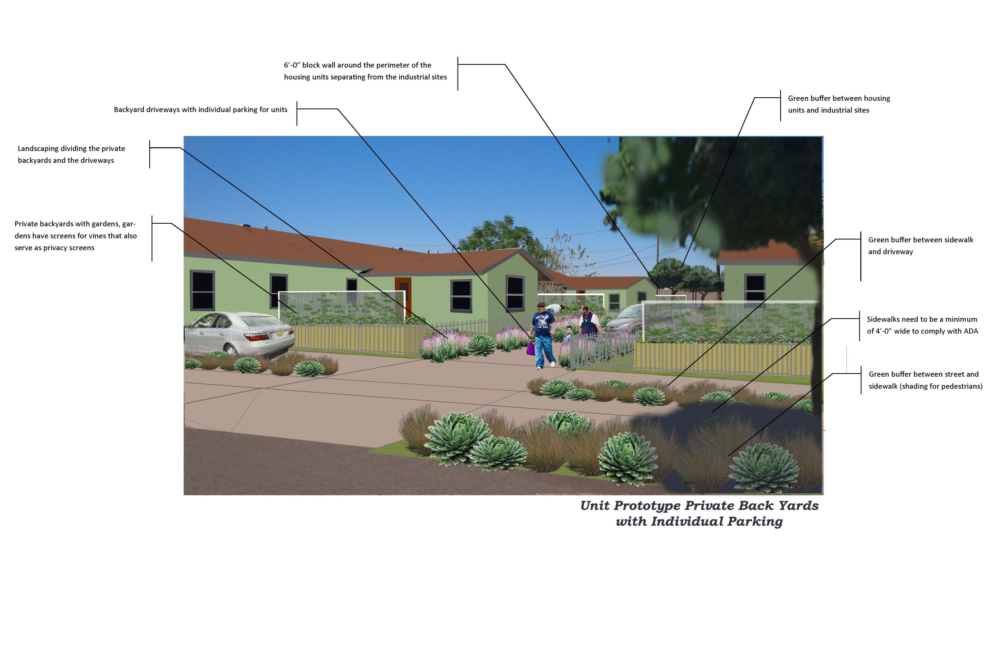

Slide 26
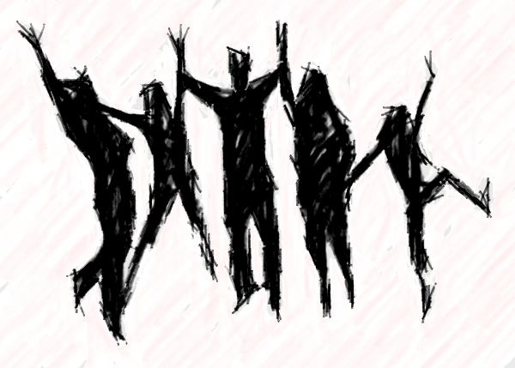
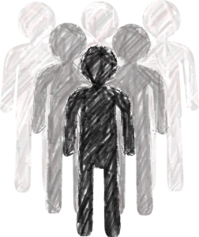
where are we now
COLLABORATION
FUNDING
LEADERSHIP
SELF-EFFICACY
Notes:
Evidence-based, community-embedded recommendations generated enthusiasm and passion in the funding community
Unprecedented cooperation between several city and county departments (still continues)
Redevelopment received $44million – HIA recommendations implemented in design submitted for funding housing tax credits historic preservation
Local foundation funded park design
Local organizations participating in art installations
City Streets department conducting independent pedestrian traffic study; applied to Casino funds for potential Hawk crossing recommended by HIA
City of Phoenix is funding a park programming person
Residents feel empowered – now engaged in leadership classes from local CDC to create a council

Slide 27
resources
Coffelt-Lamoreaux Public Housing Redevelopment HIA was funded by Local Initiatives Support Corporations (LISC) Phoenix and the Access to Housing and Economic Assistance for Development (AHEAD) program from the Federal Home Loan Bank (FHLB) of San Francisco.
To learn more about this HIA and a case study of the HIA, visit:
http://www.pewtrusts.org/hip/coffelt-lamoreaux-public-housing-d.html
Debarati “Mimi” Majumdar Narayan, PhD
Director of Research and Strategies
Catalyze Research and Consulting
miminarayan@catalyzeresearch.com

