Slide 1

USING QUANTITATIVE MODELING TO SUPPORT SOCIAL LEARNING
Nicole Iroz-Elardo, PhD, ud4h
nirozelardo@ud4h.com
Andrea Hamberg, Oregon HIA Program
andrea.hamberg@state.or.us
National HIA Meeting
Notes:
Many of the polices that have significant impact on health are outside of the field of health. HIA provides a way to take a systematic look at the way those policies impact health, and make recommendations to improve health outcomes.
HIA helps us leverage investments in other sectors to improve health
Policies and programs implemented at the local, state, and federal levels can have an impact on population health in a variety of ways. Policies and programs may be designed to target health outcomes directly, or by tackling the variety of factors that determine those outcomes. They can focus on downstream factors, such as ensuring that children are immunized at appropriate times of changing individuals’ diet and exercise behaviors. Or, they can focus on more upstream factors, such as encouraging college attendance or stimulating economic development.

Slide 2
Acknowledgements
This work was completed at the Oregon Health Authority, Public Health Division with the support of grants from:
  CDC Healthy Community Design Initiative
  Health Impact Project, a collaboration of the RWJ Foundation and the Pew Charitable Trust
It uses the Integrated Transport & Health Impact Model (ITHIM) which was provided free of charge. We thank:
  Developer Dr. James Woodcock at the Centre for Diet and Activity Research, Cambridge Institute of Public Health
  Dr. Neil Maizlish at the State of California Department of Public Health for U.S. updates and collaboration
Notes:
Advisory committee was critical to our success. We had 37 people provide feedback, data, analysis, and review. Steve White, Kim Ellis

Slide 3
Example 1
Statement of Evidence:
The benefits of active transportation likely outweigh the risks.
de Nazelle A, Nieuwenhuijsen MJ, Anto JM, Brauer M, Briggs D, Braun-Fahrlander C, et al. Improving health through policies that promote active travel: a review of evidence to support integrated health impact assessment. Environment international. 2011;37(4):766-77.

Slide 4
Example 2 - Annual (in 2035) Health Benefits by Attributable Pathway
Avoided Illness (DALY)
Avoided Mortality
Scenario A
Scenario B
Scenario C
Draft Approach
Notes:
Expected health benefits are graphically presented here where the size of the pie chart varies according to the relative size of overall health benefits by scenario and slices of the pie represent the health benefits attributable to each pathway. As we would expect, the draft approach is performing slightly better than Scenario B.
The burden of disease approach allows us to consider, with confidence, tradeoffs by pathway. ITHIM suggests that physical activity is by far the largest driver of reduction in illness as seen by the large dark blue pie slices. Air quality and physical activity are about even for avoided premature deaths. Traffic safety, the “public health” metric that transportation planners normally are concerned about, is dwarfed by the gains in air pollution and physical activity.

Slide 5
How does quantitative modeling interact with the social learning environment in HIA?
Do we like modeling?
  Modeling is resource intensive
  Want to be inclusive of all types of knowledge
    Community knowledge
    Qualitative knowledge
    Experiential knowledge
  Unclear if/how it supports our values of democracy and equity
BUT, we are supposed to capture magnitude of impact…

Slide 6
2 Elements of Social Learning
cognitive enhancement
  Learn about problem and solutions
  Your own and others perspectives
moral development
  Move towards a collective solution
  Implies a better decision because of the process
Bandura, A. (1977). Social learning theory. Englewood Cliffs, NJ: Prentice Hall.
Webler, T., Kastenholz, H., & Renn, O. (1995). Public participation in impact assessment: A social learning perspective. Environmental Impact Assessment Review, 15, 443-463.

Slide 7
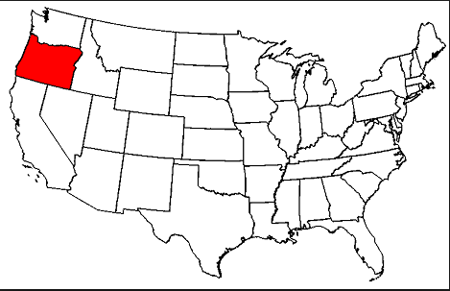
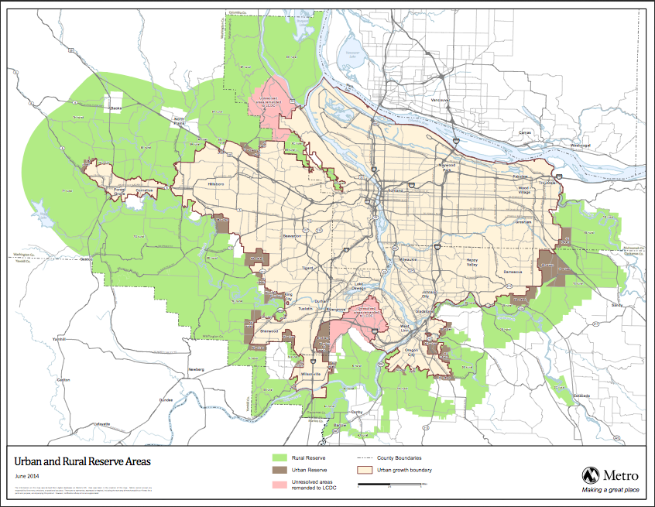
Notes:
Portland Oregon
Red line is UGB (1979, protect farmland)
2.3 million people
3 counties
25 cities
http://www.vacation2usa.com/p1_state_oregon_map.php
http://www.esri.com/news/arcnews/summer08articles/metros-regional.html

Slide 8
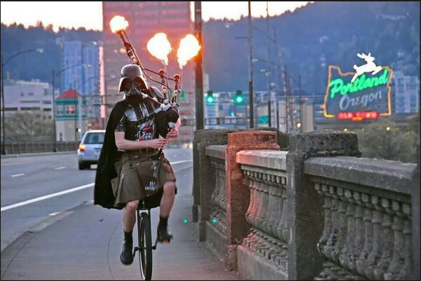
Notes:
Portland Oregon
Red line is UGB
2.3 million people
3 counties
25 cities
http://www.vacation2usa.com/p1_state_oregon_map.php
http://www.esri.com/news/arcnews/summer08articles/metros-regional.html

Slide 9
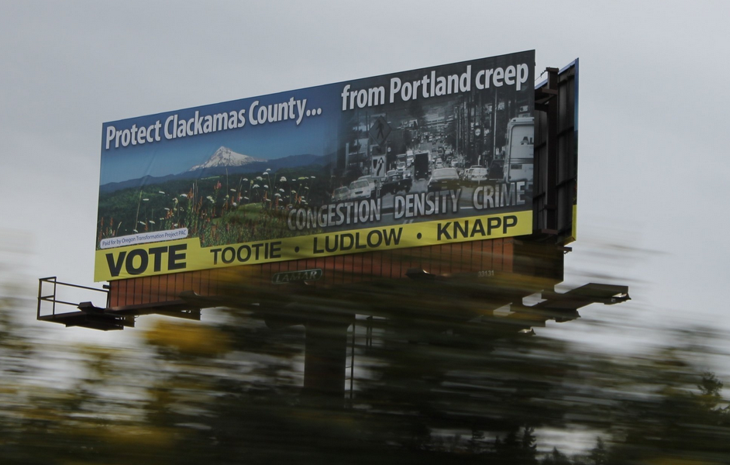
Notes:
Policy decision
Even the best policy analysis can’t overcome some realities:
Clackamas
congestion-reduction reduces GHG
we won’t say yes unless we guarantee that we can still expand our freeways

Slide 10
Metro’s Climate Smart Communities Scenarios Project
Legislative mandate
Portland, OR MPO
Plan and implement
Decrease emissions from light duty vehicles by 20% by 2035

Slide 11
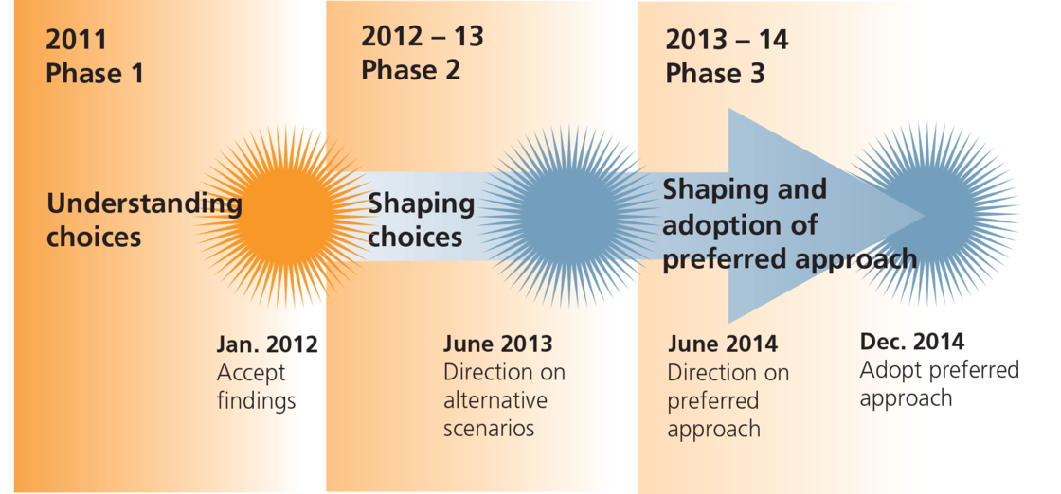
Metro’s Climate Smart Communities Scenarios Project
Climate Smart Communities Scenarios HIA
April 2013
Community Climate Choices HIA
March 2014
Community Smart Scenario HIA
September 2014
Notes:
Metro required by state legislature to Reduce GHG emissions from light duty cars and trucks to 20% below 2005 levels.
The project began in 2011, development of GreenSTEP (ODOT to estimate GHG levels), created 144 scenario options, ran through GreenSTEP, we analyzed the range for health impacts in 2012/2013. Using that information and a lot of community engagement, Metro developed 3 alternative scenarios, and received direction from Metro Council on what to include in the preferred approach.
In the last handful of years, there has been significant theoretical and practical progress made in augmenting travel demand modeling, scenario modeling, and sketch planning with quantitative estimations of health impacts.
Over the past 3 years, OHA has partnered with Metro to explore quantifying health for their Climate Smart Communities Scenario planning efforts.
Series of 3 HIAS
CSCS HIA in 2012-April 2013
CCC (Community Climate Choices) HIA in March 2014
Rapid update with CSS (Climate Smart Scenario) to address draft approach in September 2014

Slide 12
Integrated Transport Health Impact Model (ITHIM)
Miles traveled by mode per person per week
PM2.5
Traffic Safety (mode by functional class)
Metabolic Equivalents
TRAFFIC SAFETY
Collisions resulting in fatalities or severe injuries
PHYSICAL ACTIVITY
Breast Cancer
Colon Cancer
Depression
Dementia
Diabetes
PHYSICAL ACTIVITY & AIR QUALITY
Stroke
Ischemic heart disease
Hypertensive heart disease
AIR QUALITY
Lung Cancer
Inflammatory heart disease
Respiratory disease
Notes:
Specifically, ITHIM investigates :
Traffic safety through a matrix of mode by mode collisions and probability of fatalities or severe injuries. The miles traveled by mode – in particular the dominance of VMT – is thus accounted for.
Converts average miles walked/cycled to metabolic equivalents and applies that to 8 diseases including cancer, mental health, diabetes, and heart disease
Uses PM2.5 as an indicator for both lung cancer/respiratory disease and heart disease.
ITHIM was initially developed using global burden of disease data. This was updated with U.S. prevalence data for the San Francisco and CSCS HIA work. For the CCC HIA, PHD further refined ITHIM by using Oregon-specific prevalence data for mortalities; local demographic data was used to extrapolate WHO models to local populations for DALYs.
We used the outputs to estimate potential health-costs
Compared to how other people use ITHIM, we have treated air quality differently (completed through sensitivity analysis, by holding pm2.5 constant while varying other metabolic equivalents)
Question: why did you do that? We think this would be a really nice improvement to future versions of the model. We wanted to help DEQ understand the level of cardiovascular impact (people come in with disciplinary expectations/bias into scenario planning; with GHG reduction planning, people are going to assume that air quality will be the biggest impacts. One of the best parts of ITHIM is to help people grapple with tradeoffs across disciplines.

Slide 13
Data Input | Baseline (2010) | Scenario A Current Trajectory | Scenario B Adopted plans with increased revenue | Scenario C Scenario B plus additional policy/ infrastructure and new funding sources | Draft Approach Adopted 2014 RTP plus investment for transit and lower-cost TSMO and information
Reduction in GHG |  | ↓12% | ↓24% | ↓36% | ↓29%
Miles traveled per person per week | 134 | 125 | 117 | 102 | 112
Average distance by mode per person per week¹ | Walk=1.3 Bike=2.1 Car=129.9 | Walk=1.7 Bike=2.2 Car=120.8 | Walk=1.8 Bike=3.0 Car=111.5 | Walk=1.8 Bike=3.6 Car=96.3 | Walk=1.8 Bike=3.4 Car=106.8
PM_{2.5} (µg/m3)² | 7.7291 (5-year average) | 6.4429 | 6.4180 | 6.3925 | 6.4109
 |  | ↓16.6% | ↓17.0% | ↓17.3% | ↓17.1%
UGB population | 1,481,118 | 1,954,716 (2035 Estimate)
Notes:
Highlighted are the variables that drive ITHIM.
Average distance per person per week walking and biking is how the model derives physical activity.
(Note walk trips to bus are collapsed into that walking figure.)
Walk, bike, and vehicle miles tell us about traffic safety.
PM2.5 is for air pollution.
Where did these inputs come from?
ITHIM requires assumptions about transportation that come from a transportation demand model (provided by Metro). They used
The PM2.5 number came from GreenSTEP, a model designed to estimate GHG emissions, with pm2.5 as a bonus, with significant uncertainty (not the model’s priority). DEQ changed PM2.5 models part way through. 2010 (the baseline) is the lowest year we’ve ever had, so we used a 5 year average to make a more reasonable assumption.
The GHG drops include very aggressive fuel and fleet assumptions (70% of the reduction required).

Slide 14
How come you are placing all this emphasis on physical activity rather than air quality in a climate change plan…..

Slide 15
Annual (in 2035) Health Benefits by Attributable Pathway
Avoided Illness (DALY)
Avoided Mortality
Scenario A
Scenario B
Scenario C
Draft Approach
Notes:
DEQ “I learned a lot about the benefits of [physical] activity. I mean I always kind of knew that was the case but just putting it on a scale against other [benefits]. That was really interesting”
Expected health benefits are graphically presented here where the size of the pie chart varies according to the relative size of overall health benefits by scenario and slices of the pie represent the health benefits attributable to each pathway. As we would expect, the draft approach is performing slightly better than Scenario B.
The burden of disease approach allows us to consider, with confidence, tradeoffs by pathway. ITHIM suggests that physical activity is by far the largest driver of reduction in illness as seen by the large dark blue pie slices. Air quality and physical activity are about even for avoided premature deaths. Traffic safety, the “public health” metric that transportation planners normally are concerned about, is dwarfed by the gains in air pollution and physical activity.

Slide 16
But your model doesn’t capture design…..

Slide 17
FINDINGS: Physical Activity
Data Input | Baseline (2010) | Scenario A | Scenario B Adopted plans with increased revenue | Scenario C Scenario B plus additional policy/ infrastructure and new funding sources | Draft Approach Adopted 2014 RTP plus investment for transit and lower-cost TSMO and information
Average distance by mode per person per week¹ | Walk=1.3 Bike=2.1 Car=129.9 | Walk=1.7 Bike=2.2 Car=120.8 | Walk=1.8 Bike=3.0 Car=111.5 | Walk=1.8 Bike=3.6 Car=96.3 | Walk=1.8 Bike=3.4 Car=106.8
Avoided Deaths |  | -42 (1.0%) | -57 (1.4%) | -63 (1.6%) | -61 (1.5%)
Decrease in Illness (DALYs) |  | -672 (0.7%) | -1,099 (1.2%) | -1,292 (1.4%) | -1,223 (1.3%)
Notes:
If the average person walks one additional ½ mile and bikes an additional 1.2 miles per week, ITHIM predicts 61 saved lives and about a 1.3% decrease in illnesses studied. This is a small amount of walking and a reasonable amount of biking resulting in significant health benefits.
It is important to note that about 2/3rds of the mortality benefits of the Draft Approach are from walking (see the difference between Baseline and Scenario A) with the remainder from the increase in biking.
One way we can tease this out is noting that average walk distances for Scenario B, C, and Draft Approach are essentially the same. This suggests that everyone taking a 0.4 mile bike ride once a week – a mere 8 blocks round trip – would prevent 4 deaths a year. Compared to today, an average person should be biking an additional 1.3 miles which would equate to 13 avoided deaths.

Slide 18



FINDINGS: Physical Activity
61 Avoided
Annual Deaths
(by 2035)
Draft Preferred Scenario
1.3 (baseline)
0.5
2.1 (baseline)
1.3
Miles Traveled per Person per Week
Notes:
Additional ½ mile walk per week is a gain of about 48 avoided deaths.
Additional 1.3 miles (26 blocks in Portland) of bike riding a week is worth about 13 deaths.

Slide 19


FINDINGS: Traffic Safety
Lost Lives
Saved Lives
Sum of Avoided Fatalities
Scenario A 1.4
Scenario B 4.0
Scenario C 12.1
Draft Preferred 5.9
-5
0
5
10
15
Notes:
*Avoided injuries and fatalities result, in part, from less congestion on busy roads by shifting short trips to walking and biking. An increase in bicyclists and pedestrians, however, has the potential to exacerbate the inequitable distribution of injuries and fatalities currently borne by those using active transportation.
*For example, our modeling shows that the draft preferred will result in 9 fewer fatalities for car passengers but increase the walking and cycling fatalities by about 2 each. Similar patterns emerge with severe injuries.
*Again, this suggests designing and retrofitting to support active modes thoughtfully. ITHIM does not account for increased separation of modes, etc – but the trajectory in the literature clearly shows that perceived (and thus adoption) and real safety increase with certain design choices.
*Similarly, aggressive projections in transit miles traveled for the Draft Preferred also suggests design around transit/bus stops should be a high priority to both encourage adoption and protect pedestrians walking to and from transit.
Absolute vs. relative. Why this matters? Zero deaths. Policy implications, important data point for communication with policy makers. This data is post-processed (not an automatic output of ITHIM).
******OLD NOTES*******
There were a total of 1,297 pedestrian crashes resulting in injury in the Portland region between 2007 and 2010. Of those crashes, 252 resulted in a death or an incapacitating injury. The majority of pedestrian crashes occur while pedestrians are crossing the roadway, either at an intersection or mid-block. Nearly 80% of all serious and fatal pedestrian crashes occur when people are crossing the roadway.
There were a total of 1,503 bicycle crashes resulting in injury in the Portland region between 2007 and 2010. Of those crashes, 140 resulted in a death or an incapacitating injury. Most bicycle crashes occur at intersections – 73% of all serious and fatal bicycle crashes occur at an intersection.
Making streets much safer for people walking and riding bicycles and dramatically reducing bicycle and pedestrian crashes is an important element of health. Feeling and being safe while walking and bicycling is an important factor in the choices people make whether to walk or cycle at all, and therefore is a critical part of a complete transportation system. Transportation safety is also an equity issue. Research and data show that often people with low incomes and people of color are much more likely to live near wide, high-traffic streets and are thus much more likely to be injured by an auto.

Slide 20
But your model isn’t detailed enough to address vulnerable populations …..

Slide 21
FINDINGS: Air Quality
 | Baseline (2010) | Scenario A | Scenario B | Scenario C | Draft Preferred
PM_{2.5} (µg/m3)² | 7.7291 | 6.4429 ↓16.6% | 6.4180 ↓17.0% | 6.3925 ↓17.3% | 6.4109 ↓17.1%
Avoided Deaths |  | -58 (1.8%) | -59 (1.8%) | -60 (1.8%) | -59 (1.8%)
Decrease in Illness (DALYs) |  | -489 (2.4%) | -497 (2.5%) | -506 (2.5%) | -499 (2.5%)
Notes:
ITHIM suggests that the 17.1% reduction in ambient concentrations of PM_{2.5} under the Draft Preferred would result in at least 29 annual avoided deaths from respiratory conditions, inflammatory heart disease, and lung-cancer cases.
An additional 30 avoided deaths from diseases often attributable to physical activity but also caused by PM_{2.5} – stroke, ischemic heart disease, and hypertensive heart disease – would also be expected to occur. Improved air quality would also reduce respiratory illness and inflammatory heart disease by at least 1.3%.

Slide 22
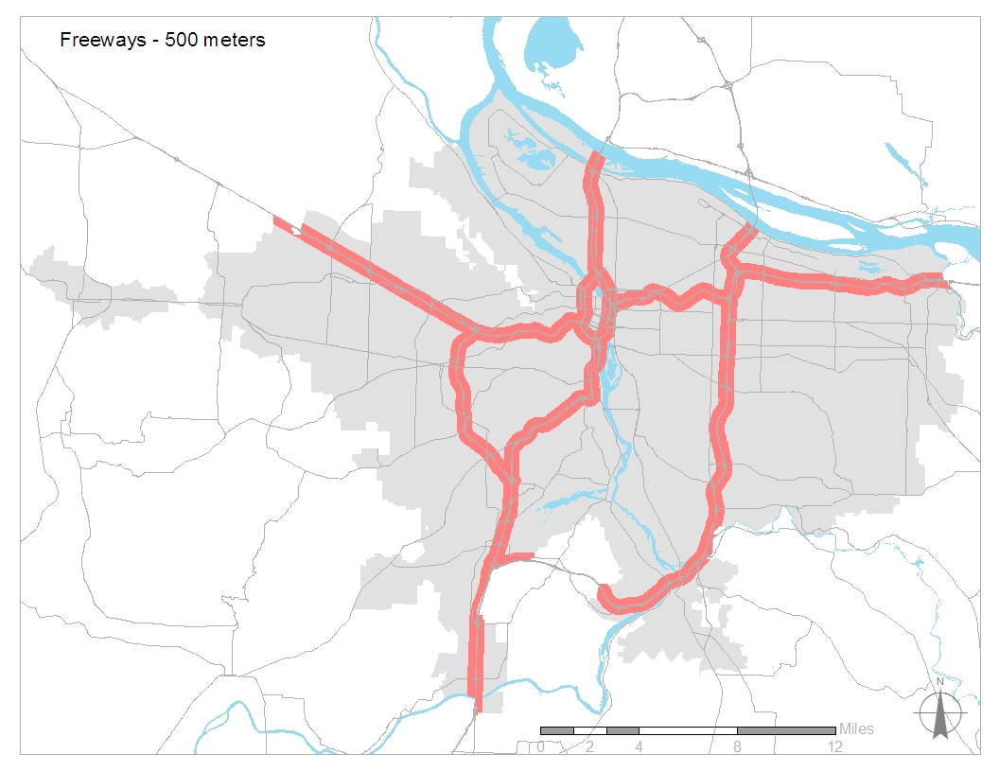
Notes:
Increasing the pubic health field is recognizing transportation related pollutants as a line-source. We wanted to characterize near-road exposure (or traffic proximity) because it is a significant risk including increased risk of asthma exacerbation, childhood leukemia, high blood pressure from noise and PM, etc. Further, there is evidence that low-income and minorities – particularly AA – are more likely to live in a freeway air shed. These populations are also at higher risk for other respiratory due to cumulative effects of poorer housing quality and greater social determinants of health.
In 2010, 12.6% of the population within the urban growth boundary lived within 500 meters of a freeway. A similar analysis showed 40.9% of the population in 2010 lived within 300 meters of a major arterial or freeway. (Note that the greatest risk seems to be the 150 meters.)
Metro assumes that a larger proportion of population growth will occur along transportation corridors than elsewhere. In public health, we recognize that air pollution is not the only concern – so there are likely benefits (physical activity, access to resources, control of sprawl, increased use of transit leading to less climate change) of this type of development. However, we urge thoughtful consideration about the design, building, and retrofitting of buildings and active transportation facilities along these routes to minimize the air pollution exposure. For example, in 2010 295,000 households lived in traffic analyses zones (TAZ) within 300 meters of frequent service transit lines; by 2035, this is expected to increase to 443,000 households.
ITHIM’s inability to handle/quantify localized air quality impacts is a significant problem for HIA, especially when considering health equity.

Slide 23
Conclusions
Quantitative modeling can prompt social learning
Requires providing opportunities for discussing assumptions, analysis, and results
May take lots of time

Slide 24
Direct questions to…
Nicole Iroz-Elardo, PhD
  nirozelardo@ud4h.com
  www.urbandesign4health.com
Andrea Hamberg, HIA Program Coordinator
  andrea.hamberg@state.or.us
  www.healthoregon.org/hia
Kim Ellis, Metro
  Kim.ellis@oregonmetro.gov
  http://www.oregonmetro.gov/public-projects/climate-smart-communities-scenarios
Notes:
ITHIM limitations:
ITHIM is limited in its ability to quantify and compare health pathways by the specific diseases included in each pathway. Inclusion of disease is based upon the availability of data for the relative risk, the relative importance of the disease for that particular exposure, and the ability to control the relative risk for other diseases of interest. Table E-1 lists the specific diseases by exposure category in this version of ITHIM. Because ITHIM is limited to the 13 diseases, it likely underestimates the health benefits from reducing GHG emissions in all of the major exposure routes. Contemporary trends in medical science are increasingly linking physical activity to many other diseases, conditions, and cancers. Similarly, traffic safety in ITHIM is limited to prevalence rates of reported collisions; ITHIM thus underestimates the number of prevented collisions to the extent that collisions are under-reported – particularly for bicyclists. Air quality is limited in ITHIM to PM2.5 exposure only and thus underestimates health benefits from lower concentrations of a variety of ambient pollutants including ozone and air toxics.

