Slide 1
Communicating About Equity in Health Impact Assessment National HIA Meeting June 16, 2015
Logan Harris, Jonathan Heller & MaryAnn Sorenson Allacci

Slide 2
SOPHIA Equity Working Group
Formed in 2011 to address gap in HIA practice: equity is a core value, but limited guidance and few tools had been developed to help practitioners align their actions with this value.
Advancing equity involves identifying and rectifying the policies and conditions that result in systemic, avoidable, unfair, and unjust differences in health status and mortality rates across population groups.

Slide 3
SOPHIA Equity Working Group
Equity Working Group Products
Primer on Promoting Equity in HIA
Equity Metrics for HIA Practice
Current Project: Communicating about Equity in HIA

Slide 4
Examples of Advancing Health Equity in HIA
Farmers Field HIA in Los Angles: Empowering those most impacted
"So we voiced our opinion with the HIA. We're still voicing our opinion...'Cause our voice is very important." – Community Advisory Committee member
“[The HIA brought] structure and thoroughness with which resident voices and concerns were brought forward in a concise and useful way.” – Academic partner
“Clearly [resident] power has grown, in comparison to where we were when we started.” – Community partner co-leader
“[The HIA] brought together residents from all the neighborhoods who probably would not otherwise have worked on this project.” – Community partner co-leader
Notes:
Each group reports 1 barrier; show of hands as to whether others have faced this as well.

Slide 5
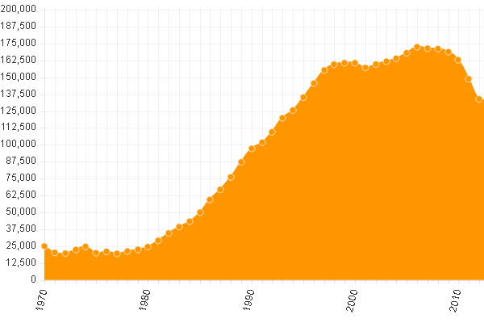
Examples of Advancing Health Equity in HIA
Rehabilitating Corrections in California: An HIA on Prop 47
The problem is clearly stated:
"Someone who is convicted of a minor, non-violent offense…can be charged with a felony and has a higher likelihood of serving a longer sentence and even potentially going to prison…The root causes of the problems that got you into prison are unlikely to be dealt with...you are unlikely to receive any meaningful drug treatment or mental health care.“
Number of people in prison in CA, 1970-2014 www.prop47impacts.org
Notes:
Each group reports 1 barrier; show of hands as to whether others have faced this as well.

Slide 6
Why Communication?
Practitioners often struggle with effective and strategic communication on equity
Logic alone may not win the day, there’s a need to create messages that people connect to and don’t alienate them
Questions for participants:
What challenges have you faced in communicating about equity?
What have you done to overcome these challenges?
Notes:
Record identified issues on a flip chart

Slide 7
What we did
Conducted interviews with equity communications experts:
Lori Dorfman, Berkeley Media Studies Group
Beth Kanter, Spitfire Strategies
Nat Kendall-Taylor, Frameworks Institute
Kathi Schaff, Alameda County PHD
Anat Shenker-Osorio, ASO Communications
Reviewed literature on framing and communications strategies
Strategies compiled target general audiences
Notes:
Hand out document, take 10 minutes to read it

Slide 8
1. Know your communications objectives
Communications strategy should include specific objectives related to equity, and align with overall strategy to advance equity by informing policy debates
In HIA: Think about communication early and often. Process outcomes can be as important as the impact on decision-making.

Slide 9
2. Describe the problem
Provide a clear and concise description that is relevant to local context
Dwelling on disparities too much can stigmatize people facing inequities. Acknowledge they exist and focus on specific areas to address them
In HIA: Part of assessment when discussing existing conditions. Explicitly make the connections between policy, as a structural source of inequities, and health

Slide 10
3. Describe your values
Speaking from a place of shared values can convince people to pay attention and show why they should care. Commonly held values include fairness, opportunity, and equality
In HIA: Equity is a core value and should be stated clearly. Early in the process and report, answer questions like: Why does it matter that health inequities persist? How does it affect us all?

Slide 11
4. Focus on solutions, not just problems
Clearly state solutions that address equity, and when possible provide examples of how these have been put into practice
In HIA: Highlight solutions up front, e.g. in an executive summary or infographic, rather than waiting until the end of a long document

Slide 12
5. Illustrate impact with data and stories
Empirical data may not matter as much as we hope, and can be misrepresented by others. Use stories alongside quantitative data to help people relate.
In HIA: Don’t overwhelm your audience with statistics in communications materials, rather highlight one to three meaningful statistics on inequities in an executive summary or press release. Use stories from focus groups or interviews to bring these to life

Slide 13
6. Use simple terms to describe issues. Avoid jargon
Use concrete examples to describe “equity” and “social determinants of health” rather than relying on abstract terms
In HIA: Describe actual inequities concretely and illustrate how the issue you are focused on links to health outcomes. Don’t assume that jargon like “social determinants of health” will have meaning for your audience.

Slide 14
7. Make the case that it’s in our ability to make change
Don’t use a passive voice to describe decisions made by people. For example, “the economy” is not doing anything own, policies made by people shape the economy.
In HIA: Explain what policies led to the existing conditions you found, identify actions to address conditions, and target recommendations to responsible parties.

Slide 15
8. Know your audience and understand what motivates them
Focus on messages that resonate with your base, the “movable middle” will follow. Be OK with conflict, you may not be able to appease all audiences
In HIA: Communications strategies should target those likely to use HIA findings to demand policy change that reduces inequities

Slide 16
9. Choose your messenger strategically
An “inside/outside” strategy is often useful. Community members can be spokespeople and tell their own stories, while health professionals often hold status which make them respected voices.
In HIA: The process of conducting an HIA can build coalitions among various spokespeople, and build leadership among those most impacted by policies to empower them as messengers in advancing equity

Slide 17
What about messages targeting specific decision-makers?
Conduct research to understand their values and what kind of information drives their decisions – is it data, stories, hearing from their constituents?
If you need someone’s vote for a short-term policy win, and equity is not motivational to them, it may be best not to talk about equity. But this trade-off should be part of a longer-term strategy.

Slide 18
Gathering Feedback
Break into three groups, each group will review 3 of these strategies in more detail
Refer to the handout for more detailed descriptions and examples
Questions for participants:
What are your general impressions of these strategies?
Which strategies have worked for you and which haven’t?
Is there anything missing?
Do you know additional examples of HIAs that have successfully used these strategies?

Slide 19
Gathering Feedback
What should the Equity Workgroup consider working on in the future?
Does anyone want to join us in those activities?
Thank you!
Contact:
Jonathan Heller: jch@humanimpact.org
Logan Harris: logan@humanimpact.org
MaryAnn Sorensen Allacci: maryann.sa@rutgers.edu

