Slide 1
Using GIS in HIA
3rd Annual National HIA Meeting
Tuesday, June 16, 2015
Lauren Adkins, Amy Prues, Alexander Hall, Justicia Rhodus
CSS-Dynamac
Florence Fulk
U.S. EPA Office of Research and Development
The views expressed in this presentation are those of the author[s] and do not necessarily reflect the views or policies of the U.S. Environmental Protection Agency.
Notes:
Hello and welcome everyone. As Sarah mentioned, my name is Lauren Adkins and I work as a Public Health Specialist for CSS-Dynamac in Cincinnati, Ohio. As a contractor to the U.S. Environmental Protection Agency, I provide support on EPA’s HIA initiatives.
Really quick, I would like to mention the history behind EPA’s work in HIA. EPA is working to test models, tools, and best practices that enable communities to move towards more sustainabile and healthy states. EPA’s Sustainable and Healthy Communities (SHC) research program is considering health impact assessment (HIA) as one of the many decision-support tools for providing science-based resources and information to decision-makers. EPA employs geographic information systems (GIS) as another decision-support tool to help carry out its mission to protect human health and the environment.¹ In 2013, EPA released a review, conducted of 81 HIAs performed in the U.S., to obtain a clear picture of how HIAs are being implemented nationally and identify potential areas for improving the HIA community of practice. The review found that GIS or other mapping techniques were used for illustrative purposes in only half (52%; n=42) of those HIAs and used for actual geospatial analysis in only one-third (36%; n=29) of the HIAs reviewed.² Considering the potential to use GIS methods in health research, EPA identified this opportunity to raise awareness of how GIS could be applied in HIA.
This presentation will highlight how we used GIS in the Assessment step of one EPA-led HIA located in Atlanta, Georgia. The HIA case studies I am going to talk about today is the Expanded Proctor Creek Watershed HIA, currently in progress. Since I only have a short time to go over this case study, I will provide to you my contact information in case you would like more information about this HIA and/or EPA’s work in HIA. I also want to note that I am not a GIS Specialist, but I can direct you to someone who can answer your questions for specific GIS-methods used.
Footnotes:
¹ GIS applications in health research include identifying spatial disparities in health outcomes, evaluating health determinants and outcomes in a geographic context, and identifying environmental justice communities of concern, understanding environmental conditions in specific locations, targeting areas of greatest environmental risk, enforcing environmental regulations, and addressing potential homeland security issues (for more information refer to EPA’s National Geospatial Program at http://www.epa.gov/geospatial/about.html).
² The HIAs evaluated appraised proposals in the four sectors of transportation, housing/building/infrastructure, land use, and waste management/revitalization.

Slide 2
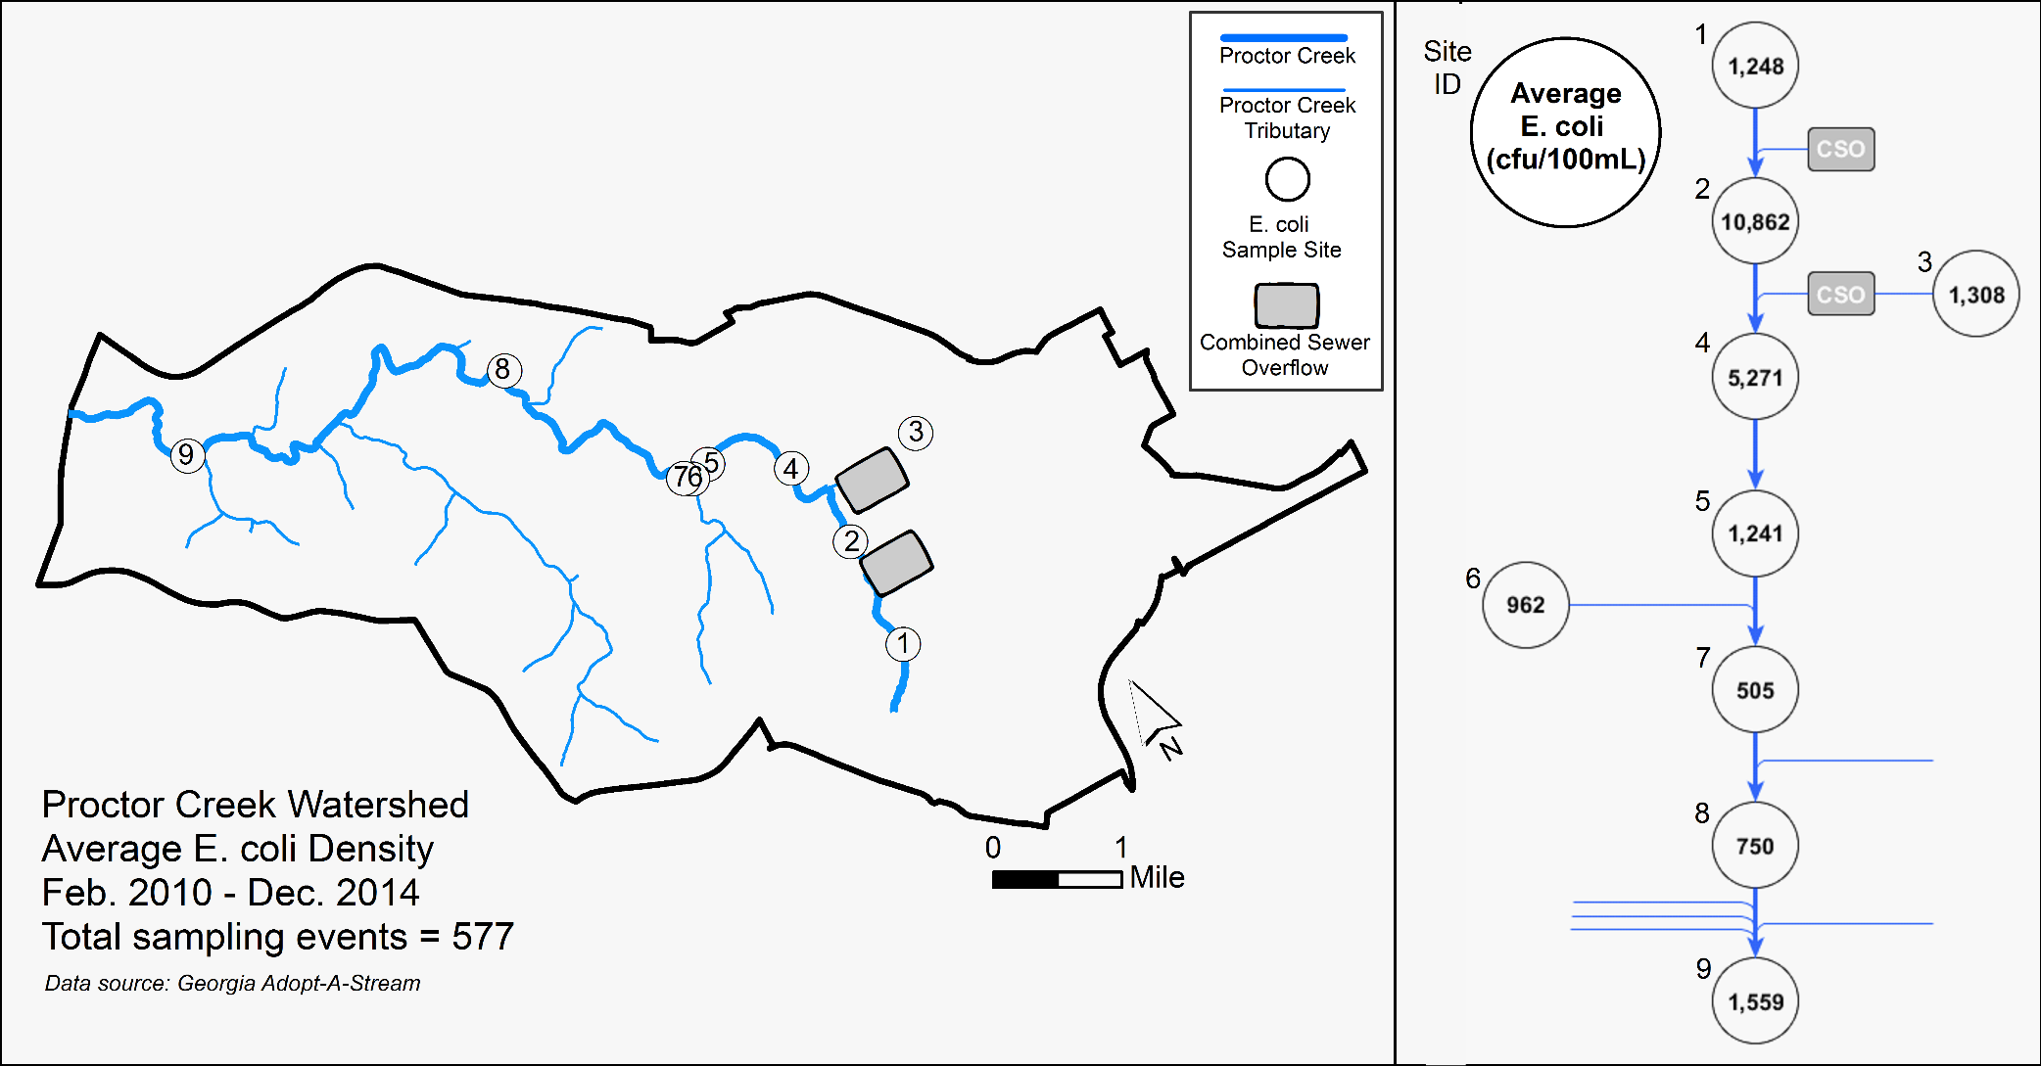
EPA’s HIA Case Study in Atlanta, GA
Notes:
Most areas within the City of Atlanta use a combined sewer system in which stormwater and sewer discharge flows together, through an underground conveyance system, to a treatment facility. During periods of heavy rainfall or snow, however, these systems bypass the treatment facility and discharge directly into a nearby waterbody, widely referred to as a combined sewer overflow (CSO) event. Proctor Creek¹ is one of the many water bodies in the Atlanta metropolitan area that is on the state’s list of impaired waters, due to urban runoff and CSO events. The graphic displayed, which is a good example of taking different types of data and making sense of it geographically, shows where the combined sewer overflows are located in relation to the tributaries and main stem of Proctor Creek. Furthermore, you can see how the Escherichia coli levels jumped higher after an combined sewer outflow. The observed 10,000 colony forming units (per 100mL) far exceeds the maximum allowable density for E. coli in these waters, which is 575 (colony forming units) per 100 mL.
The City of Atlanta adopted green infrastructure as one of many approaches to help address issues with Atlanta’s impaired waters. ² EPA supports using elements of green infrastructure technology³ because it has been shown to reduce capacity burden on existing infrastructure, improve urban ecosystems, and provide energy and maintenance savings. EPA is currently leading an HIA on a proposed environmental district that will evaluate where green infrastructure would best serve the communities in the Proctor Creek Watershed.
Footnotes:
¹ Proctor Creek is located entirely within the city’s jurisdiction and drains a watershed of approximately 10,198 acres of primarily residential and commercial properties to where it discharges into the Chattahoochee River.
² In February 2013, the City Council adopted an amendment to the City of Atlanta Code of Ordinances (Chapter 7, Article 10) aimed at promoting green infrastructure and runoff reduction practices for all new and redevelopment projects in the city.
³ Green infrastructure describes incorporating natural elements, such as soil and vegetation, into the design of infrastructure to capture and treat stormwater.

Slide 3
GIS Applications in Assessment
Using GIS to map the vulnerable populations
Percentage of Householders over age 65, living alone
Percentage of Population reported as Minority
Percentage of Population over age 65
Percentage of Population under age 5
Population density
Notes:
Census data is used widely in HIA to profile the population affected and help identify vulnerable sub-groups within the population. GIS was used to map the demographic data from the Census and identify potentially vulnerable populations. GIS Specialists took the demographic data¹, such as population density, children under age 5, elderly over age 65, reported minority, and elderly living alone, joined it with spatial data,² then normalized and ranked the tracts from lowest to highest scores across the watershed.³ Combining the demographic and spatial information allowed researchers to identify the tracts with the most vulnerable population to environmental and socioeconomic stressors relevant to the HIA. It is important to note that vulnerability can vary depending on the health impact of interest, the evidence supporting the pathway of impact, and the context (background) of the region.
Footnotes:
¹ Demographic data were extracted from the 2010 decennial Census and the 2010 American Community Survey 5-year estimates and compiled and averaged in Excel.
² Shapefiles were taken from the Topological Integrated Geographic Encoding and Referencing [TIGER/Line®] files and compiled with demographic data in ArcGIS.
³ using quintiles (a universal standardized unit range)

Slide 4
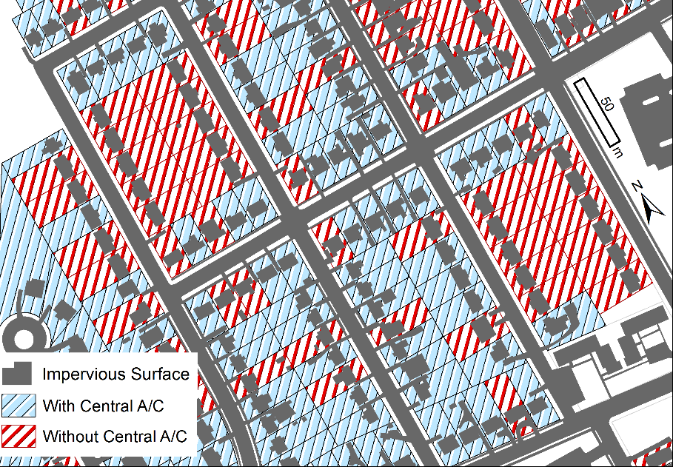
GIS Applications in Assessment
Physical environment determinant of interest:
Exposure to extreme heat events
Notes:
Stakeholders identified a need in the community to address heat stress and charged the HIA Project Team with evaluating the potential for green infrastructure implementation to impact local climate conditions and relief from heat-related illness in the Proctor Creek Watershed. Atlanta is a metropolitan area that experiences a phenomenon known as the urban heat island effect, in which highly developed regions experience warmer surface temperatures.¹ Urban heat islands can amplify the health effects of exposure to extreme heat events. Extreme heat events are periods of summertime weather that are substantially hotter and/or more humid than typical for a given location at that time of year. Exposure to extreme heat events can lead to heat-related illness, complications with pre-existing health conditions, and in severe cases death. Based on the literature review, researchers found that children, the elderly, and those with compromised immune systems are particularly vulnerable (i.e., pre-disposed) to the harmful impacts of extreme heat events. Air conditioning was found to be a protective factor against heat-related illness.
Researchers identified an extreme heat event that occurred in the study area and identified areas considered to be “hot spots.”² Through GIS analysis of data obtained from a housing survey, researchers found that 56% of occupied residential properties had central AC. Assuming that the other 44% of homes did not have a consistent form of AC, researchers applied statistical analysis methods and found that there were non-random clustering of areas with and without central AC, indicating that some areas are potentially more at risk from EHEs. Our next step is to overlay the environmentally high risk areas with demographic data to identify the populations most at risk and make recommendations to mitigate the adverse health effects of extreme heat events. The next step is to examine whether the health-related data has similar spatial patterns as the environment-related data.
Footnotes:
¹An effective way of estimating where the impact of an extreme heat event will be greatest is to identify the impervious surfaces and apply land surface temperatures. A search was performed to identify cloud-free landsat images taken during the identified extreme heat event. Finally, the TRS Toolbox (which is a freely available toolbox created for use in ArcMap) was used to calculate the land surface temperature. The highest temperatures were found to coincide with impervious surfaces and highly urbanized areas. Using remotely sensed imagery to calculate the land surface temperature was found to be more accurate than interpolations from distant and sparsely located weather station data and better at capturing the hot spots common in urban areas due to the urban heat island effect.
² The EHE was identified using the CDC’s National Environmental Public Health Tracking Network.

Slide 5
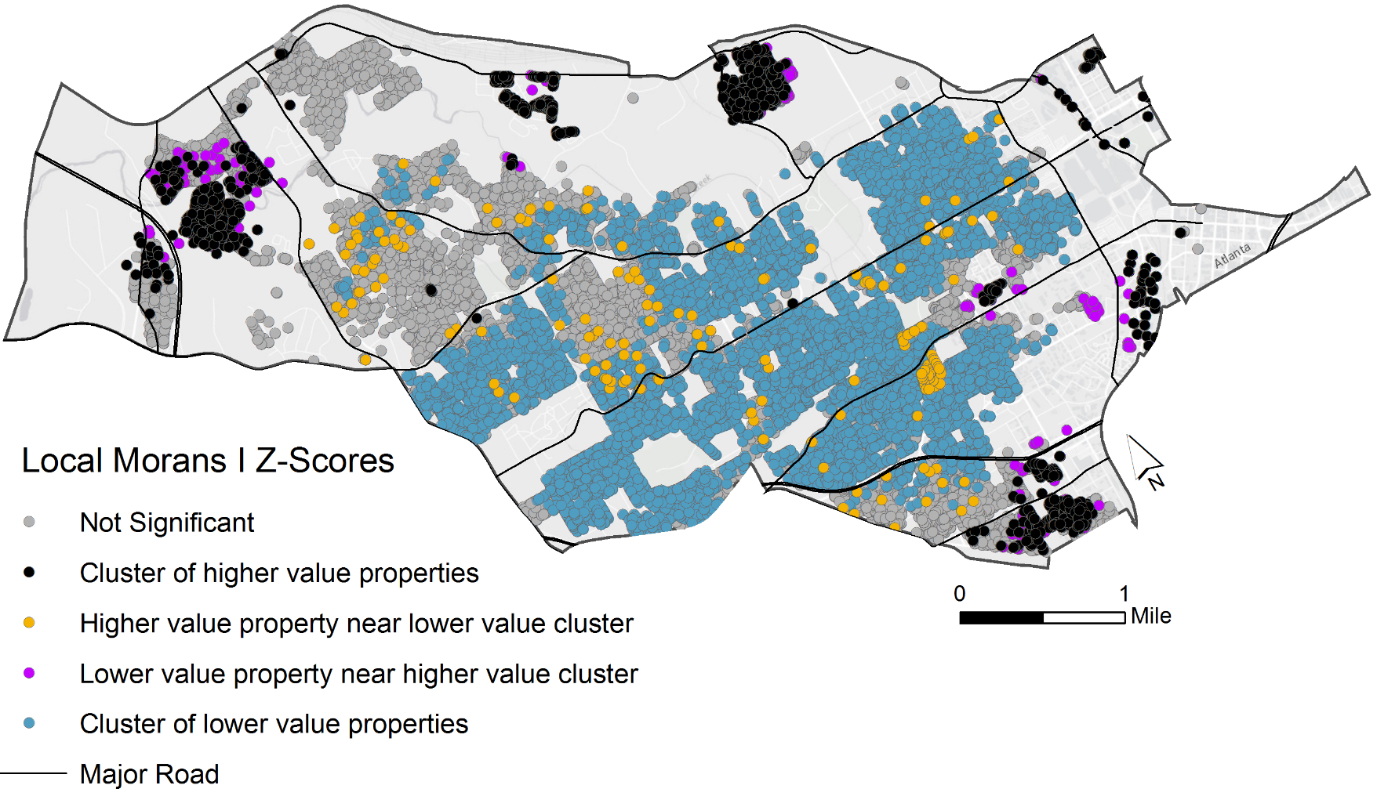
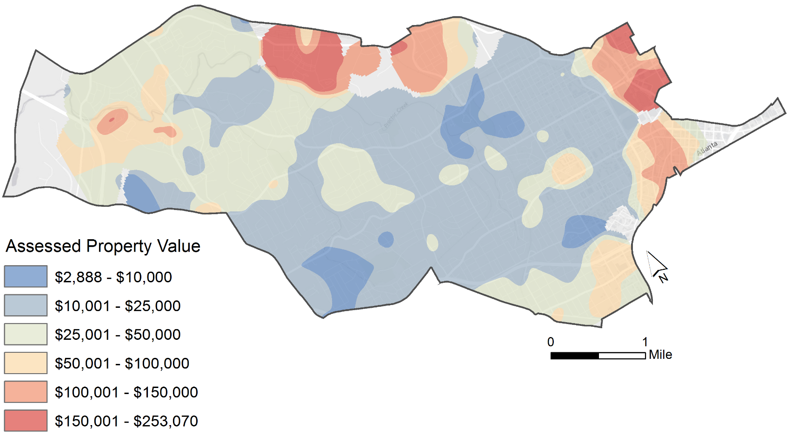
GIS Applications in Assessment
Socio-economic determinant of interest:
housing costs (property values)
Notes:
Implementing green infrastructure has been shown to increase the value of nearby properties; however, increased property values and housing market revitalization can have adverse impacts on individual household economies, especially for those that are already cost burdened or spending more than 30% of their income on housing costs. With increased property values comes higher property taxes and (in some cases) increased rent, both of which raise the costs of living.
GIS Specialists mapped assessed property values¹ to see if there were any areas that may be affected more by changes in property values. Statistical analysis was performed to test whether the locations of high value and low value homes were randomly distributed. Investigators found that there was non-random clustering of high value homes (in black) around the periphery of Proctor creek and a non-random clustering of low value homes (in blue) occupying the center (i.e., living next to or near Proctor Creek). We can gleam from this information that the conditions of Proctor Creek will inequitably affect lower income homes. The next step is to combine the data for indicating cost-burdened homes (i.e., households paying at least 30% of income for monthly housing costs).
Footnotes:
¹ The HIA Project Team acquired primary data from the Fulton County Tax Assessors Office (via disk) and geocoded that data with the Proctor Creek Watershed shapefile. The GIS Specialist mapped this data in ArcGIS and used statistical applications to test whether the locations of high value and low value homes were randomly distributed. The (second) image illustrates areas where there were non-random clustering of high value homes (in black) and low value homes (in blue). If implementing green infrastructure does affect property values, these areas may be affected more.

Slide 6
GIS Applications in Assessment
Socio-economic determinant of interest:
Vacant and derelict properties
Notes:
The presence of derelict properties, combined with the occurrence of flooding, creates a barrier to healthy living conditions. Blight and vacant properties have been a persistent issue in the Proctor Creek communities, and persons with lower socioeconomic status are often more vulnerable to these conditions because they lack protective social and economic buffers against the adverse impacts.
The HIA Core Project Team wanted to know if there were areas with a higher proportion or clustering of blight and/or vacant properties. Surveyed deteriorated and/or vacant properties were mapped to identify potential spatial patterns.¹ Analyses showed that vacant and derelict properties are not evenly distributed throughout the Proctor Creek watershed. While the entire study area has a vacant and derelict property rate of 10%, GIS analysis was able to identify areas with an abnormally high density of these properties. The “hot spot” shown in the inset map on the right shows an area that has a vacant and derelict property rate of 40%. Investigators in the HIA will propose actions that will help mitigate the negative public health outcomes associated with vacant and derelict properties in these “hot spot” areas.
Footnotes:
¹ Parcel characteristic data were obtained for the study area from the City of Atlanta Assessor’s Office and joined to publically-available parcel polygons. The HIA Project Team also acquired primary data from the 2013 City of Atlanta Strategic Community Investment Survey dataset. Each parcel had a unique land use code (LUC) denoting its use (residential, commercial, industrial, etc.) and whether it was vacant. First, residential and commercial parcels with vacant LUCs were selected (Figure 5, Vacant Properties). These selected parcels were given a mean center point and the points were used to create a point density raster. Next, tabular data denoting lot(s) and/or structure(s) in poor and/or deteriorated condition were taken from the City of Atlanta Community Investment Report and joined to the parcel features. A dot density raster was created from the mean center of these derelict parcels (Figure 5, Derelict Properties). The Select by Location tool was used in ArcGIS to identify parcels that are both vacant and derelict. Point features of the mean center of the selected parcels were used to create a point density raster. The inset map in Figure 5, Vacant and Derelict Properties, shows an area of the study area that has a high density of vacant and derelict properties.

Slide 7




Thank You!
Florence Fulk
EPA – Office of Research & Development
Justicia Rhodus
EPA Contractor: CSS – Dynamac
Amy Prues
EPA Contractor: CSS – Dynamac
Alex Hall
EPA Contractor: CSS – Dynamac
Lauren Adkins, CPH, MPH
CSS-Dynamac
Phone: 513-569-7218 Email: adkins.lauren@epa.gov
Notes:
I would like to take my final minutes to thank the fabulous people who are responsible for this presentation. Florence Fulk, who is attending and presenting at this conference, is the principal investigator responsible for the HIA initiatives within EPA’s ORD. Justicia Rhodus (Tish), who is also attending and presenting at this conference, is our project leader, science writer, and technical editor. Amy Prues and Alex Hall are our GIS Specialists providing all of the hard work. GIS will continue to be used in the Expanded Proctor Creek Watershed HIA and in other HIAs EPA is leading.
I want to thank each of you for participating in this session and hope you enjoyed the information provided. Again, please feel free to contact me for any additional questions or comments you have about this presentation. Enjoy the rest of the program!

Slide 8
Additional Slides

Slide 9
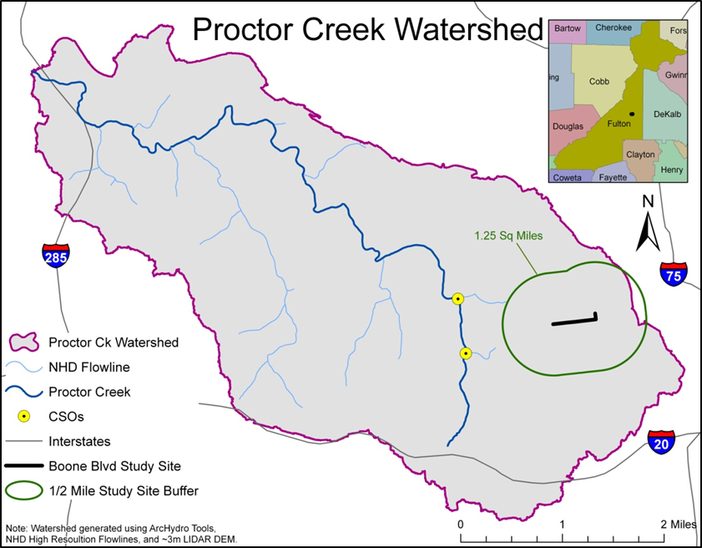
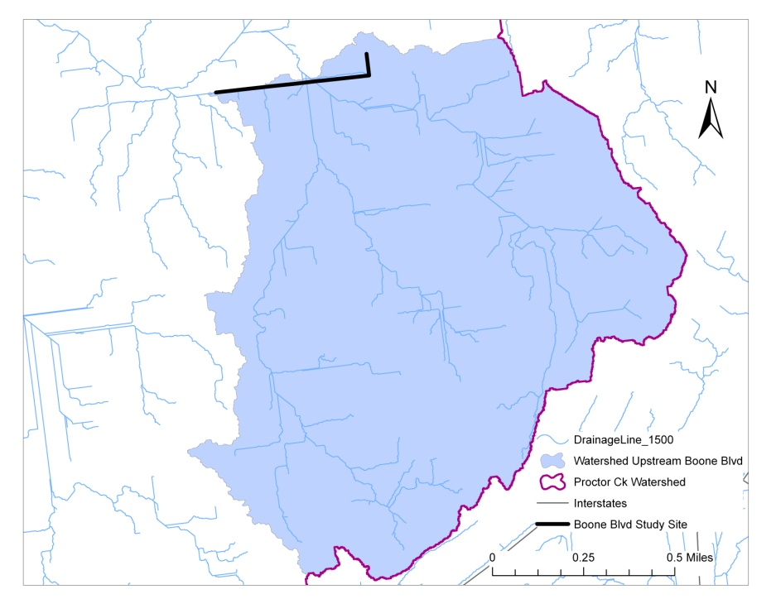
GIS Applications in Scoping
Using GIS to map the geographic scope
Discharge point
Notes:
According to the updated HIA Minimum Elements (September 2014), Scoping should establish the demographic, geographical, and temporal boundaries for impact analysis. In regards to the health determinants- water quality and flood management, the HIA Project Team wanted to know how implementing the proposed green street project would affect conditions in the immediate vicinity of the project site (i.e., the community) and how those impacts would relate to the rest of the watershed.
In order to define the “area affected” in regards to water quality and flooding, the HIA Project Team used geospatial data from the US Geological Survey (USGS), to generate the watershed area and perform impact calculations.¹ The Proctor Creek Watershed was generated and calculated to be 15.81 square miles. The area upstream of the proposed project site (where water will drain from the headwaters to the project site) was generated and calculated to be 1.29 square miles. The GIS team modeled flow lines from where runoff would theoretically move overland. This application was useful to anticipate where stormwater would pool and pose risks to injury and/or structure damage. In the expanded Proctor Creek Watershed HIA, investigators will apply health impacts identified from the smaller HIA to the larger watershed, and use the information to identify optimal locations for replicating green infrastructure projects.
Footnotes:
¹ In order to get a hydrologically correct watershed, the GIS Specialist used ArcHydro, which is a set of data models and tools that operates within ArcGIS to support geospatial and temporal data analyses. In ArcHydro, GIS Specialists work with:
Data from the National Hydrography Dataset, which represents the national drainage network with features: such as rivers, streams, canals, lakes, ponds, coastline, dams, and stream gages); and
Digital Elevation Model (DEM) to model surface flow lines and generate watersheds.

