Slide 1
Identifying Ways to Effectively Work across Sectors:
How Health Impact Assessment Fits within the “Health in All Policies” Framework in Los Angeles County
Lauren Gase, MPH
Chief, Health and Policy Assessment
Division of Chronic Disease and Injury Prevention

Slide 2
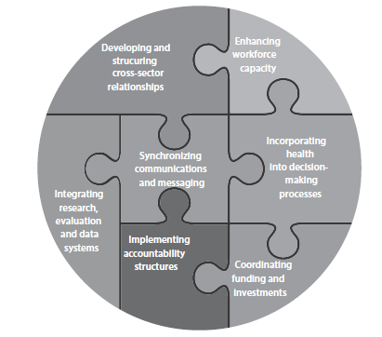
Strategies for Implementing Health in All Policies

Slide 3
Developing and Structuring Cross Sector Relationships
Collaborative Structure: Los Angeles County School Attendance Task Force
  Lead by Presiding Judge of the Children’s Courts
  Multidisciplinary stakeholders
    County Departments: CEO, courts, probation, law enforcement, mental health, social services, public health
    School districts
    Community-based organizations: social justice organizations, non-profits

Slide 4

Incorporating Health Into Decision-Making Processes
Health Impact Assessment: Assessing the costs and benefits of providing free public transit passes to students
Policy/Program Agenda: Identifying the highest priority recommendations for reducing truancy

Slide 5
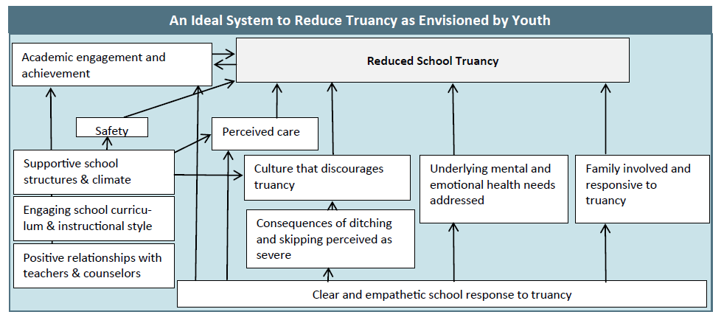
Integrating Research, Evaluation and Data Systems
Program Evaluation: Evaluation of the Los Angeles County Teen Court program
Community-Partnered Research: Understanding youth’s experiences with current “state” of truancy reduction system

Slide 6
Lessons Learned
Build credibility as an unbiased source for assessment and evaluation expertise
Link to existing collaborations/partnerships
  Understand and start with their goals
Be prepared to offer many types of tools (e.g., evaluation, policy analysis)
  HIA as one of many ways to add value
Need for messaging strategies to create awareness about the interconnections between partner/sectoral goals (e.g., health, education, juvenile justice)

Slide 7
Moving Forward
Continue to foster an infrastructure that allows for ongoing collaborative opportunities and the routine integration of youth wellness priorities
  Opportunities for integrated data systems, coordinated funding and cross-sector training?
  Launch of place-based, scalable models?
Look for opportunities to integrate multi-sector collaborations within other Departmental areas
  Value added of overarching HiAP Council?

Slide 8
References to a Few Products
HiAP Framework Manuscript
  Gase LN, Pennott R, Smith K. “Health in All Policies”: Taking Stock of Emerging Practices to Incorporate Health in Decision-Making in the United States. Journal of Public Health Management and Practice. 2013;19(6):529-540.
Transit Pass HIA Report and Issue Brief
    http://publichealth.lacounty.gov/pa/PA_Projects.htm
Transit Pass HIA Manuscript
  Gase LN, Kuo T, Teutsch S, Fielding JE. Estimating the Costs and Benefits of Providing Free Public Transit Passes to Students in Los Angeles County: Lessons Learned in Applying a Health Lens to Decision-Making. Int J Environ Res Public Health. 2014;11(11):11384-97.
Policy and Program Priorities Manuscript
  Gase LN, Butler K, Kuo T, The Los Angeles County School Attendance Task Force Workgroup. The current state of truancy reduction programs and opportunities for enhancement in Los Angeles County. Children and Youth Services Review. 2015; 52:17-25.

Slide 9
Acknowledgments – Contributors and Members of the Health Impact Evaluation Center
OFFICE OF HEALTH ASSESSMENT AND EPIDEMIOLOGY
Margaret Shih, MD, PhD
Ricardo Basurto-Davila, PhD, MSc
Katherine Butler, MPH
OFFICE OF PLANNING, EVALUATION AND DEVELOPMENT
Virginia Huang Richman, PhD, MPH
DIVISION OF CHRONIC DISEASE AND INJURY PREVENTION
Tony Kuo, MD, MSHS
Eloisa Gonzalez, MD, MPH
Amelia DeFosset, MPH
Taylor Schooley, MPH

Slide 10
lgase@ph.lacounty.gov
213-427-4402
Lauren Gase, MPH

Slide 11
Integrating Health and Transportation:
Policy, Projects, Data Collection and Monetization
THE HONORABLE KEN WILBER, CHAIRMAN
Rochelle Carpenter
National Health Impact Assessment Meeting
June 17th, 2015

Slide 12
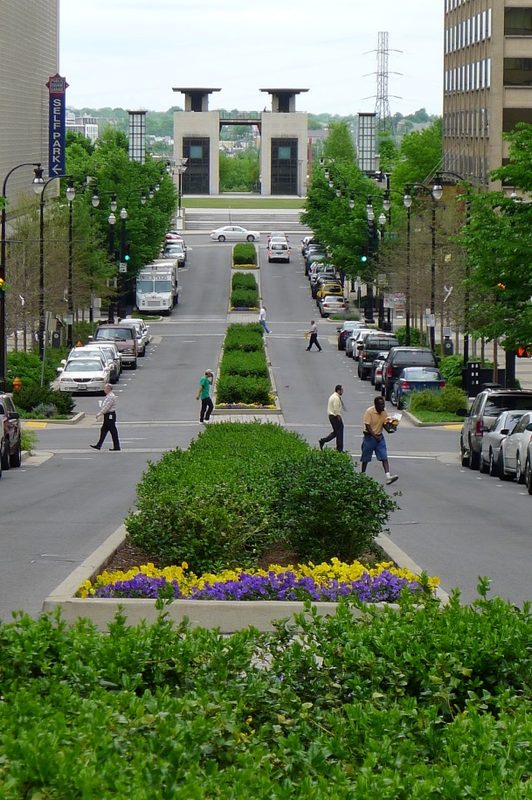
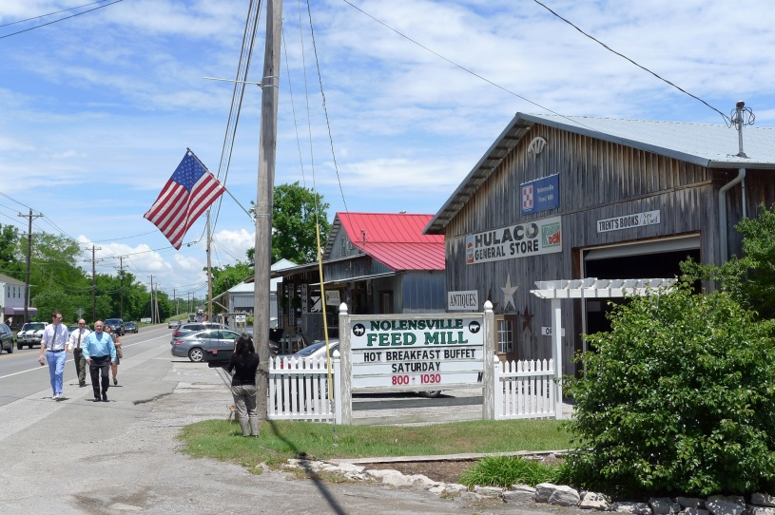

Health in All Policies
Five key elements of Health in All Policies:
Promote health, equity and environmental sustainability
Support intersectoral collaboratives
Benefit multiple partners
Engage stakeholders
Create structural or procedural change

Slide 13
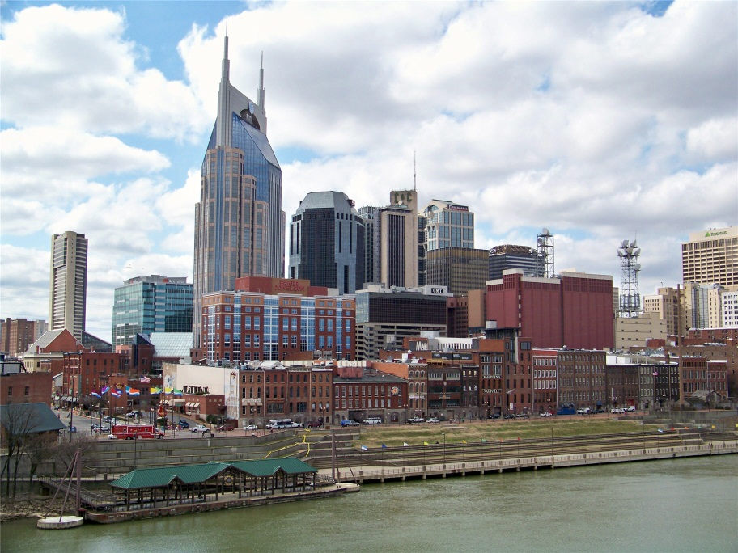

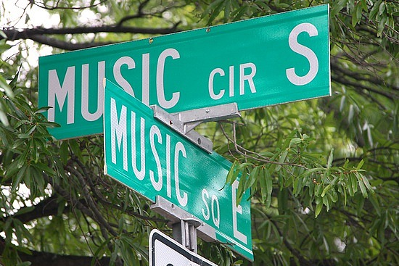
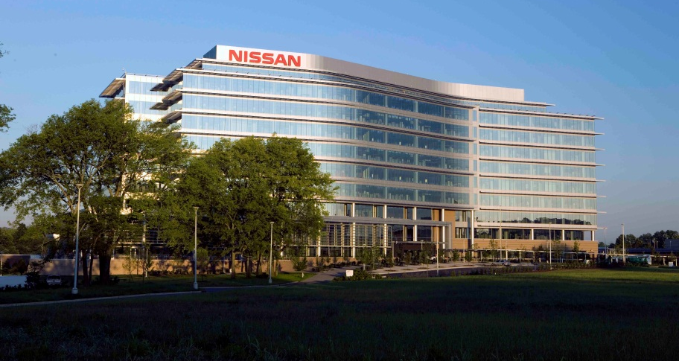
Middle Tennessee

Slide 14
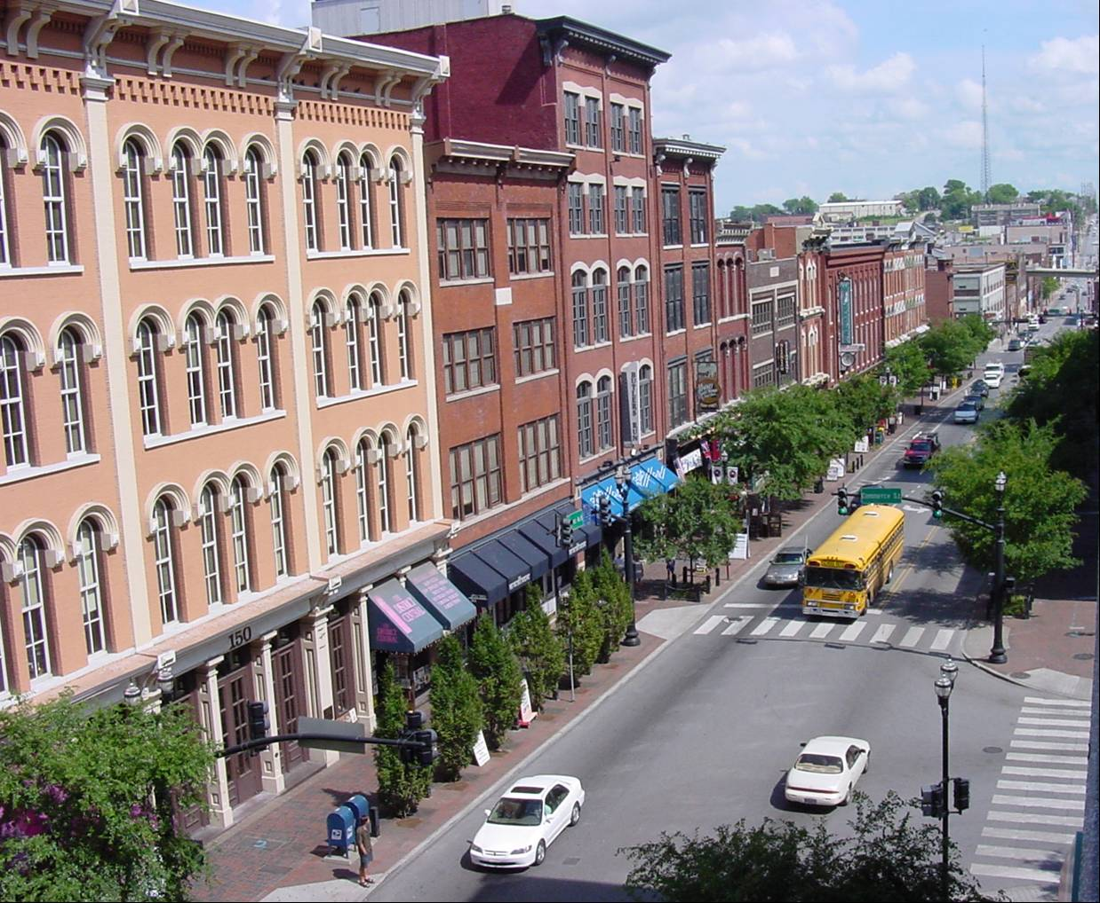
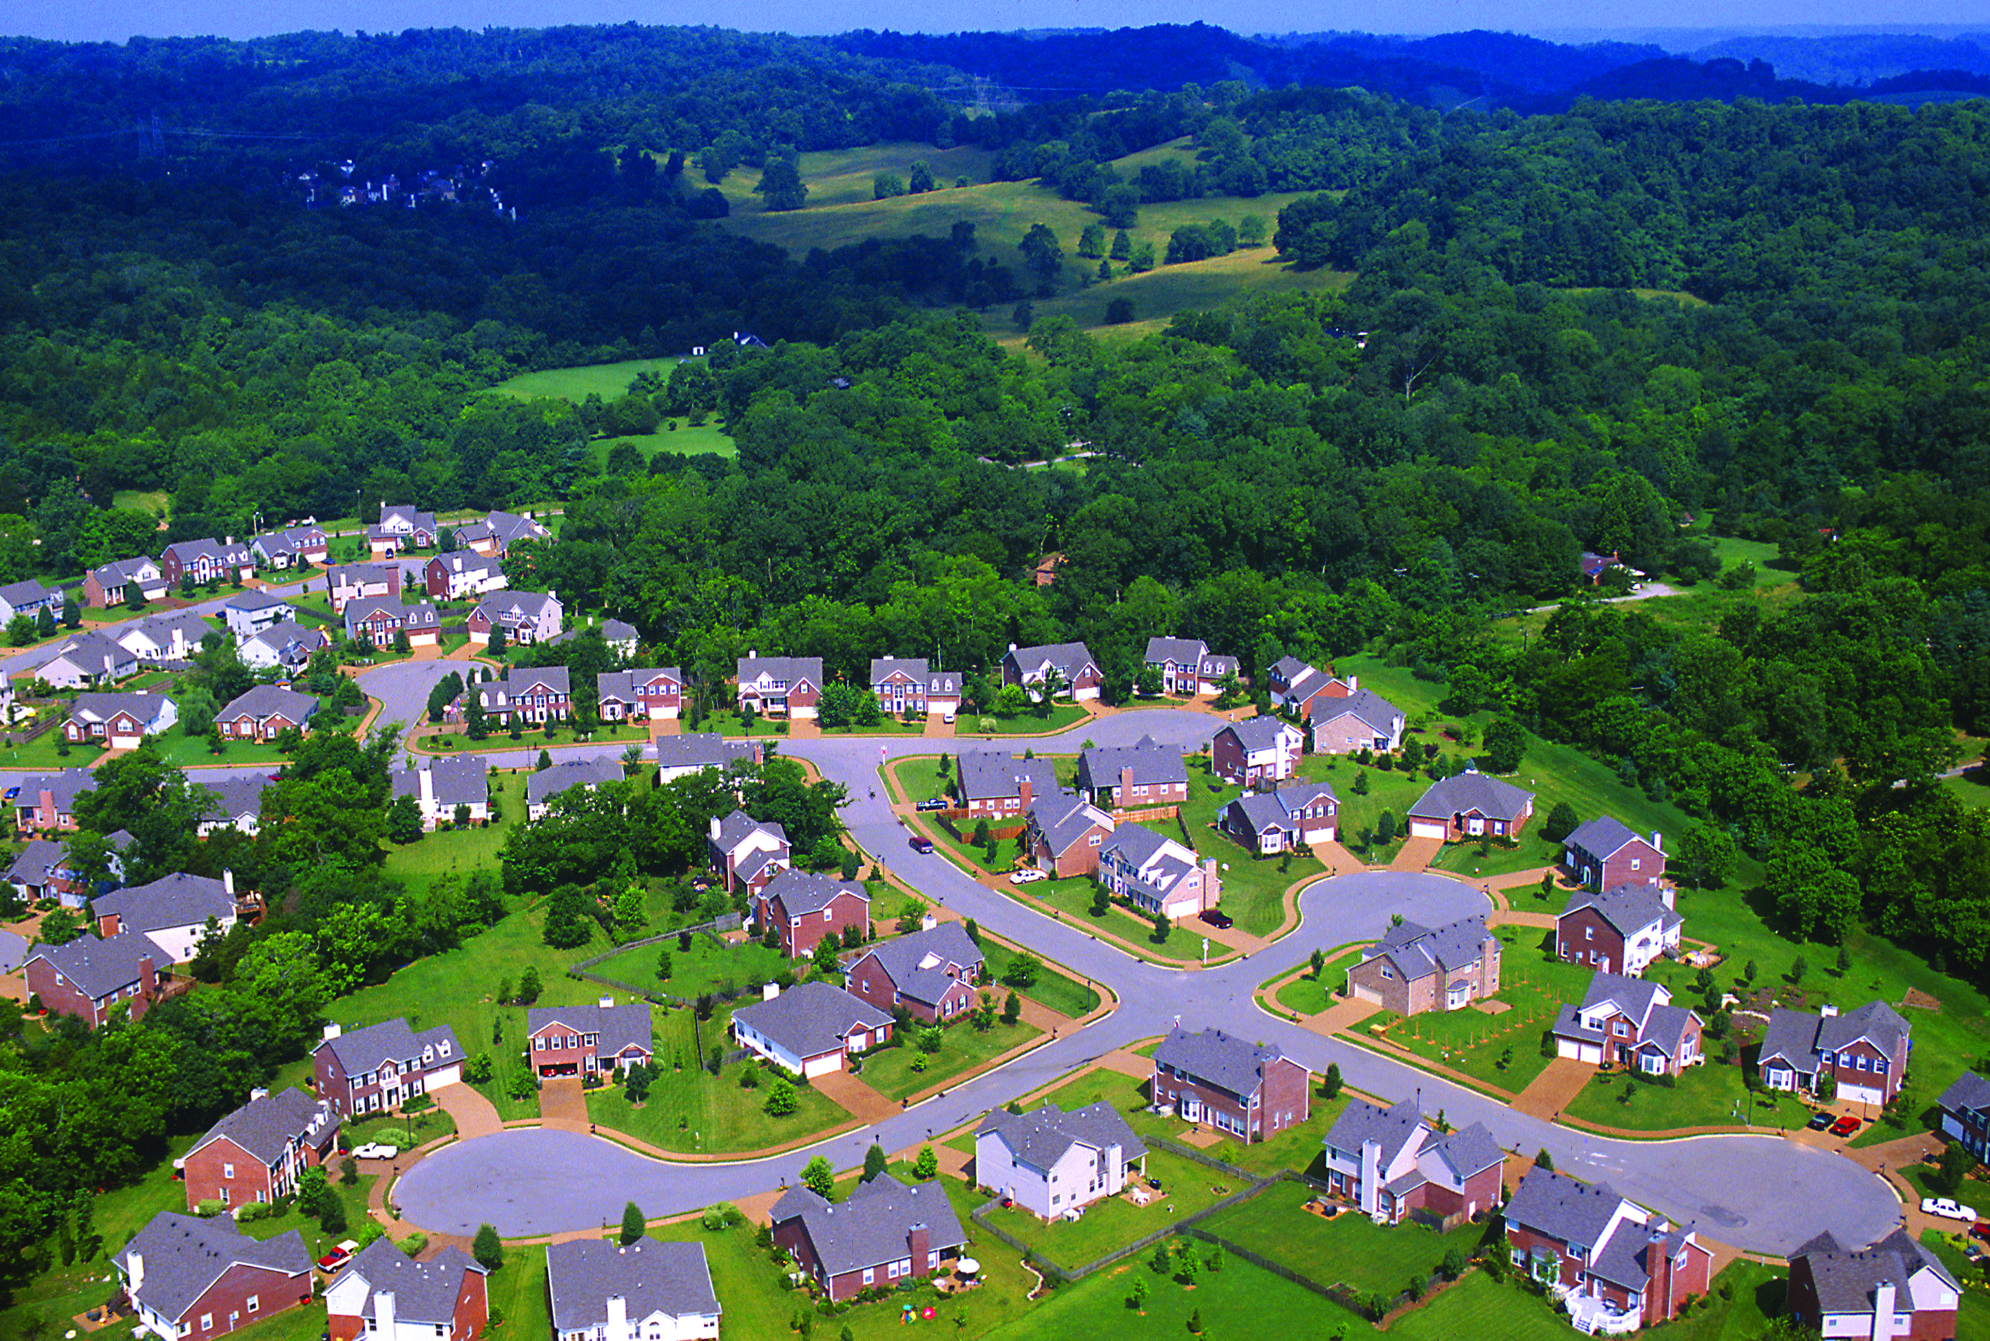
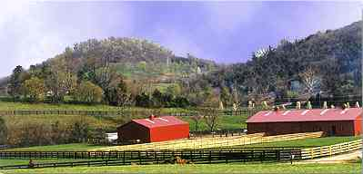
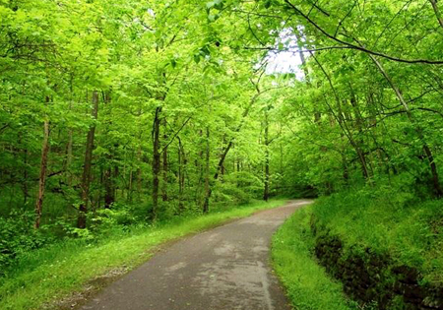
Middle Tennessee

Slide 15
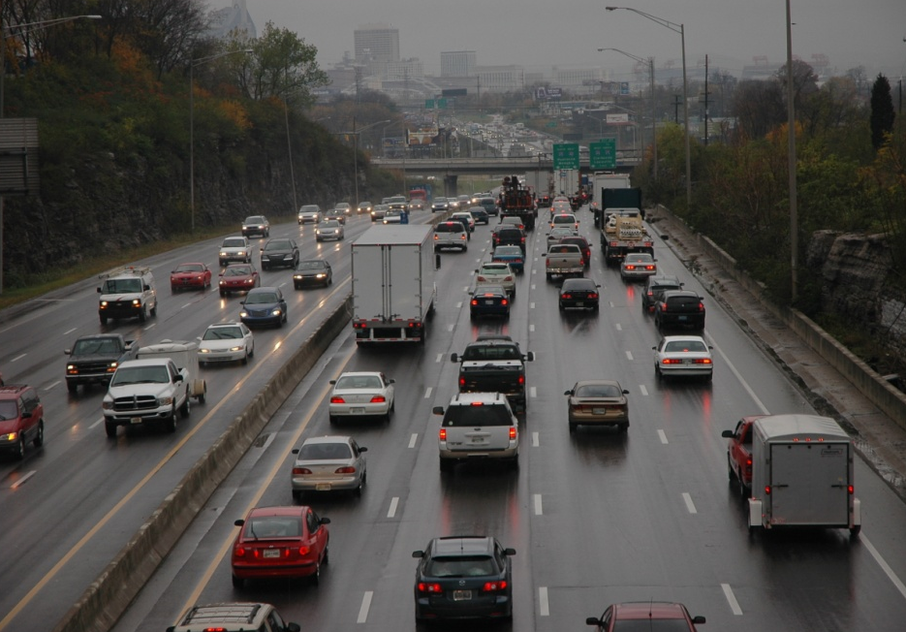
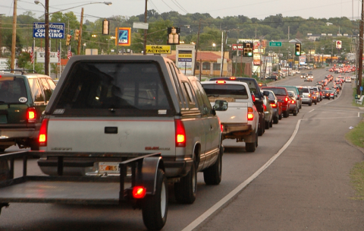
History of Expansive Development
Strong Cross-County Commuting Patterns
Growing Costs of Traffic Congestion
Household Budgets Consumed by Transportation Costs
Longer Travel Times
Few Options for Seniors
Dangerous by Design
Housing Choices
Worsening Personal Health / Increasing Costs

Slide 16
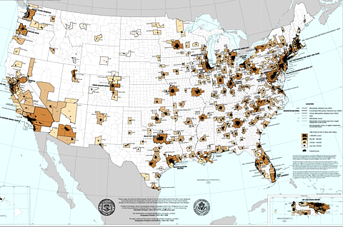
Metropolitan Planning Organizations
Notes:
Established through federal legislation, MPOs exist throughout the United States in urbanized areas of more than 50,000 people. Each MPO is comprised of representatives from city and county governments, their respective state Department of Transportation (DOT), the Federal Highway Administration and the Federal Transit Administration of the United States DOT, and other local or regional transportation-related agencies such as transit authorities and airports. It is through MPOs that local communities prioritize state and federal funds for various transportation projects and programs. 385 MPOs

Slide 17
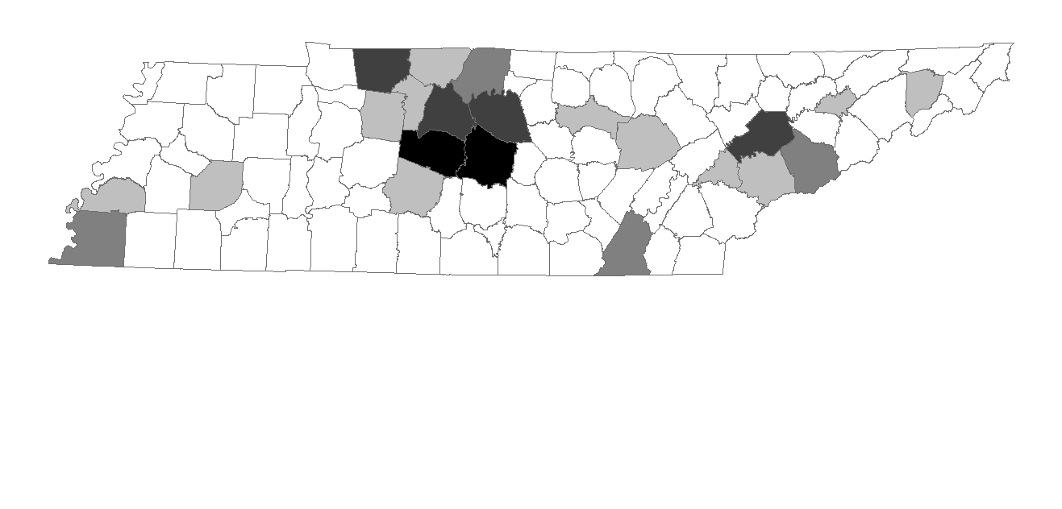
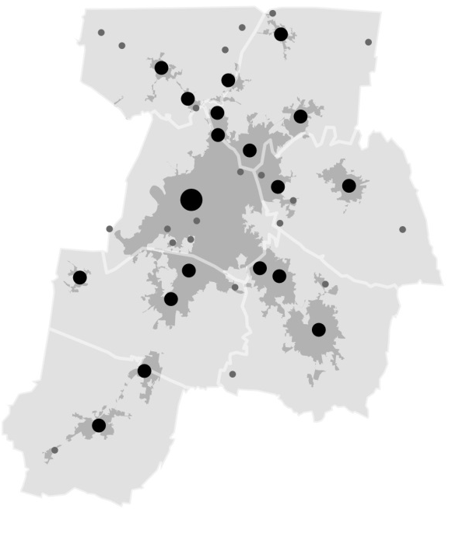
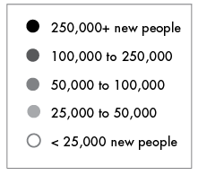

Nashville Area MPO
2.5 million statewide
1.7 million
in Middle Tennessee
Notes:
What are the driving forces behind the challenges facing our region?
Looking at population growth across the state – we currently have roughly 6.5 million in Tennessee – we expect about 9 million people in the state between now and 2040. More than half of the state’s growth is expected to occur in Middle Tennessee, this projection comes from national economists which understand market dynamics, migration shifts across the county as well as the natural growth that is expected to occur.
What this map is showing you is that both Williamson and Rutherford counties are both expect to add more than 250k people of the next 25 years. As you can imagine this growth will have a profound impact on our transportation and economic prosperity. Now, it’s not good enough to just understand the populations projections – part of our job as an MPO is to look ahead and determine where we need to invest in transportation infrastructure to support this growth by drilling down to understand where people will live and work in the future.

Slide 18
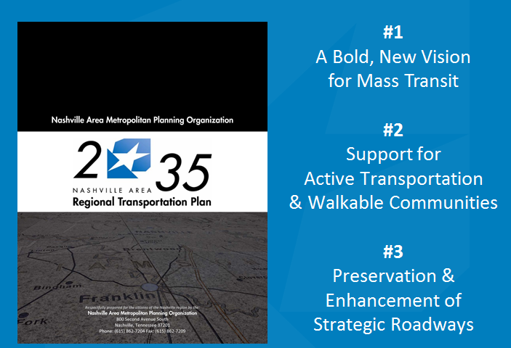
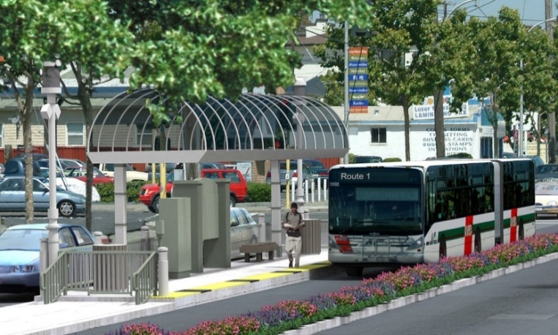
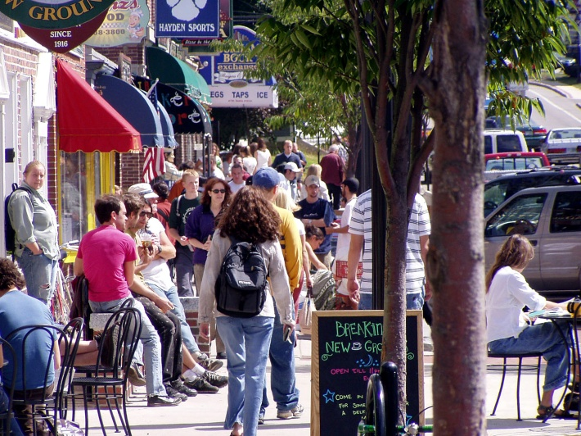
Policy: Public Opinion
  1st choice: improve and expand mass
  transit options
  2nd choice: make communities more
  walkable & bike-friendly
  3rd choice: build new or widen
  existing roadways
Notes:
To find out about local attitudes, we conducted a random sample 10-county survey with 1,100 responses asking residents how they would like to spend transportation dollars -- the answers were to prioritize mass transit first, make communities more walkable and bikeable, and build new roads as the last choice, demonstrating that people want alternatives to driving.

Slide 19
MPO’s Urban STP Investment Strategy
70% - Roadway projects that improve health
15% minimum investment in Active Transportation & Walkable Communities
  Sidewalks, bicycle lanes, greenways, transit stops, and education
10% minimum flexed to Transit
  Combined with Federal Transit Administration funds to help implement regional vision for mass transit
5% Intelligent Transportation Systems
  Using technology to manage traffic

Slide 20
MPO’s Urban STP Investment Strategy
2040 Plan Projects Scored on Criteria – 100 points
  Quality Growth and Sustainable Development – 15pts
  Multi-Modal Options – 15pts
  Health & Environment – 15pts
  Safety & Security – 20pts
  Congestion Management – 15pts
  System Preservation & Enhancement – 10pts
  State & Local Support/ Investment – 5pts
  Freight & Goods Movement – 5pts
70% Multi-Modal Roadway Safety & Capacity
Projects Scored on Criteria – 100 points
  Quality Growth and Sustainable Development – 15pts
  Multi-Modal Options – 15pts
  Health & Environment – 10pts
  Safety & Security – 10pts
  Congestion Management – 10pts
  System Preservation & Enhancement – 15pts
  State & Local Support/ Investment – 15pts
  Freight & Goods Movement – 10pts
Notes:
Here is a look at the scoring criteria. The criteria in orange relate to health and safety.
450 Projects Submitted – approx 300 projects in final plan
75% of Roadway Projects have bike/ped element
8 Greenway Projects not on roadway network

Slide 21
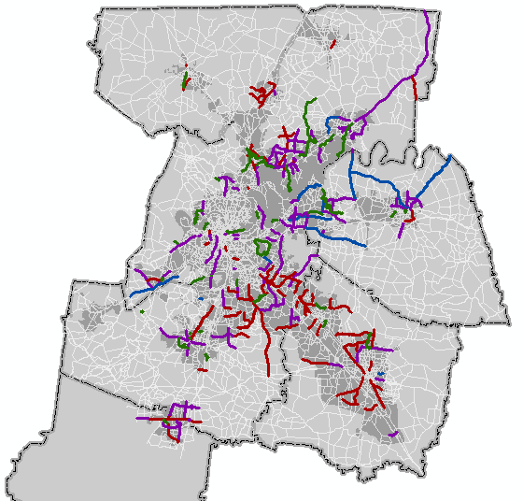
Projects: Complete Streets
2035 Plan: 70% of adopted roadway projects include sidewalks, bicycle lanes, or shared-use lanes
(up from 2%)
70% roadway $ to projects that improve health
Notes:
Did this by changing scoring criteria

Slide 22
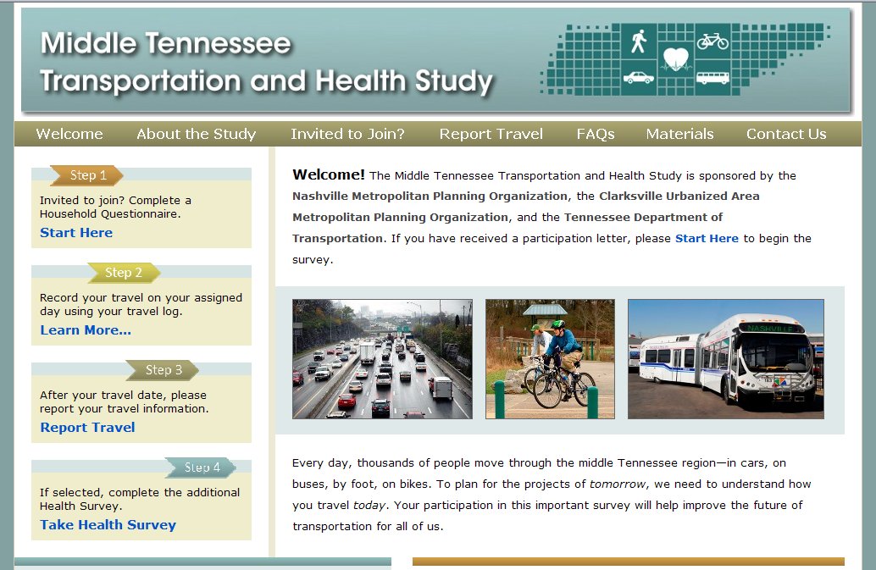
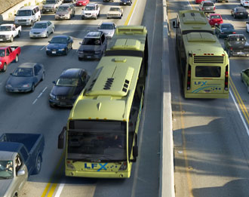
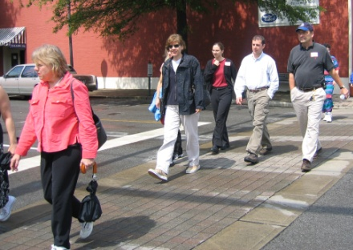
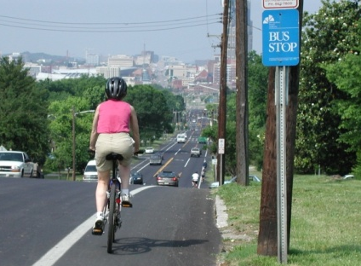
Data Collection: Middle Tennessee
Transportation and Health Study
Transportation, Physical Activity and Health Data Collection and Analysis
www.middletnstudy.com

Slide 23
Integrated Transportation and Health Impact Modeling (ITHIM) Tool
ITHIM is a comprehensive health impact model
  Health benefits of physical activity
  Health benefits of reduced air pollution
  Health risks of bike/ped vs auto accidents
  Age/Gender effects
Notes:
Some health impact models are simple and only focus only on the benefits of increased physical activity. They may ignore important co-factors such as increased risk of injury and age/sex-specific effects. A good example is the HEAT model from the WHO. While useful, this tool is somewhat limited in its capabilities.
ITHIM advances health impact modeling beyond the benefits of increased physical activity by accounting for changes in bike/ped crash risk that may accompany changes in mode share, and accounting for the effects of reduced air pollution on respiratory conditions, and it does many of these calculations across sex and age strata.

Slide 24
Diseases and Exposures
Physical Activity | Air Pollution | Collisions
Ischemic Heart Disease | Respiratory Infections | Auto
Depression | Cardiovascular Disease | Bicycle
Dementia | Hypertensive Heart Disease | Pedestrian
Diabetes | Inflammatory Heart Disease | Bus
Colon Cancer | Lung Cancer | Truck
Breast Cancer | Respiratory Disease (kids) | Highway
All-Cause Mortality | Stroke | Arterial
 |  | Local
 |  | Fatal
 |  | Non-Fatal
MODE
ROAD TYPE
SEVERITY
Notes:
(I will be the third talk about ITHIM in this session, so the listeners will be familiar with the model).
Many of the diseases accounted for in ITHIM are prevalent in TN or are affected by inactivity and obesity. That makes ITHIM particularly relevant for measuring health impact in this area.

Slide 25
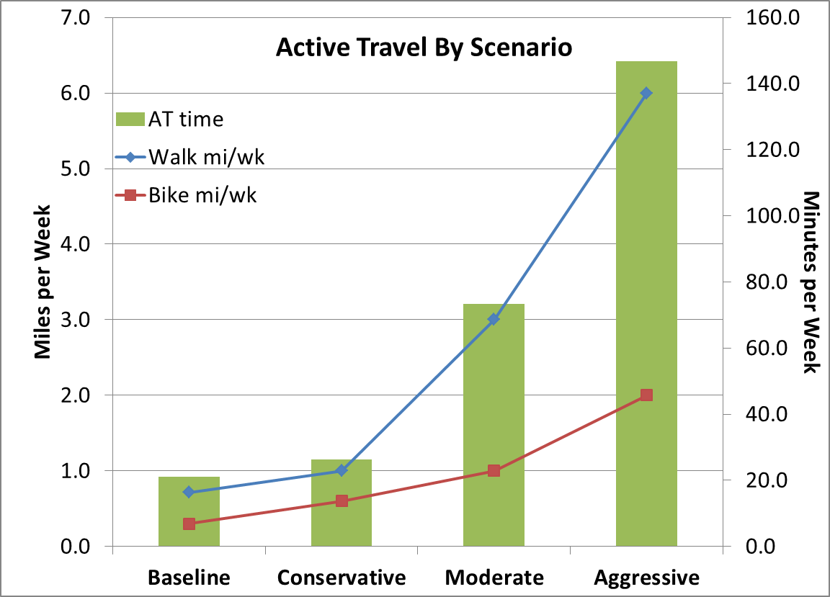
Happening Now: Integrated Transport and Health Impact (ITHIM) Model

Slide 26
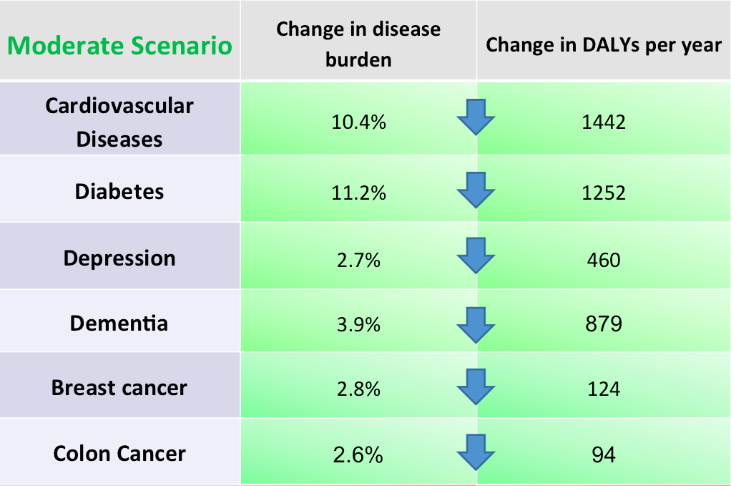

Monetization: Impacts of Physical Activity via Transportation on Health
Savings:
$200 Million per year in healthcare costs
Notes:
ITHIM helping translate message of health impacts of transportation.
Moderate Scenario:
Additional 10 Minutes of walking or bicycling a day
Reduce Cardiovascular Disease by 21% and Diabetes by 8%
$200 million a year saved in health spending ($300 million yr/TIP)
ITHIM will be incorporated with our Activity Based Model (ABM) to help calculate future benefits of increased bicycle, pedestrian and transit travel.

Slide 27
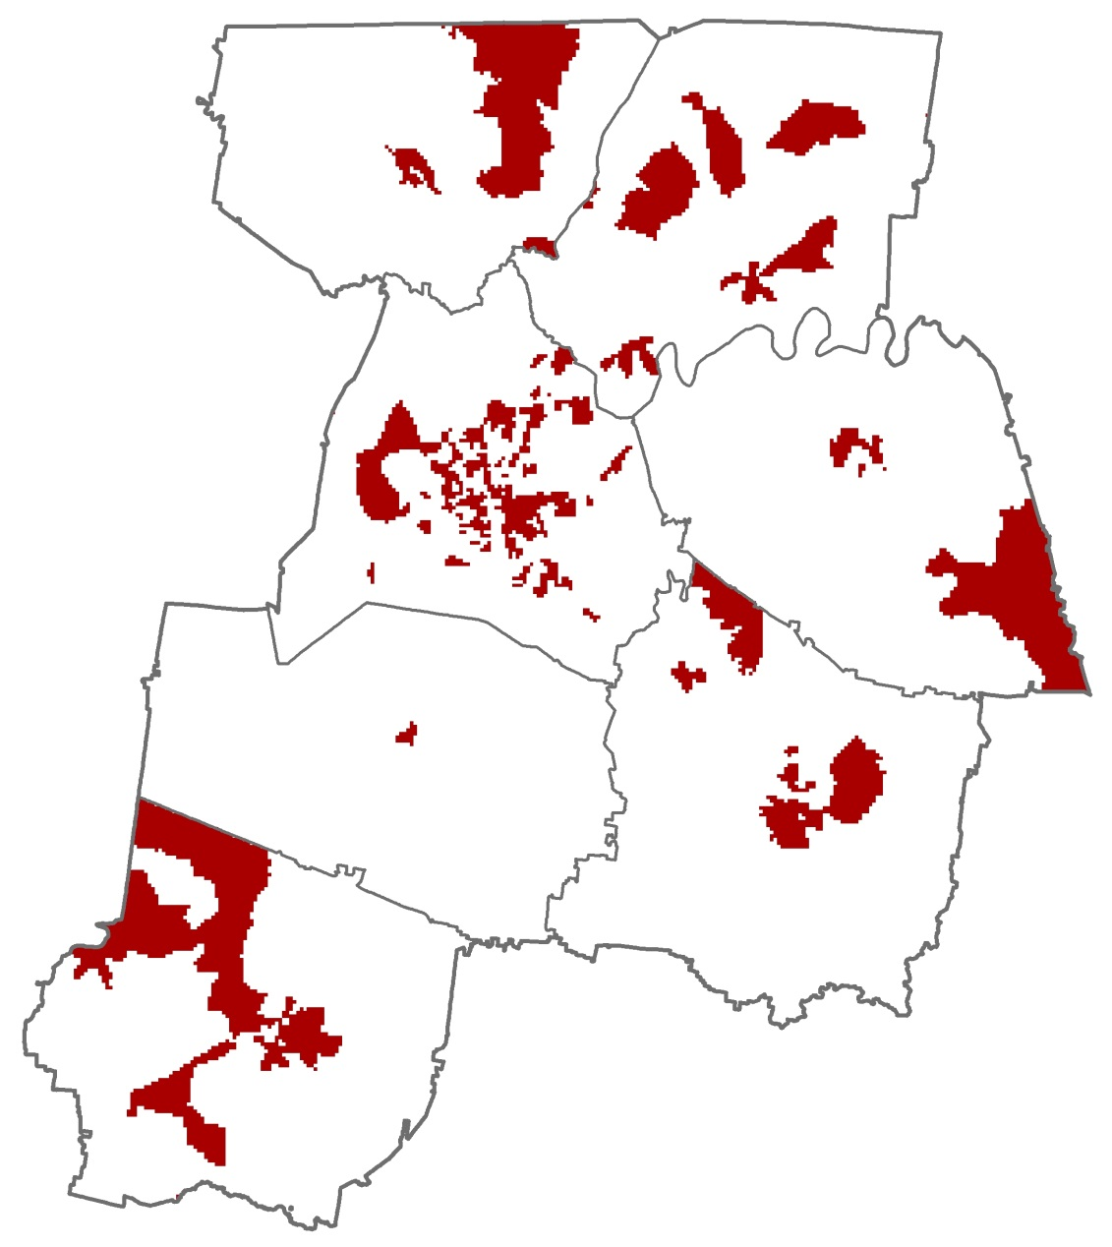
Prioritization: Health Priority Areas
Health Priority Areas
3 out of 4:
Poverty
Unemployment
Carless Household
Aging (over age 65)

Slide 28
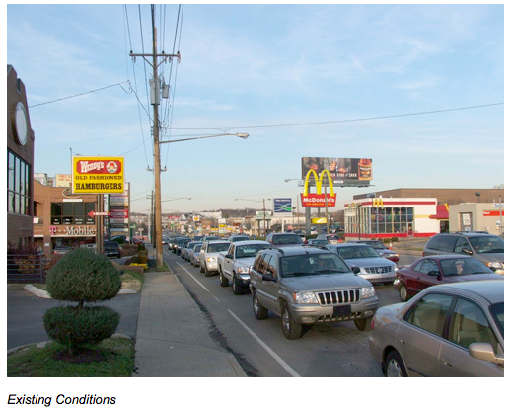
Health in All Policies: Green Hills

Slide 29
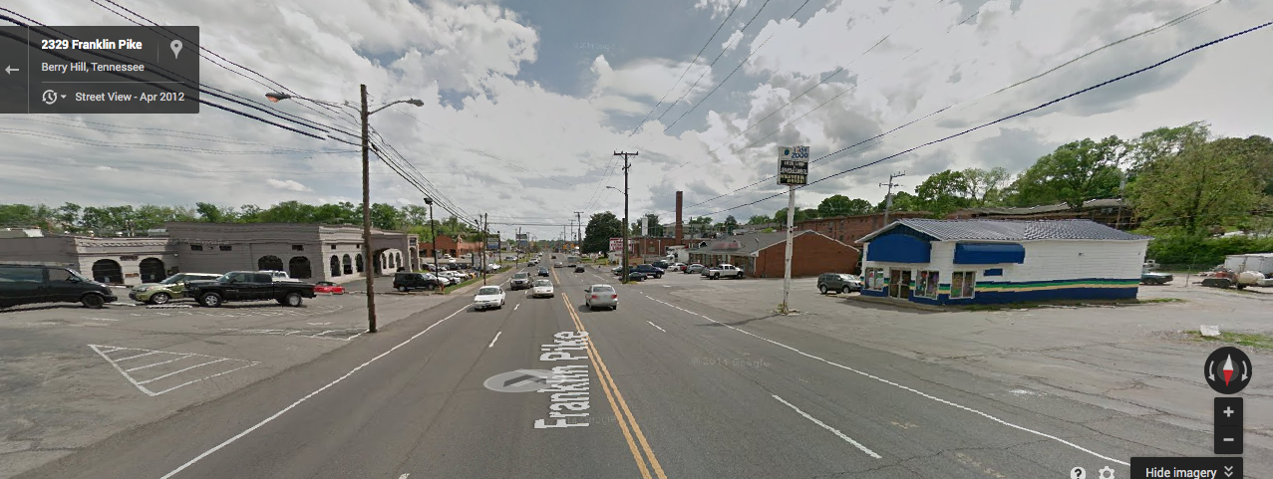
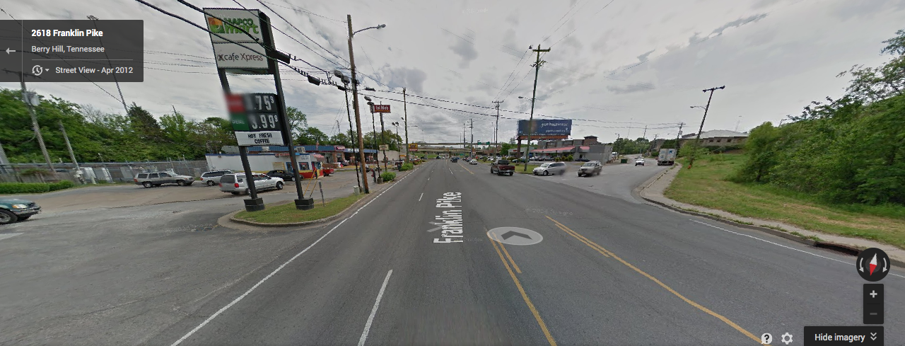
Health in All Policies: Franklin Pike/8th Avenue S

Slide 30
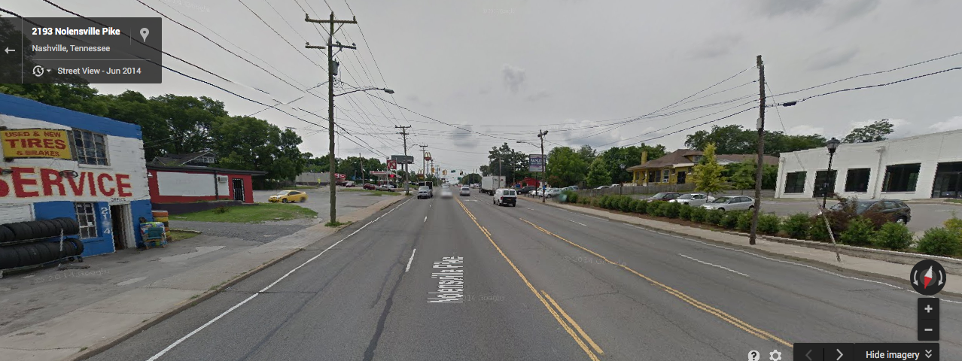
Health in All Policies: Nolensville Pike

Slide 31
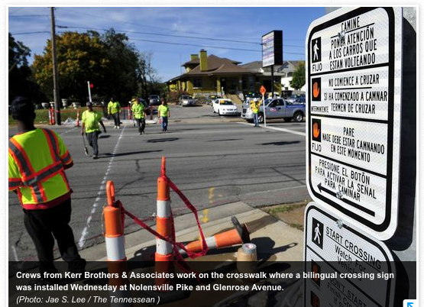
Nolensville Pike: City’s First Bilingual Crosswalk

Slide 32


@NashvilleMPO
/NashvilleMPO
Rochelle Carpenter
Senior Policy Analyst
Nashville Area MPO
carpenter@nashvillempo.org

Slide 33




Slide 34
Approaches to operationalize HiAP:
Using a Sustainability Certification framework to advance Health In All Policies Integration
Donna Drewes, PP/AICP
Co-Director
Sustainable Jersey
Sustainability Institute at TCNJ

Slide 35
Implementing Health in All Policies
Sustainable Jersey Certification Program-Framework for Progress
Program Strategies
  Building cross- sector relationships
  Incorporating health into decision-making
  Benefits multiple partners, robust stakeholder engagement
  Supports structural change
  Coordinates funding

Slide 36
What is Sustainable Jersey?
Sustainable Jersey coordinates priorities, resources, and policy among public and private, state and local actors to help communities and schools achieve their sustainability goals. Capped by prestigious certification, the program has three components.
Sustainable Jersey:
Identifies actions to help municipalities and schools become more sustainable
Provides tools, resources, and guidance to make progress
Provides access to grants and funding for municipalities and schools

Slide 37
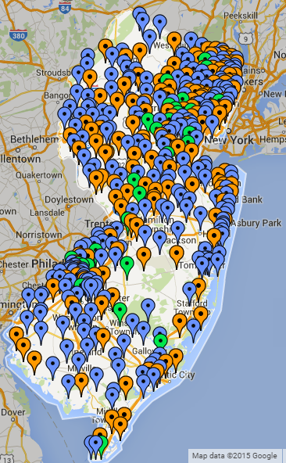
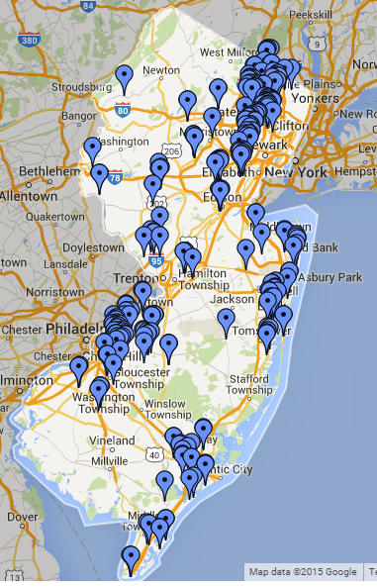
Sustainable Jersey
423
Municipalities
76
School
Districts
208
Schools

Slide 38
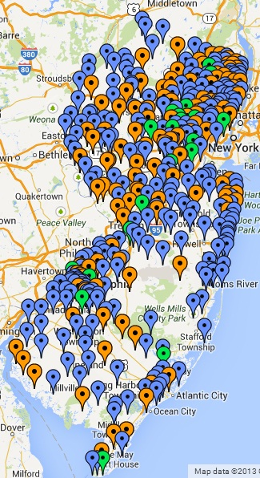
Participating Communities
Program start: February 2009
423 (75%) NJ municipalities participating
86% of NJ’s population lives in these
communities
177 municipalities certified:
  149 towns at bronze level
  28 towns at silver level

Slide 39
Program Metrics
423 | Registered Municipalities (75% of State)
33% | Communities Certified in New Jersey
23 &10 | Municipal & School Task Forces (over 300 organizations participating)
7,000+ | Actions completed (since 2009)
 | Policies/Ordinances (Complete Streets, Outdoor Smoking, Urban Ag, Parking, Healthy Food)
 | Programs (Mayors Wellness, Safe Routes to Schools, Breakfast after the Bell, healthy food access, School Wellness Councils, Indoor Air Quality, School Health Assessment, lead education and training)
 | Projects (farmers markets, Anti-idling education, school & community gardens, access to water, tree planting, outdoor classrooms)
 | Plans (Bike/Ped Plans, Sustainability Elements, Farmland Preservation, tree canopy, open space, Resiliency, Extreme Temperature, Coastal Flooding and Sea level rise)

Slide 40
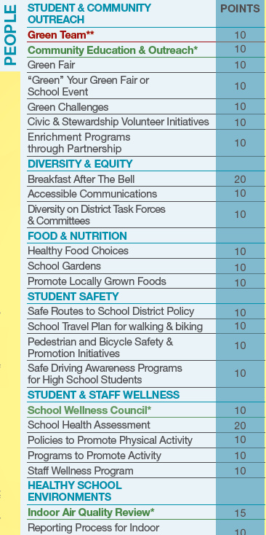
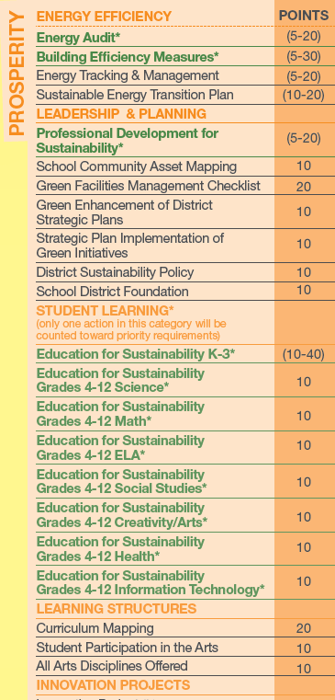
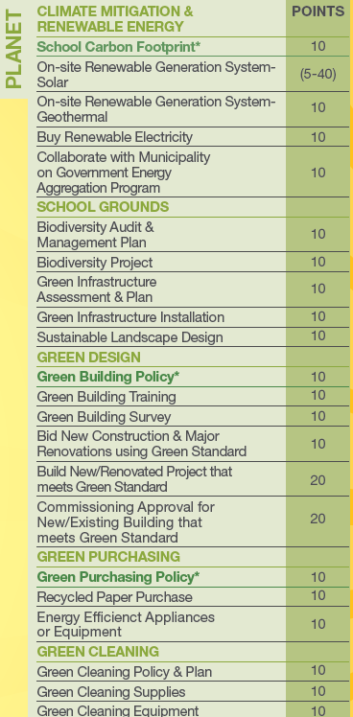
Actions: Prosperity, Planet, People
Notes:
Each of the Sustainable Jersey actions that towns do to become certified are divided into the Prosperity, Planet and People categories. Each action comes with a fully resourced tool which includes: What is it? Why is it important? Who should be involved? How long will it take and what will it cost? In addition, there are resources in the tools themselves. And a “spotlight” section on successful communities.
The technical content of the program’s actions are developed with the help of 22 task forces that comprise New Jersey state local officials, experts, non-profit groups, and members of the business community. Recommended best practices/actions are vetted with local government officials.

Slide 41

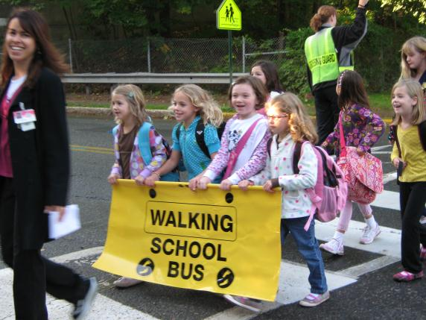
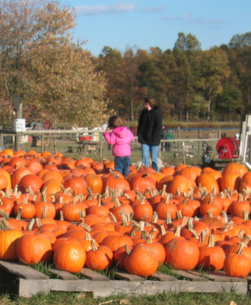
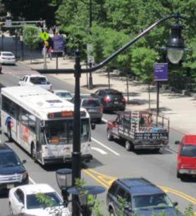
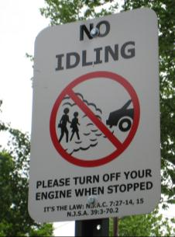
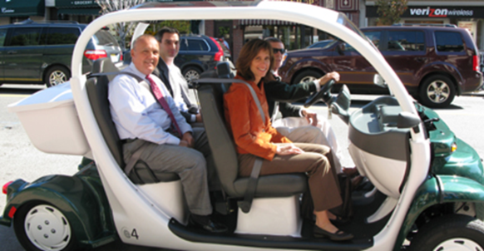
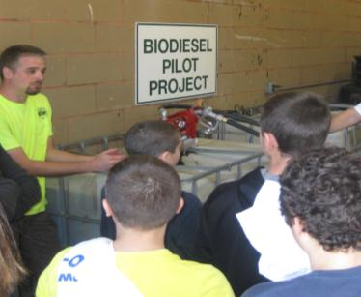
Certification Benefits
Recognition
Save Money, Get Money
Access to Training and Guidance
Promote your community
Advance Sustainability
Notes:
Just to recap – here are a few of the certification benefits.
Save money. Get money. Sustainable Jersey includes actions that can help you improve efficiency and cut waste.
Gain access to training, tools and expert guidance.
Get recognized. Promote your town.
Conserve valuable resources. Protect the environment.

Slide 42
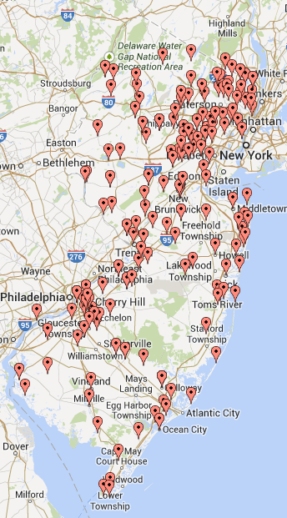
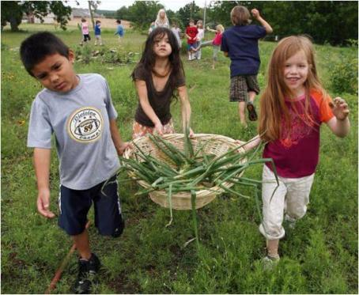
Small Grants Program
Awarded Grant Locations
Since 2009 Sustainable Jersey has awarded 340+ grants ranging from $2,000 capacity building grants to $35,000 model project grants. To date, over $2,300,000 has been awarded.
Funding Provided By:
Walmart
PSEG Foundation
New Jersey Department of Health
Gardinier Environmental Fund
NJ Education Association

Slide 43
Who Creates The Actions/Standards?
To create rigorous and broadly accepted standards and actions we convened Task Forces on 33 different issues in both school and municipal programs
Task Forces utilize 300 volunteer leaders from:
    Academia
    Non-profit sector
    Business community
    State, local, federal, and county government
Task Forces identify best practices, develop new models, support training and leverage resources from state agencies, NGO’s, regional and the corporate sector

Slide 44
Advancing Health in All Policies
Two Prong Approach
Encourage Professional Development and Training on HIA’s
Develop new or update existing Actions to incorporate health in all policies focus
Technical Leadership:
  NJ Health Impact Collaborative-Rutgers University
  PEW –Health Impact Project and RWJ
  Georgia Health Policy Center

Slide 45
Advancing Health in All Policies
New HIA Training Action– will award points for municipal planners, planning board members or health professionals that attend training
Updates/Revisions Underway:
  Extreme Temperature Planning
  Bicycle and Pedestrian Audits
  Bicycle and Pedestrian Plans
  Complete Streets Policy and Program Integration monitoring
Notes:
Discuss HiAP updates for each of the actions.

Slide 46
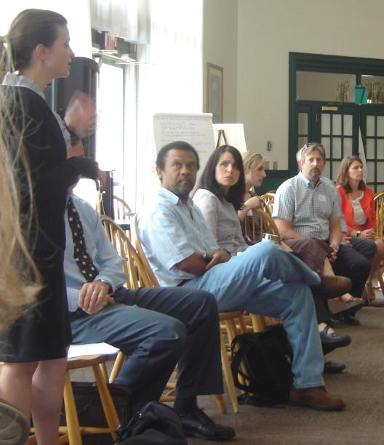
Advancing Health in All Policies
Next Steps and Timeframe
New or Updated Actions and associated toolkits incorporated into program early fall
Outreach, education & training
Highlighted at workshops at NJ League of Municipalities, NJ American Planning Association, other health and transportation

Slide 47
Lessons Learned
Collaboration critical- but need to spend time to build base knowledge to make progress
Be strategic and focused when selecting initial HiAP initiatives, look for those with high probability of success. Best practices need to be backstopped by multi-agency/organizational support, technical services, training, and optimally funding
Curb or manage enthusiasm - change needs to be structurally supported, so go slow

Slide 48
Thank you!
Sustainable Jersey website
  www.sustainablejersey.com
  www.sustainablejerseyschool.com
Donna Drewes PP/AICP, Co-Director
Sustainable Jersey
Sustainability Institute at The College of New Jersey
drewes@tcnj.edu

