Slide 1

Strengthening States
for 40 Years

Slide 2
National Conference of State Legislatures
Bipartisan organization, funded by state legislatures
Serves the 7,382 legislators and 30,000+ legislative staff of the nation's 50 states, its commonwealths and territories (and Scotland)
Covers every topic of state policy
  State fiscal policy (appropriations and taxation)
  State legislative management
Activities:
  Research and information on topics of interest to the states
  Technical assistance and training
  Opportunities for policymakers to exchange ideas
  Lobbying at the federal level for states' interests

Slide 3
Health Impact Assessments
“We study economic impacts and environmental impacts; we should be looking at the health impacts.”
West Virginia Senator Dan Foster, 2005
HIA Law in States
MA HIA for Transportation
WA HIA for Washington Bridge
VT HIA for ACA Law
2015 Sessions
23 bills in 10 states
CA, MA, MN, MO, MS, NC, NJ, NY, OR and TX

Slide 4
Health Impact Assessments
What do Legislators Need?
Justify Efficacy of Policy; Policy Evaluation
Improve the Public Health System
  ACA makes Health Care a Public Cause
  Medicaid is #1 cost for states
Deescalate Constituent Anger
  Ensure public is engaged

Slide 5
Health Impact Assessments
What do HIAs do?
Evaluates Public Health Policy
  Assessing and Evaluating
Demonstrates Cost-Effective Public Health Policy
  Recommendations and Monitoring
Engages the Public
  Scoping and Reporting
Overall, it improves the Public Health System

Slide 6
Health Impact Assessments
MN S 1671
establishes a program requiring the Commissioner of Health to conduct health impact assessments on topics selected by the Legislative Audit Commission; appropriates money.
MO HR 565
urges the United States Army to explain chemical testing which occurred in St. Louis in the 1950s and 1960s and requests the federal government to conduct a study on the health effects of such

Slide 7
HIA – Policy Data
What are they thinking??
NY S 2745 – Enacts the Upholstered Furniture Safety Act
3. The department may, following public hearings, adopt rules and regulations authorizing an exemption to subdivision one of section 37-0903 of this title upon a determination by the commissioner that the proposed chemical flame retardant will not negatively affect human health or the environment. Such determination may only be made after the completion of a comprehensive health impact assessment conducted by the department of health, following a model recommended by the centers for disease control and prevention.
NY S 3844 – Prohibits the Use of Chemical Flame Retardants on Residential Furniture
3. The department may, following public hearings, adopt rules and regulations authorizing an exemption to subdivision one of section 37-0903 of this title upon a determination by the commissioner that the proposed chemical flame retardant will not negatively affect human health or the environment. Such determination may only be made after the completion of a comprehensive health impact assessment conducted by the department of health, following a model recommended by the centers for disease control and prevention.

Slide 8
HIA – Air Pollution
MA H 2040 - Comprehensive study of data on the health effects of particulate air pollution from surface transportation.
The study shall focus on understanding the health impacts from fine and ultrafine particulate matter upon populations that are located within 500 feet of any roadway with 50,000 or more motor vehicle trips per day, or any rail line regularly used by diesel locomotives; provided further, that the study shall include, but not be limited to, examining respiratory and cardiovascular disease and cancer incidence that may be affected by exposure to surface transportation-related particles. The following departments and agencies of the commonwealth shall provide information to the center for environmental health of the department of public health relevant to this study: the department of environmental protection, the department of transportation (MassDOT), and the central transportation planning staff of the Boston metropolitan planning organization. The department of public health shall report its findings, or a progress report, together with any recommended response actions by the commonwealth to the house and senate committees on ways and means, to the Secretary of the Executive Office of Energy and Environmental Affairs, and to the Secretary of the Executive Office of Transportation, not later than two years after the adoption of this act; provided further that no less than $250,000 shall be appropriated for this purpose.

Slide 9
HIA – Public Schools
MA H 738
Department of Environmental Protection and the Department of Public Health develop health risk assessment guidelines of proposed school construction sites.

Slide 10
HIA – Vulnerable Communities
NJ S 1150; A 1594
Concerns environmental permits in low-income, minority communities.

Slide 11
HIA – Fresh Foods
MA S 1230 - Accessibility of fresh food retail in communities
Study the public health impact of inadequate access to fresh food retail; develop innovative strategies and recommendations to increase access to fresh food retail, including: legislation, economic incentives and financing options, improvements to transportation, public-private partnerships, pilot program(s), and the improvement of food programs already in existence.

Slide 12

HIA – Fresh Foods
MS S 2547 – Small Business and Grocer Act; Underserved Communities
9) The agency shall prepare and submit an annual report to the Legislature on any projects funded and outcome data that includes the health impact of the program.

Slide 13

HIA – Food Policy
NC H 250; HS 296 – the corner store initiative act to assist healthy food small retailers.
(k) Reports. – The Department shall publish a report on the use of funds in the Healthy Food Small Retailer Fund on or before April 30 of each year. The Department shall submit the report electronically to the Joint Legislative Oversight Committee on Health and Human Services, the House and Senate appropriations committee with jurisdiction over agriculture and natural and economic resources, and the Fiscal Research Division. The report shall include the amount of funds disbursed, the geographic distribution of disbursements, and an evaluation of the outcome of the disbursements, including the health impact associated with the funding.

Slide 14
HIA – Food Policy
TX H 1485; S 1509 – Grocery Access Investment Fund
(b) The Texas Department of Agriculture shall establish monitoring and accountability mechanisms for projects receiving Financing and shall report annually to the Legislature on the projects funded, the geographic distribution of the projects, the costs of startup and administering the program, and the outcomes, including the number and type of jobs created and health impact associated with the program.

Slide 15
HIA – Energy Policy
MA H 2032
Study the health impacts from wind turbines to protect the health.
NY S 1220
Relates to natural gas development using hydraulic fracturing; enacts provisions to ensure natural gas development practices will be sustainable and safe. Requires an HIA be performed.
1. No permit shall be issued under section 23-0501 of this article until the department of health has completed the health impact assessment described in subdivision two of this section and the department has adopted regulations and implemented any mitigation measures recommended in the health impact assessment. The purpose of a health impact assessment is to provide detailed information about the effect oil and gas operations are likely to have on public health, to identify measures that could be implemented to minimize any adverse effects of such operations, and to suggest alternatives to such an action so as to form the basis for a decision whether or not to undertake or approve such activities.

Slide 16
HIA – Synthetic Turf
What are they thinking??
CA S 47 – Study on Synthetic Turf
Require the Office of Environmental Health Hazard Assessment, by July 1, 2017, to prepare and provide to the Legislature and post on the office's Internet Web site a study analyzing synthetic turf, as defined, for potential adverse health impacts.

Slide 17
HIA – Procurement Policy
OR H 3309
Requires the contracting agency, before advertising or soliciting procurement, to request Oregon Health Authority to conduct public health impact assessment on proposed procurement; permits authority to charge contracting agency actual costs that authority incurs in conducting assessment; permits contracting agency to exempt procurement or class of procurements from assessment requirement after consulting and conducting screening with authority.

Slide 18
HIA – Solid Waste
MA H 2004 - BioMass Facilities and Solid Waste Reduction
The department of public health shall conduct a public health impact analysis of each proposed biomass-fueled electricity generating facility in the Commonwealth

Slide 19
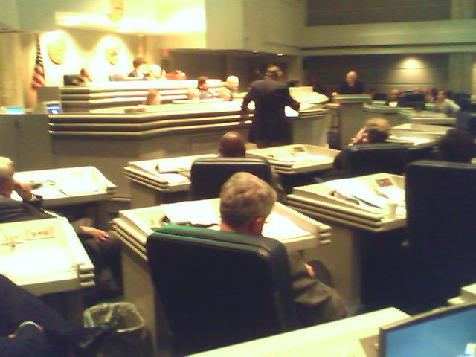
HIA Legislation
Must be Cost Containing
  How much money
  How many people
Must Establish parameters for determining the range of health effects to study
Must Determine whether HIAs should be encouraged or required
Must Identify how HIAs will be funded

