Slide 1
Applying HIA to Natural Disaster Planning: Lessons from the Field
2015 National Health Impact Assessment Meeting
Washington, D.C.  June 16-17, 2015
Presented by:
Jon Carnegie, AICP/PP
Karen Lowrie, Ph.D.

Slide 2

This project is supported by a grant from the Health Impact Project, a collaboration of the Robert Wood Johnson Foundation and The Pew Charitable Trusts.

Slide 3
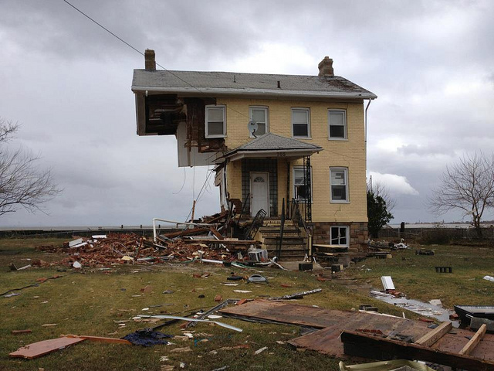
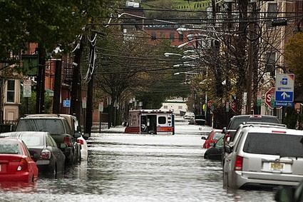
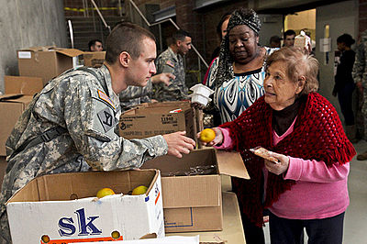
Background

Slide 4
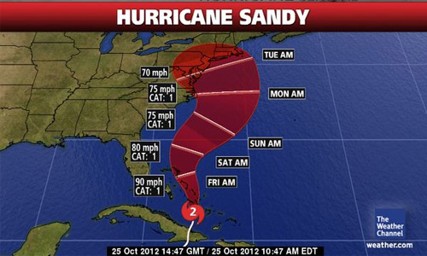
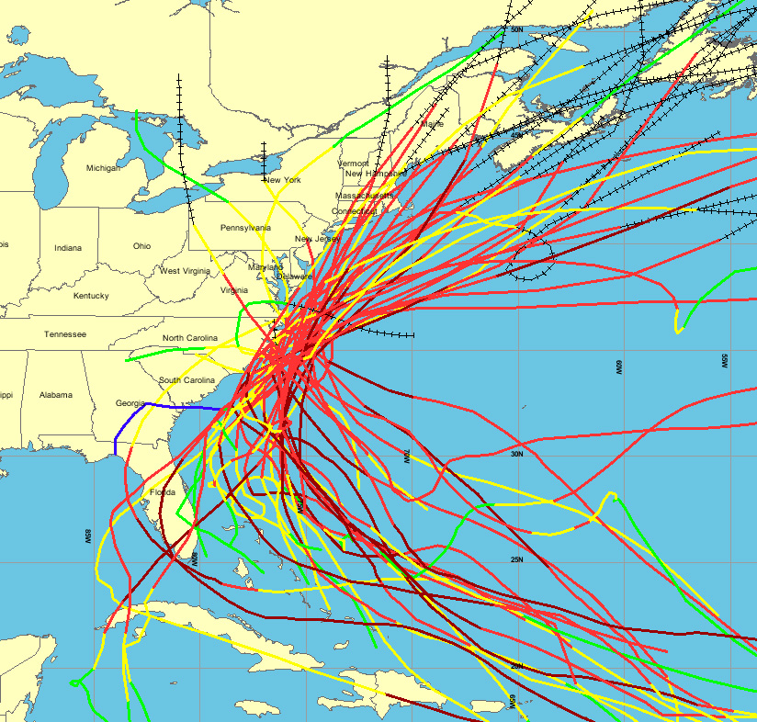
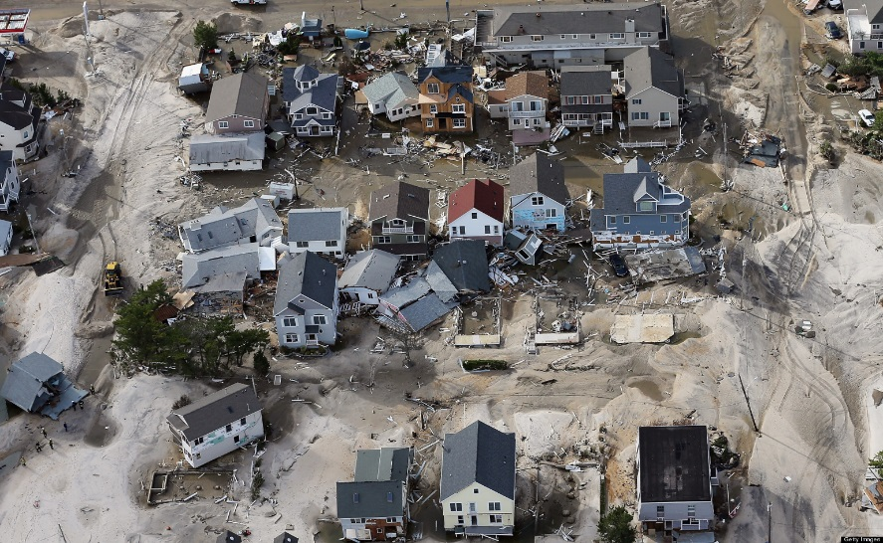
New Jersey Context
130 miles of coastline
Coastal storm threats
  Nor’easters
  Tropical cyclones

Slide 5
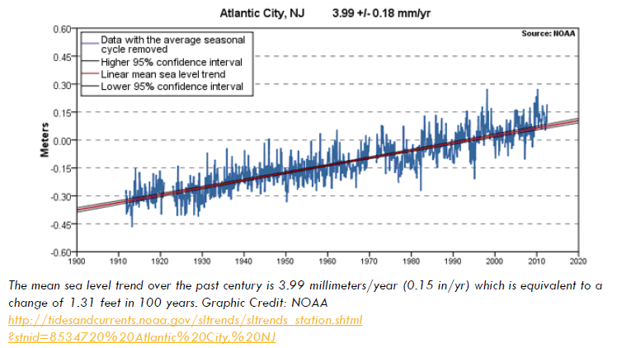
Sea-Level Rise

Slide 6
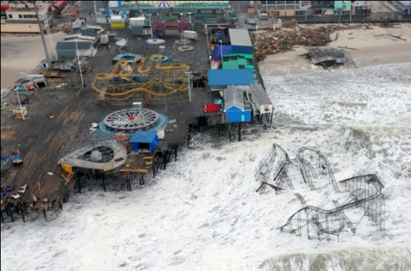
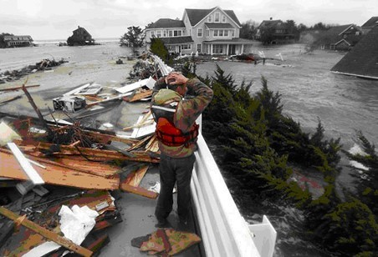
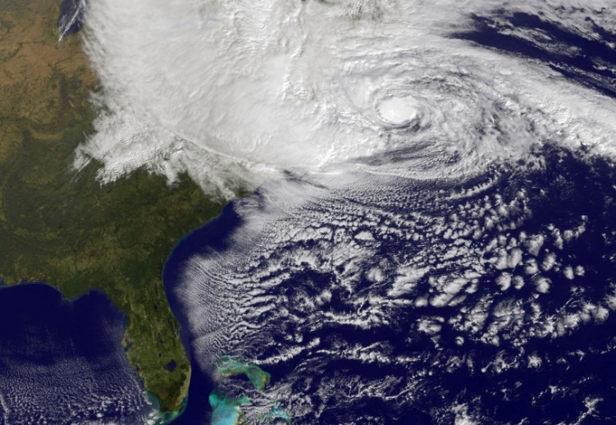
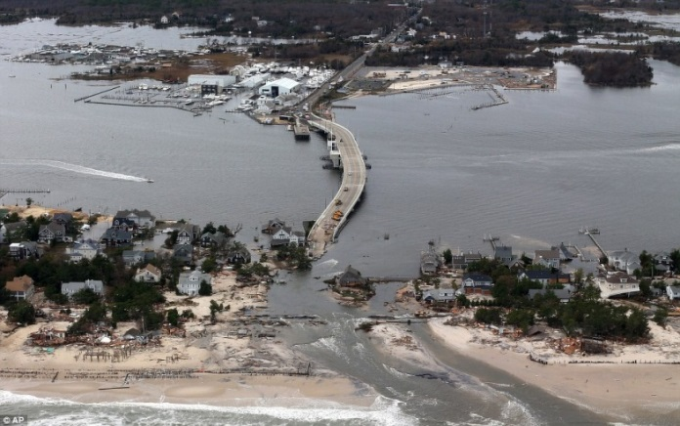
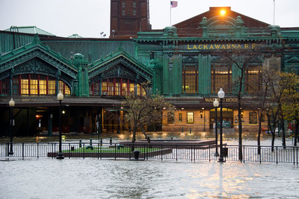
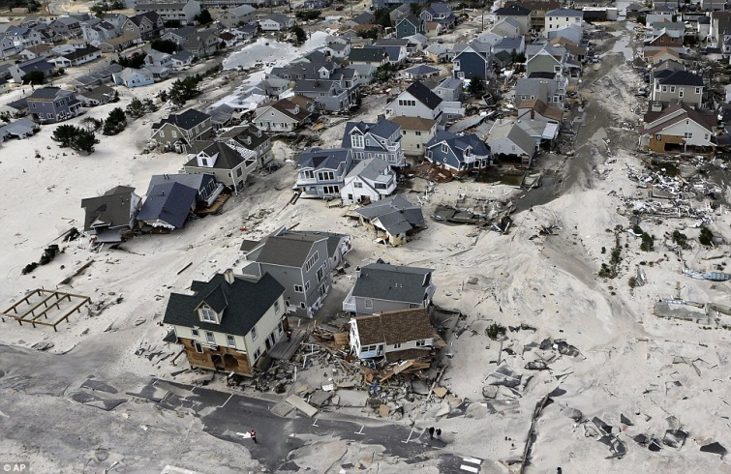
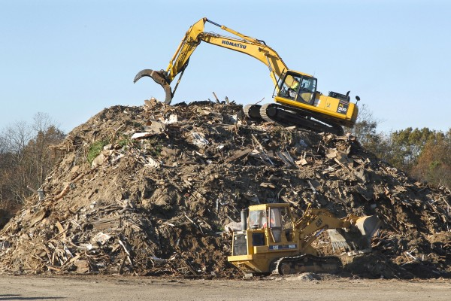

Sandy Impacts
Notes:
34 fatalities
72,000 homes and business damaged/destroyed
$36.8 billion in damage to property and infrastructure
Economic losses to business estimated to be +/- $30 billion
2.4 million households lost power
Major transportation infrastructure damage
780,000 + gallons of oil/fuel spilled
Millions of gallons of raw sewage discharged into rivers and bays

Slide 7
Pre-Project Screening
Improvements to Sanitary Sewer System (Highlands, NJ)
Wastewater Management Infrastructure Alternatives Feasibility Study (Cumberland County, NJ)
Community Rating System Adoption (multiple jurisdictions)
Resiliency Alternatives Analysis (Jersey City, NJ)
Mystic Island Voluntary Home Buyout (Little Egg Harbor, NJ)
Stormwater Management Plan Amendments (Hoboken, NJ)
Decision
Health Impacts
HIA adds Value

Slide 8




Assessing Health Outcomes of Post-Sandy Decision-making
Project Team:
Four Components:
  Conduct an HIA on voluntary buy-out scenarios for properties in a flood prone neighborhood (Mystic Island) in Little Egg Harbor, Ocean County, NJ
  Conduct an HIA on the development of a stormwater management plan to address chronic flooding in the City of Hoboken, Hudson County, NJ
  Develop a toolkit that municipalities can use to integrate HIA into local decision-making as part of the Sustainable Jersey™ certification process
  Develop overarching recommendations for how the practice of HIA can be integrated into post-disaster planning and decision-making in the United States

Slide 9
Community Planning Context
Hoboken and Mystic Island HIAs

Slide 10
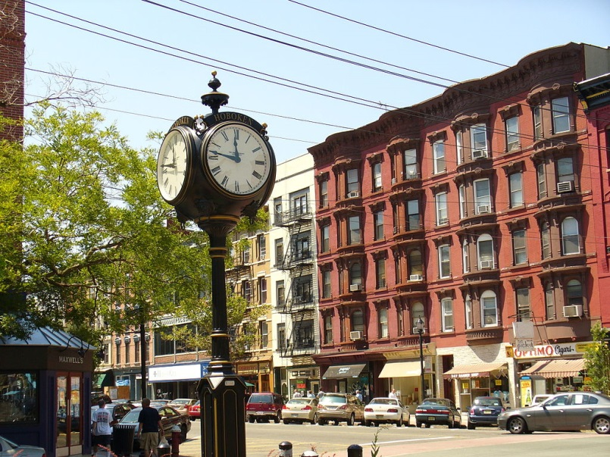
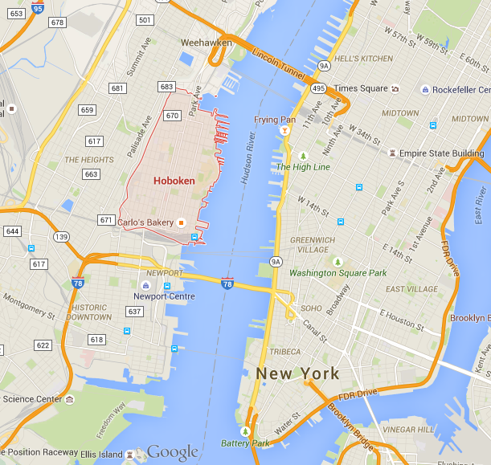
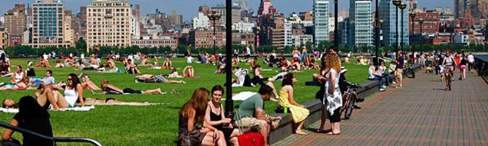
At-a-Glance
Hoboken
Originally settled in 1630
Population in 2013: 52,575
Land Area: 1.2 square miles
Located along the western bank of the Hudson River directly across from Manhattan, NY
As seen on TV: Home to Carlo’s Bake Shop
Notes:
The first officially recorded game of baseball took place in Hoboken in 1846 between Knickerbocker Club and New York Nine at Elysian Fields
Carlo’s Bake Shop calls Hoboken home..

Slide 11
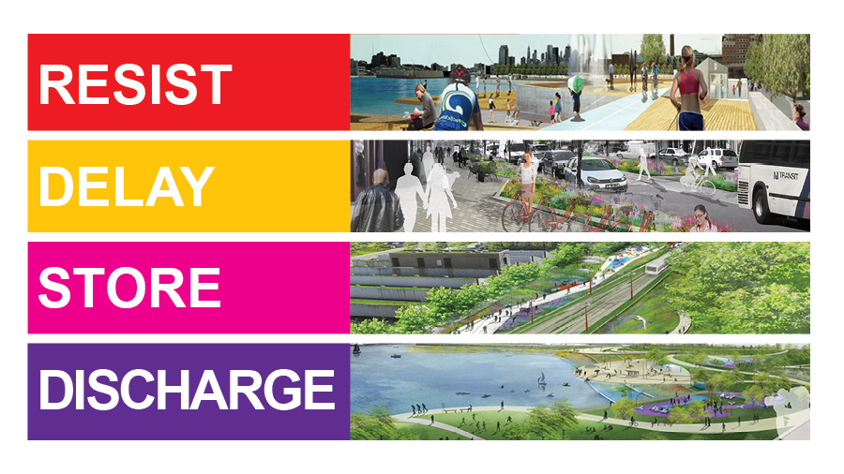
Post-Sandy Resiliency Planning: Long-Term Vision
HOBOKEN

Slide 12
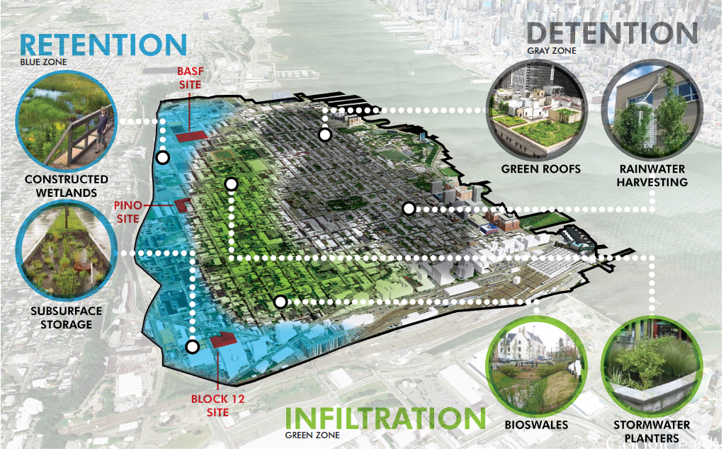
Green Infrastructure (GI) Strategic Plan
HOBOKEN

Slide 13
Proposed GI Strategies under Consideration
Hoboken
Constructed Wetlands
Permeable Pavements
Stormwater Tree Pits
Vegetated Swales
Rainwater Harvesting
Basins or Ponds
Rain gardens
Stormwater Infiltration Planters
Subsurface Storage
Green Roofs

Slide 14
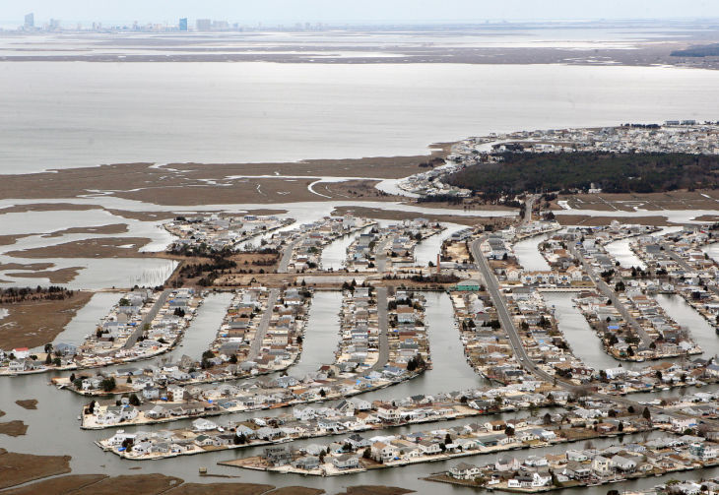
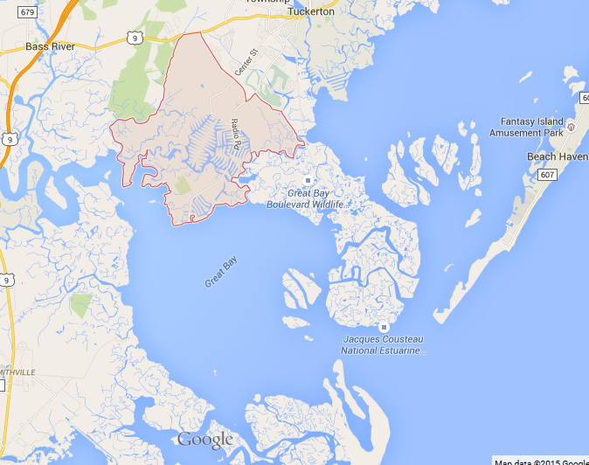
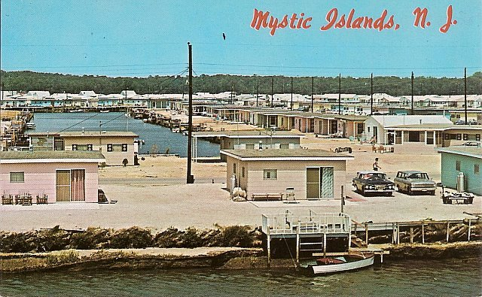
At-a-Glance
Mystic Island
Population in 2012: 8,164
Mostly waterfront community built in the 1960’s
Originally planned as a resort of vacation bungalows, now transitioning to larger homes
Part of Little Egg Harbor Twp., NJ

Slide 15
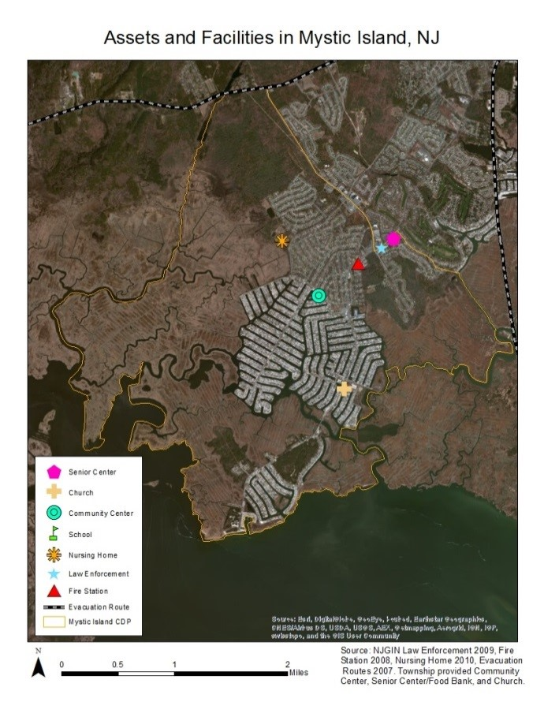
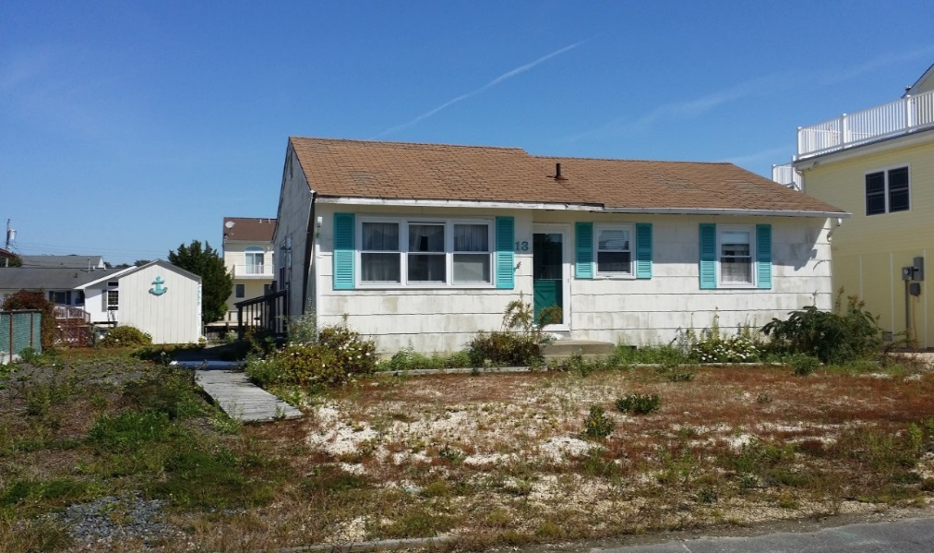
At-a-Glance (cont)
Mystic Island
Modest homes, many homes passed down through families
34% vacant (seasonal or abandoned)
Moderate income, little diversity
Employment tied to Atlantic City – downturn
Few community assets, isolated and vulnerable
Flood prone – routine and storm-related

Slide 16
Sandy Impacts and Future Challenges
Mystic Island
About 1,000 homes substantially damaged in Sandy.
Sandy was “different” – floatables and toxics
Lifting homes is expensive and problematic for elderly – creates additional vulnerabilities (emergency access, falling over, etc.)
Difficult to sell homes – falling prices even before storm
More routine flooding since Sandy – homes settled
Future - Dire predictions of sea-level rise and storm impact projections

Slide 17
Scoping Results
Hoboken and Mystic Island HIAs

Slide 18
Scope of the HIA
Mystic Island
Decision/Decision-maker: Support a voluntary residential buyout program? / Township Council and Mystic Island residents
Geography: Mystic Island / Egg Harbor Township (fiscal)
Focus: Residential buyout program to mitigate impacts of future inundation from storm surge and sea level rise
Program Alternatives:
    100 Property Voluntary Buyout
    500 Property Voluntary Buyout
Temporal Scope: Short-term (> 5 yrs.) / Long-term (up to 35 yrs.)
HIA Timeline: Sep 2014 – Aug 2015
Impacted populations & potentially vulnerable groups:
  Mystic Island property owners and residents
  Elderly and Disabled
  Lower income

Slide 19
Research Questions
Mystic Island
What are the mental and physical health impacts of voluntary buyout scenarios for the residents of Mystic Island?
Sub-questions related to health determinants:
What are the impacts related to flooding (routine due to SLR, storm events)?
What are the household economic impacts?
What are the municipal fiscal impacts?
What are the impacts to social fabric and cohesion?
What are the impacts related to open space?

Slide 20




Decision Scenario
Intermediate Effects
Health Outcomes
Determinants
Property Values
Cost s of Cleanup
Access to and Quality of Services
Town Fiscal Health
Tax Base
Cost of Services
Mental Well-Being
Loss of Population and Property
Social Fabric/Social Cohesion
Stress
Lifespan
Insurance
Buyout
Household Finances
Exposure to Green Space
Access to Open Space
Open Space
Physical Activity
Open Space
Vandalism /Crime
Obesity
Molds and Infestation
Sewage Backflow
Injuries/Drownings
Flood Damage - Routine
Fires
Flood Damage
Standing water and water damage
Flood Damage - Acute
Toxic Contamination
Costs of Cleanup and Renovation
Emergency Service Access
PTSD
Respiratory Irritation and Disease

Slide 21
Scope of the HIA
Hoboken
Decision/Decision-maker: Adoption of Stormwater Management Plan Amendments / Hoboken City Council
Geography: Entire city
Focus: Chronic repetitive flooding and associated CSO events
Temporal Scope: Long-term (20 + years)
HIA Timeline: Oct 2014 – Sept 2015
Impacted populations & potentially vulnerable groups:
  Residents (in general/women in particular)
  Older adults
  Low income individuals/families
  Undocumented residents
  Populations with Limited English Proficiency
  Renters
  First responders

Slide 22
HIA Goals
Hoboken
Understand better the health impacts of chronic flooding and CSO events in Hoboken
Understand better the potential health risks and benefits of stormwater management and flood mitigation strategies under consideration
Identify the distribution of health impacts to assess potential inequities in terms of how heath risks and benefits accrue
Identify opportunities to maximize benefits and minimize risks of flood reduction and green infrastructure implementation
Engage with City officials regarding HIA
Connect housing authority residents with resiliency planning efforts
Inform broader context of existing efforts related to hazard mitigation and resiliency planning
Identify opportunities to transfer knowledge and lessons learned to other jurisdictions

Slide 23
Potential Health Pathways & Determinants of Flooding
Hoboken
Death/Injury
Damage to residences/Loss of power
Exposure to environmental hazards (mold, HH hazardous waste) other contaminants during and after storm
Sewer back-ups in streets and basements
  Exposure to untreated sewage
Loss of mobility, wages and access to needed services
Depression, Anxiety, Alcohol/substance abuse
Potential Health Pathways & Determinants of GI
Reduced flooding
Addition of natural features and green space

Slide 24
Stakeholder Engagement
Hoboken
Mystic Island/LEH
HIA Advisory Committee (4-6 meetings)
Structured interviews
Resident focus groups
  Seniors
  Housing Authority Residents
  Social Service Providers (LEP population)
Community-wide resident survey
Pop-up Kiosk @ Shop Rite
Public open house
HIA Advisory Committee (4-6 meetings)
Key informant interviews (on-going)
Roundtable discussions
  Residents
  Local service orgs.
Community-wide resident survey

Slide 25
Baseline Conditions
Hoboken and Mystic Island HIAs

Slide 26
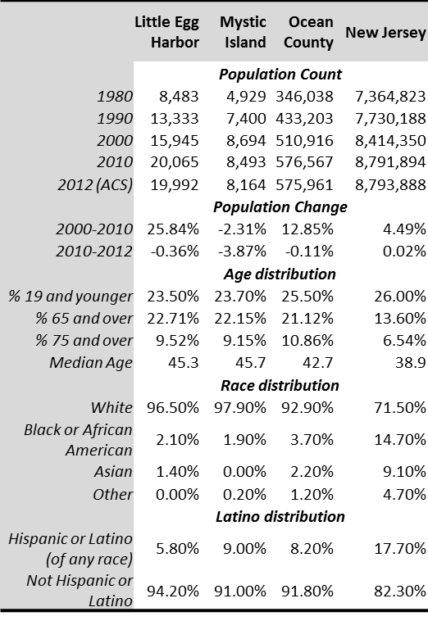
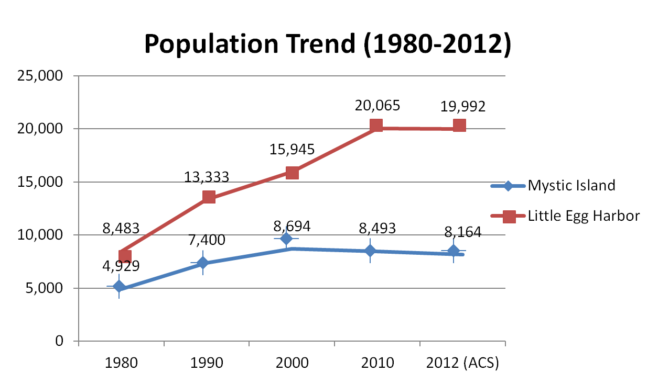
Demographics
Mystic Island

Slide 27
Baseline Health Status
Mystic Island
Ocean County, NJ:
  Higher obesity
  Less access to recreation (10% below state)
  Higher heart disease
  More smoking and drug use (treatment admissions)
Self-reported from Survey (LEH residents):
  Heart disease 3% higher than County
  Asthma 6% higher than County
  Depression at 31% (18% higher than County)

Slide 28
Focus Groups and Interviews
Mystic Island
Mental Health and Substance Abuse
  From Displacement, Financial Loss, Uncertainty and Despair
  Refuge in drugs and alcohol, domestic abuse
Health and Physical Impact
  Injuries
  Respiratory problems - Chronic exposure to mold and health hazards
  Poor nutrition
Environmental Health/Economic Impact
  Crime (looting)
  Compounds existing economic downturn
  Physical damage - Getting help to rebuild (complexity of programs)
  Toxics in flood waters (solvents, propane tanks, car batteries, etc.)

Slide 29
Survey: Stresses and Concerns
Mystic Island
“Want to move – hate it now”
“Crappy town but nice home site…full of drugs…has gotten worse in 16 years..can’t even pave a street for my kids to ride bike”
“Anxiety similar to 9/11”
“It is taking so long to recover, I would hate to see it again.”

Slide 30
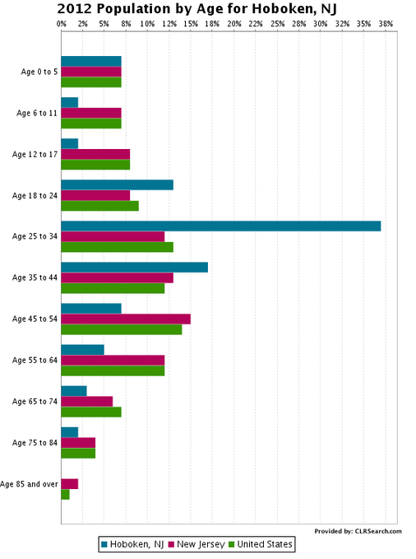
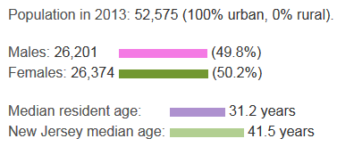
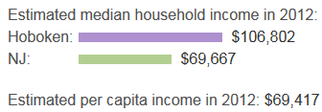
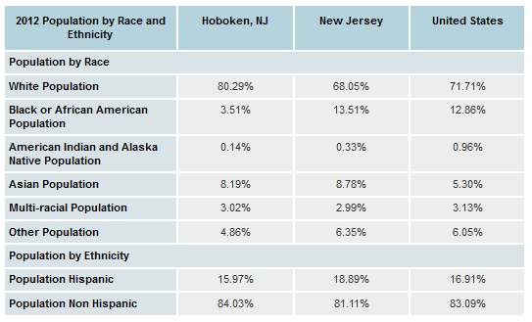
Demographics
Hoboken

Slide 31
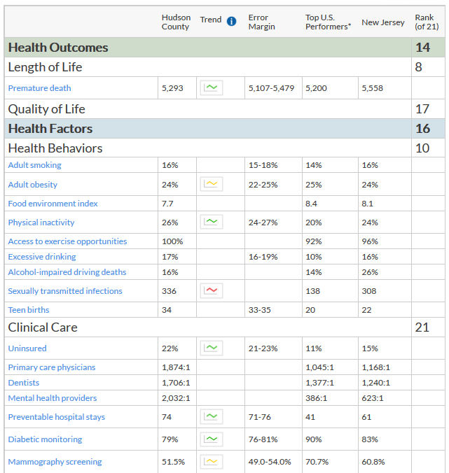
Baseline
Health
Status
Hoboken
http://www.countyhealthrankings.org/app/new-jersey/2015/rankings/hudson/county/outcomes/overall/snapshot

Slide 32
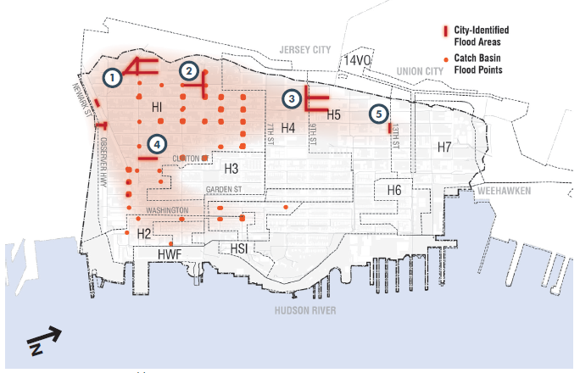
Stormwater Management Problem Areas
Hoboken

Slide 33
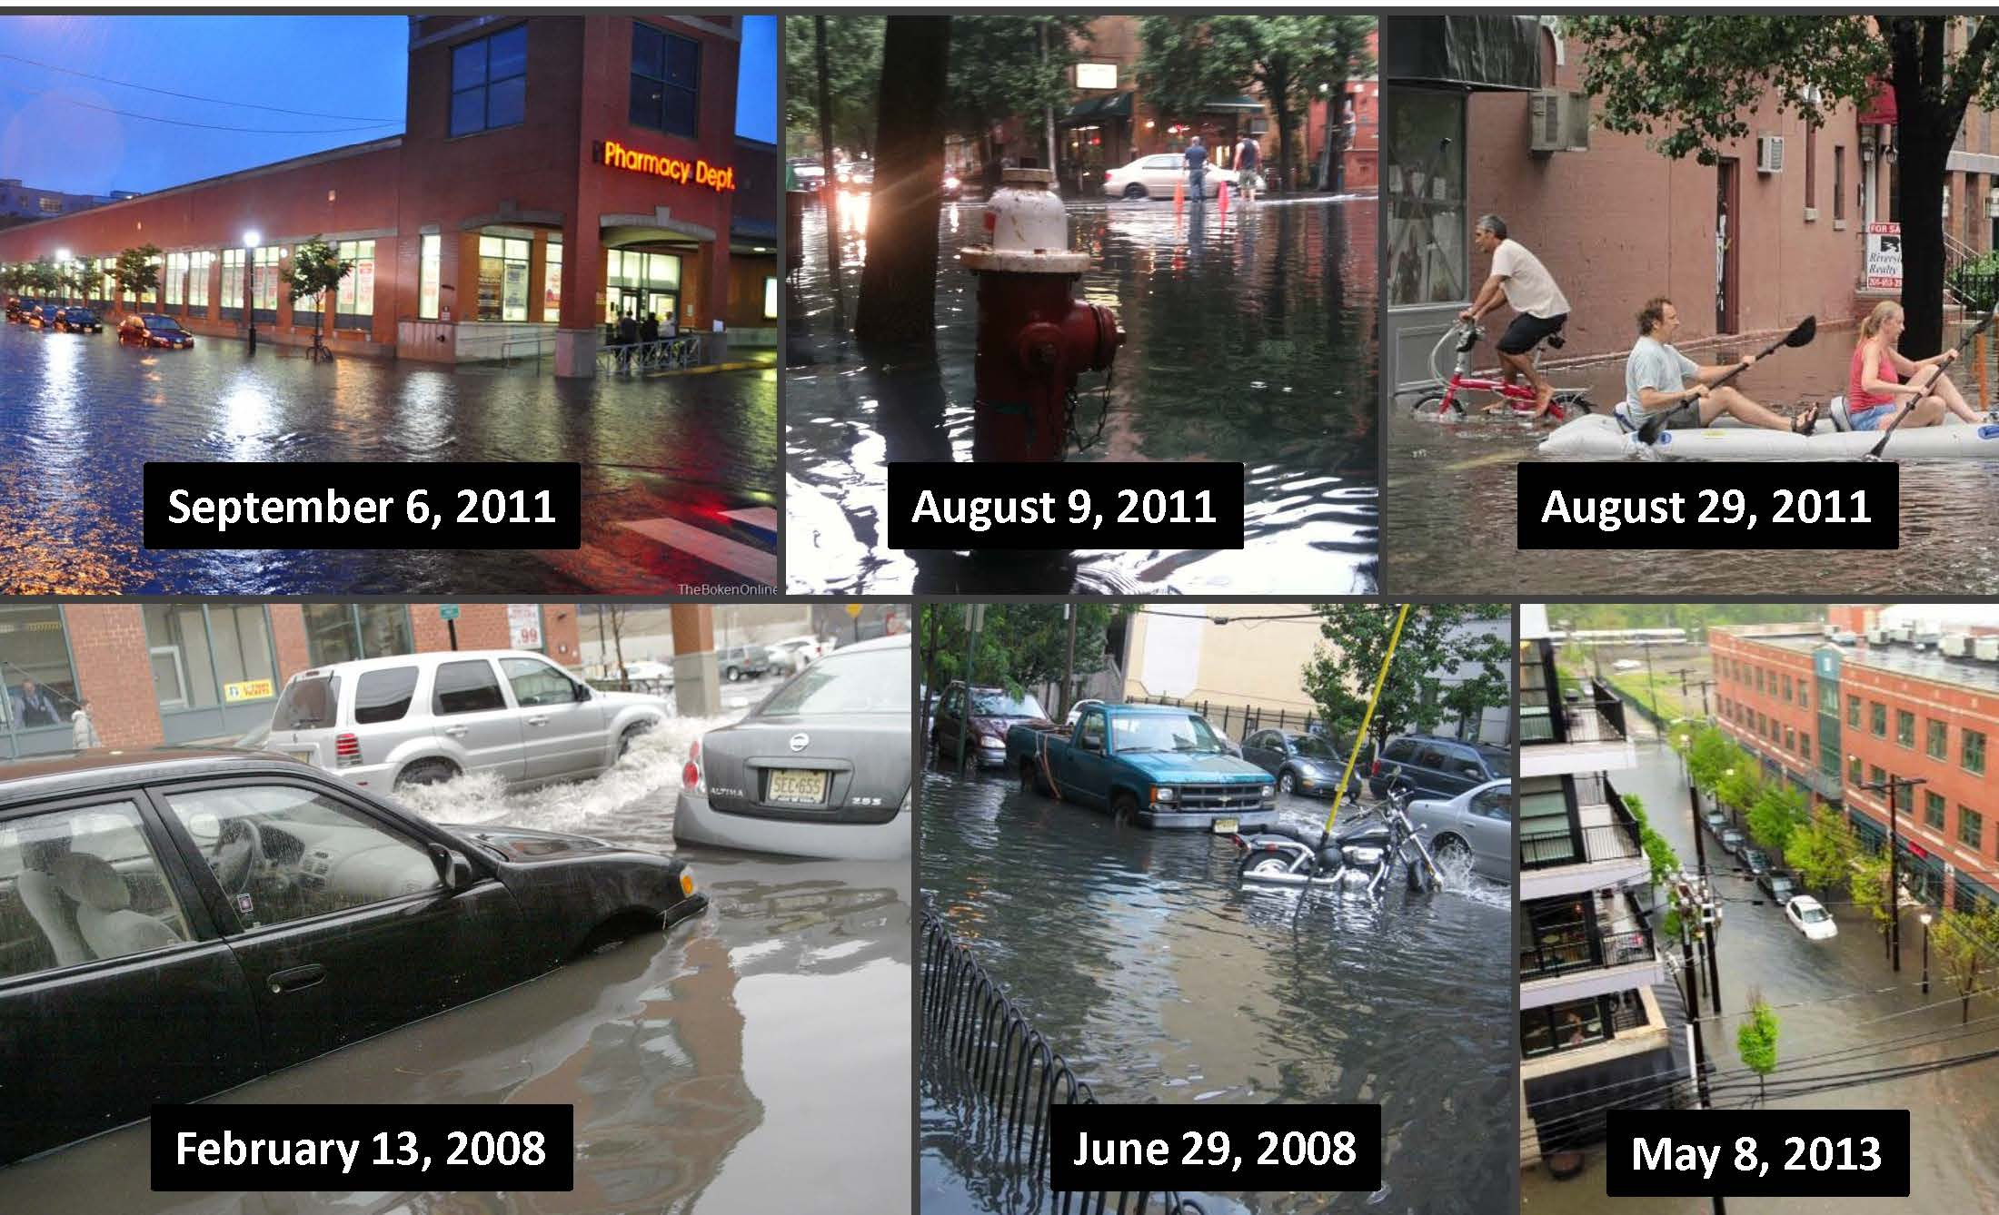
Hoboken Floods Regularly
Hoboken

Slide 34
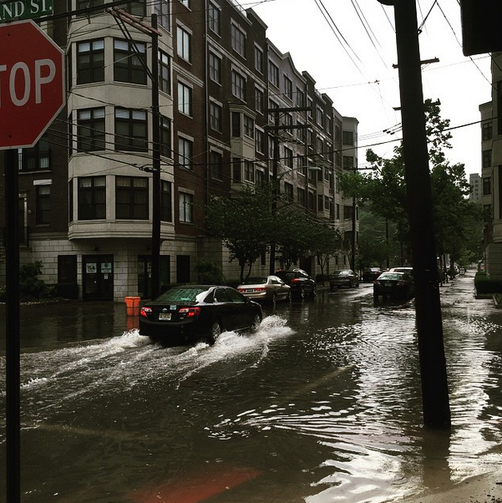
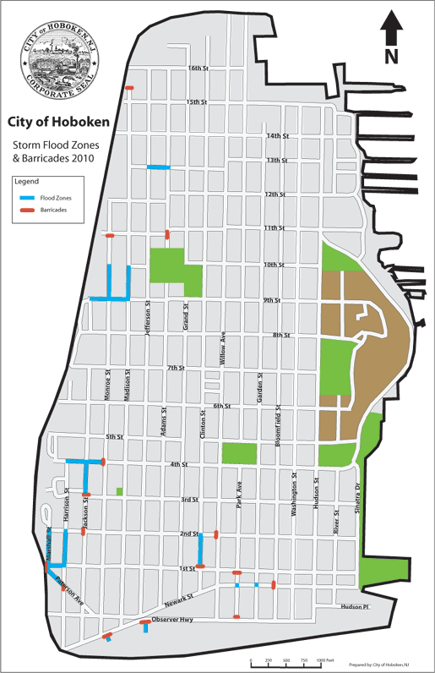
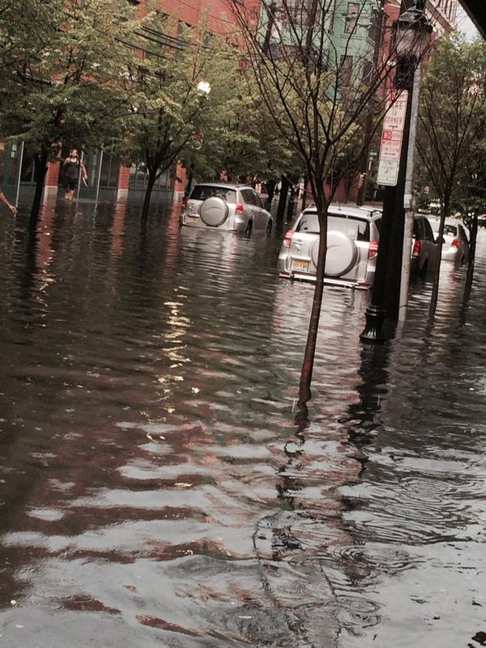
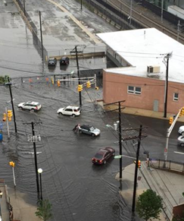
Most Recent Flooding: May 31, 2015
Hoboken

Slide 35
Precipitation and Flooding by the Numbers
Hoboken
Average rainfall: 50 inches/year
Between 2002 and 2012 the city recorded 26 dates with greater than 2 inches of rain and tides 4 feet or higher
Frequent Combined Sewer Overflow Events - estimated 5x/month on average, 18.5 m cubic ft. of effluent discharged/yr.

Slide 36
Preliminary Assessment results
Hoboken and Mystic Island HIAs

Slide 37
Potential Benefits of Green Infrastructure
HOBOKEN

Slide 38
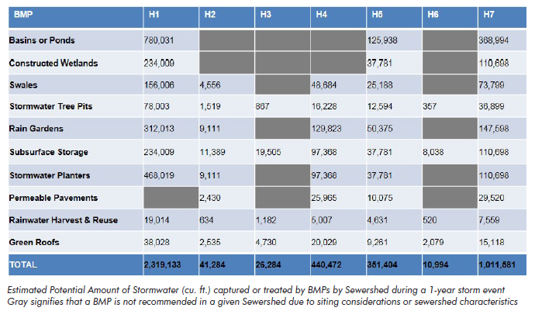
Potential stormwater runoff reduction from GI
HOBOKEN

Slide 39
Potential Health Impacts of GI
HOBOKEN
Green Infrastructure
Reduce Run-off/ Flow Rates
Reduces Flood Events & CSO Impacts
Increase in Health
-Constructed Wetlands
Increase in Pollution Retention
Increase in Bio-magnification
Decrease in Health:
-Nervous System Failure
-Behavioral issues
-Mental Health
-Tree Pits
-Swales
-Raingardens
-Infiltration Planters
Increase Soil Pollution
Increase Pollution Exposure from Soil
Decrease in Health:
-Nervous System Failure
-Behavioral issues
-Mental Health
-Tree Pits
-Infiltration Planters
-Rain Gardens
Increase Vegetation Damage
Decrease Safety
Decrease in health Prevention

Slide 40
Remaining Activities (Jun - Dec 2015)
HOBOKEN
Complete resident survey/Analyze data
  Experience with Flooding
  Impacts of flooding and CSO events
  Current health status
Characterize anticipated health effects
  Reduced flooding and Combined Sewer Overflows
  Co-benefits and risks associated with green infrastructure solutions
Evaluate the evidence and certainty of predicted effects
Develop recommendations
Convene advisory committee (2-3 remaining meetings)
Conduct public open house
Prepare final HIA report
Process, impact and outcome evaluation

Slide 41
Flooding
Mystic Island
Buyouts should reduce severity of routine and severe flooding
  Flooding produces severe mental health impacts
  Seniors are particularly vulnerable
  Physical health hazards will be reduced
Household Finances
Buyouts should improve household finances
  Reduce necessity of recovery programs
  Navigating assistance programs is harder for lower income, less-educated individuals.
  Negligible impact on taxes
  Need fair price for buyout candidates

Slide 42
Municipal Finance
Mystic Island
Buyouts should have long-term positive effect
Variables are cost of maintaining new space and property value enhancements
Social Cohesion
Reduction in abandoned homes will improve neighborhood quality
Recreation space can be gathering spot and spur local business.

Slide 43
Open Space
Mystic Island
Very positive health impacts for physical fitness and reduction of disease
Positive mental health impacts
Benefits lower income people who have limited access to private clubs
Open Space – Community Input
75% likely to use the space
Need to be able to do something there
  Preferred activities: Playground, swimming area, Park with workout equipment, Dog-walking area
Concerned about “Trash people” and “increased taxes for upkeep”

Slide 44
Possible Recommendations
Mystic Island
Use of buyout space is important – needs to benefit the community
Consider creative way to cover cost of bulkhead and maintenance of passive recreation
Social services, particularly access to mental health services, should be improved as a complement to buyout program.
Consider vulnerable populations in pre-disaster planning - duty of care and responsibility of health agencies post-event

Slide 45
Remaining Activities (Jun - Aug 2015)
Mystic Island
Complete resident survey/Analyze data
Complete Fiscal Impact Assessment
Evaluate the evidence and certainty of predicted effects
Finalize recommendations
Convene advisory committee (2 remaining meetings)
Prepare final HIA report and present to Council and public
Process, impact and outcome evaluation

Slide 46


Slide 47
Contact information:
Jon Carnegie, AICP/PP
Alan M. Voorhees Transportation Center
Bloustein School of Planning and Public Policy
Rutgers, The State University of New Jersey
Tel: (848) 932-2840
Email: carnegie@rutgers.edu
Karen Lowrie, Ph.D.
Env. Analysis & Communications Group
Bloustein School of Planning and Public Policy
Rutgers, The State University of New Jersey
Tel: (848) 932-2780
Email: klowrie@rci.rutgers.edu

