Slide 1
Lessons Learned from an HIA of HUD’s Designated Housing Rule-Making
June 16, 2015
10:45 – 11:45 a.m.

Slide 2
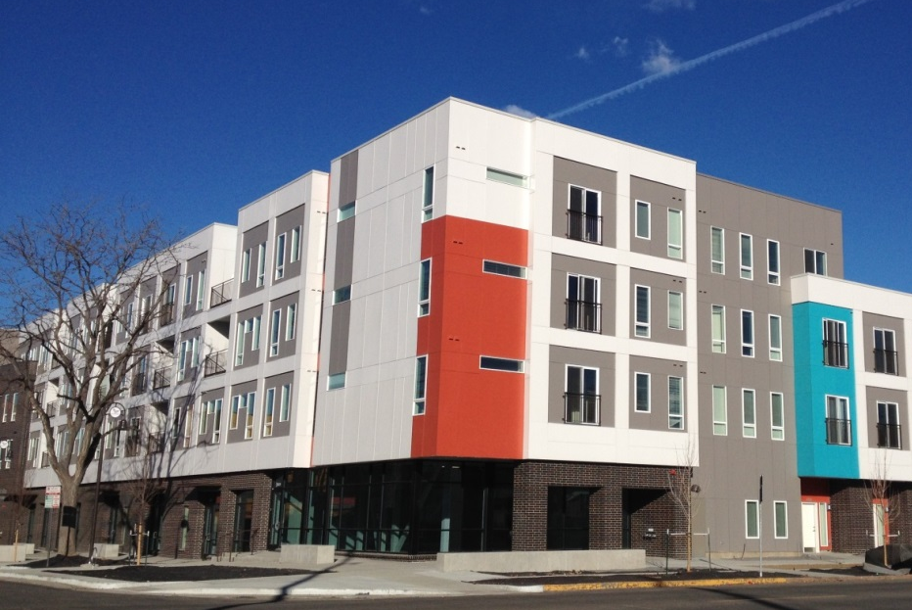
Public Housing Program Basics
1.2 million units administered locally by 3,300 public housing authorities (PHAs)
Assists 1.1 million households with over 2.3 million people
Senior families (head or spouse ≥ 62) represent 31%
Younger disabled families (head or spouse < 62 with a disability) represent 21%

Slide 3
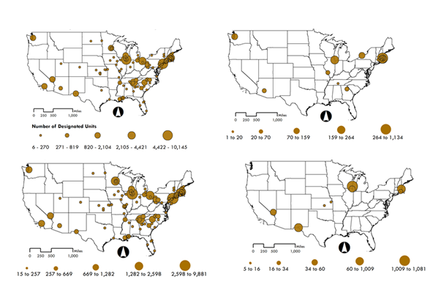
Designated Housing Rule
Total Designated Units
Disabled
Senior
Mixed
Notes:
Gives PHAs the option to designate public housing properties, or a portion of them, for occupancy by senior families, disabled families, or a mix of senior and disabled families
PHAs submit designated housing plans to HUD
New plans in place for 5 years; renewals in 2 year increments
One hundred twenty-eight PHAs in 37 states and the U.S. Virgin Islands have an approved plan to designate housing for seniors or people with disabilities.
These plans cover 63,806 units—less than 6 percent of all public housing nationwide—of which approximately 91 percent are designated for senior families, 4 percent are designated for disabled families, and 5 percent are designated for a mixed population.
The majority (96 percent) of designated units are one bedroom or studio apartments. Urban PHAs that own or manage a large number of units are more likely to use the designated housing rule than those in rural areas and those with fewer units.
Designated housing is located across the country and is concentrated in large metropolitan areas. PHAs that designate housing for disabled families or mixed populations are located primarily on the East Coast and in the Chicago region.

Slide 4
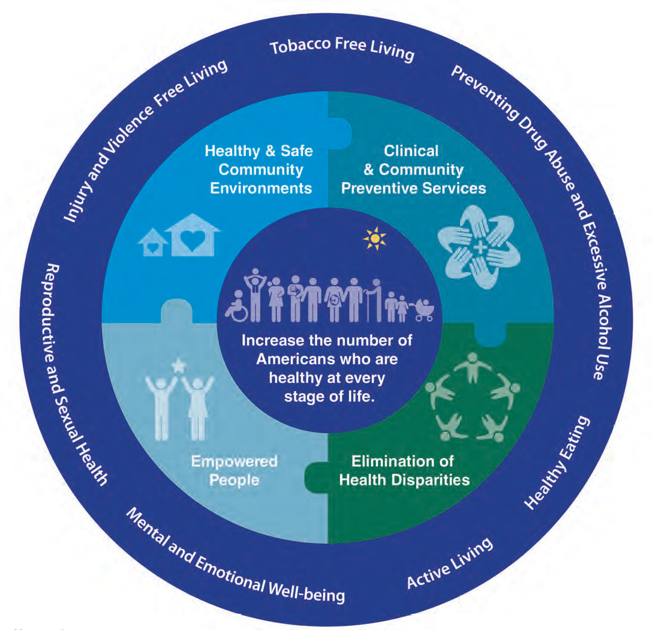
Demonstrating HIA as a Tool to Advance the National Prevention Council’s Goals

Slide 5
HIA Project Team and Advisory Committee
Team Advisory Committee
AARP
Corporation for Supportive Housing
Council of Large Public Housing Authorities
Enterprise Community Partners
National Alliance on Mental Illness / Consortium for Citizens with Disabilities Housing Task Force
National Alliance to End Homelessness
National Center for Healthy Housing
National Fair Housing Alliance
National Low Income Housing Coalition
Public Housing Authorities Directors Association
Technical Assistance Collaborative

Slide 6
Methods and Approach
Scenarios
Examined two scenarios HUD could pursue, developed in consultation with stakeholders
Systematic literature review
Reviewed more than 350 reports, peer-reviewed articles, conference papers, books, and other resources
Quantitative analysis
Behavioral Risk Factor Surveillance System, Comprehensive Housing Affordability Strategy, Resident Characteristics Report, Designated Housing Status Report
Qualitative analysis
Conducted focus groups and interviews with 147 senior and disabled public housing residents and 135 staff members and community partners at case study sites

Slide 7
Key Findings
If the rule-making process does not result in changes to the average number of units designated, as many as 16,185 units would be newly designated for seniors over the next five years, compared with 340 or fewer allocated to younger people with disabilities.
If the rule-making improves collaboration with those addressing fair housing and homelessness, access by younger people with disabilities and frail seniors to public housing units and therefore to more housing choices could increase.
If the rule-making promotes alignment of affordable housing and health resources, more senior and disabled families could gain access to supportive services that benefit health.

Slide 8
Key Findings
Residents expressed differing preferences about living in public housing designated for seniors only as opposed to public housing designated for mixed populations.
Residents expressed concerns about the accessibility of their units and of the development as a whole and how it affected their health and safety.
Mixed and disabled properties may be more likely to be located in neighborhoods with a greater share of racial or ethnic minority residents, higher poverty rates, and fewer opportunities for employment compared with senior-only properties.

Slide 9
Stakeholder Perspectives
…if there are going to be too many senior-only buildings, then that would not be a good thing for people that are younger and disabled. Because we need the housing just as much as the older people do.
“[Senior-only housing is] nice and quiet. It's nice to have those people around, basically, your same age, the same interests, or grew up, probably, in the same era that you did to share things with.”
—Younger resident with disabilities
—Senior resident
“And you could argue, well, could you not increase your younger disabled population if you had more services? And I would say that if we had services that were paid for and in place for a period of time—I'm not talking about someone getting a one-off grant—you could have that conversation…But that would assume that on the health side, everything is fixed and in place and funded.”
—PHA leader

Slide 10
Priority Recommendations
Expand efforts to use housing as a platform for supportive services
Promote fair housing initiatives to support choice in integrated community living
Improve data availability and accuracy
Equip PHAs with data to inform strategies and actions to improve neighborhood resources
These recommendations could be used more broadly to support the health of more than 1.6 million senior and disabled families that PHAs assist through the public housing and voucher programs

Slide 11
Shauna Sorrells
U.S. Department of Housing
and Urban Development

Slide 12
HUD’s Interest In HIA
HUD’s mission is to create strong, sustainable, inclusive communities and quality affordable homes for all
A member of the National Prevention Council
A multi-agency federal panel
Works to improve the health of all Americans
Chose to test the value of the HIA as a tool to advance the council’s goals using the designated housing rulemaking process

Slide 13
HUD Making Health A Priority
HUD’s mission includes utilizing housing as a platform for improving quality of life and building inclusive and sustainable communities free from discrimination
HUD assists nearly 5 millions low-income households, these households have higher rates of physical, mental and behavioral issues than the general population
 | Overweight | Diabetes
U.S. Population | 65% | 10%
Low-income Seniors | 66% | 25%
Low-income Disabled persons | 72% | 27%

Slide 14
Added Value of the HIA
A better understanding of how housing intersects with health
Six important factors:
1. Affordability
2. Discrimination and Choice
3. Housing as a Platform for Supportive Services
4. Social Environments
5. Housing Infrastructure
6. Neighborhood Characteristics

Slide 15
Ann O’Hara
Technical Assistance
Collaborative, Inc.

Slide 16
TAC/CCD/Melville
TAC: National non-profit consulting and technical assistance firm
Mission includes expanding affordable and permanent supportive housing for lowest income people with disabilities
Consortium for Citizens with Disabilities: Washington DC based coalition of 90+ disability groups.
Advocacy with administration and Congress
Melville Charitable Trust: Supports TAC/CCD Housing Task Force policy/advocacy

Slide 17
TAC/CCD and Designated Housing Policy
Issue: Equity of scarce HUD resources
Legislation in 1992 and 1996
Rule-making in 1994
HUD guidance
Research/monitoring re/loss of housing opportunity
Section 504 complaint against HUD in 1999
Congress: 60,000+ new Housing Choice Vouchers for PWD adversely affected by designation + Section 811 reforms

Slide 18
HIA and Designated Housing
Comprehensive data-driven/information collection process involving key stakeholders
Increasing scarcity of HUD resources
High priority needs
Homelessness
Olmstead/institutionalization/segregation
Correlation between housing and health
Using housing as a platform for health
Best practices/cross-sector collaboration
Potential for significant savings in other systems

Slide 19
Comments/Recommendations
Implementation challenges
Not a high priority
HUD/HHS collaboration barriers
PHA and provider capacity
Resource issues
Recommendations
Continuing role for philanthropy
Improve federal agency collaboration re/barriers
Compelling data on cost savings
OMB scoring
Making the case with Congress!

Slide 20
Proposed HIA/HUD Scenarios
Clarify HUD policies re/designated housing rule interface with other HUD financing policies
Encourage cross-sector collaboration and coordination of resources to address fair housing (e.g. Olmstead) and homelessness

Slide 21
Contact Us
Technical Assistance Collaborative, Inc. – TAC
@TACIncBoston
Visit us on the web:
www.tacinc.org

Slide 22
Acknowledgements
Project Team
Marjory Givens
Keshia Pollack
Aaron Wernham
Amber Lenhart
Steve White
Karli Thorstenson
Barry Keppard
Mariana Arcaya
Peter James
Noemie Sportiche
Rachel Banay
Funders
Robert Wood Johnson Foundation
The Pew Charitable Trusts
Key Partners
HUD’s Office of Public and Indian Housing
Centers for Disease Control and Prevention
National Prevention Council
Advisory Committee Members
PHA Case Study Sites
National Network of Public Health Institutes
Contact: rlindberg@pewtrusts.org

