Slide 1
BUILDING HEALTHY SCHOOLS An HIA on Planning School Construction Projects in Minnesota
Susan Weisman JD
Public Health Law Center
2015 National HIA Meeting
June 16-18, 2015

Slide 2
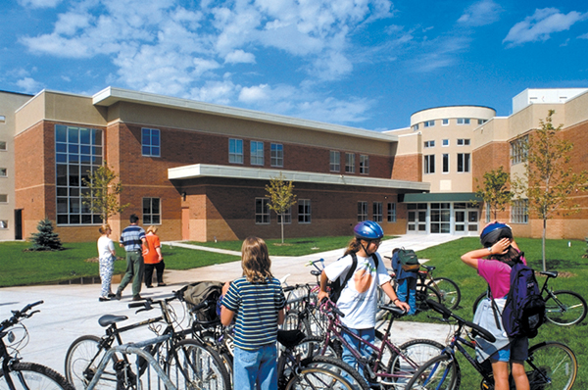
Impetus: Advancing health equity goals in school siting & design
Schools should be located in “. . . environments that contribute to the livability, sustainability, and public health of neighborhoods and communities.”
(EPA, 2011)
“To create a Minnesota where all children, families, and communities have the opportunity to lead healthy lives.” (Minnesota Healthy Kids Coalition, 2015)

Slide 3
HIA Goals
Assess Guide’s content, staying true to its purpose
Study potential benefits from consideration of health impacts:
Student health
Academic achievement
School/community partnerships
Social cohesion
Encourage revisions: Update and add guidance
Expand stakeholder participation
Encourage local school districts to use recommendations

Slide 4
Project Timeline
Fall 2013
Fall 2014
Initial data gathering; workplan refinement
Administrative start-up & national conference/training
Data gathering – stakeholder surveys; case studies
Recommendations; Reporting
Monthly steering committee meetings: scoping; development of research questions; assessment
Literature search
Completion of case studies – site visits; focus groups
Winter - Summer 2014
Recruitment of steering committee
Planning for local HIA training conference
Data analysis – secondary data analysis (MN Student Survey, SRTS data, MDE and MDH data
Completion of data collection and assessment
Monthly steering committee meetings
Report writing; Process evaluation. Report released 2/15.
ONGOING: Dissemination; Monitoring; Evaluation

Slide 5
HIA Participants
Core team: Public Health Law Center & Wilder Research
External advisors & technical assistance
15+ Steering Committee – monthly/bimonthly meetings
School administrator/elementary school principal
Department of Education school finance and program staff
Transportation planners
Facility planners
Architects
School nutrition services director
Local public health director & state association leader (LPHA)
Department of Health physical activity coordinator
HIA experts and other health equity experts
Non-profit leader (YMCA)

Slide 6
Scope & Research Questions
Food Environment: How would revisions …
Affect or increase the number of schools that promote healthy eating through design?
Affect and/or increase the number of school districts that consider healthy eating policies and practices when making school construction decisions?
Transportation Access & Joint Use: How would revisions …
Affect the type, quantity and quality of physical infrastructure at schools and how schools are incorporated into a community’s existing infrastructure or built environment?
Affect the proximity of schools to homes?
Physical Activity: How would revisions …
Affect and/or increase the number of indoor and outdoor spaces designed to support and encourage physical activity?

Slide 7
Methods
Literature review
Minnesota Student Survey data –
Student Health Index
SRTS parent survey data
Principal survey
Superintendent survey
School food service staff survey
Key informant interviews - principals
Case studies of two schools – one urban, one rural
Parent focus groups

Slide 8
Anticipated Reach
Schools are uniquely positioned to foster healthy behaviors
Aging school buildings in MN – American Society of Civil Engineers estimates $3.7 billion in infrastructure needs:
But only about 15 new construction and 25 renovation projects per year
Lack of funds limits the number of projects per year despite a growing need for improvements to facilities
Funding formulas need to be changed to achieve equitable distribution of resources
Without this, revisions could promote change in wealthier areas & widen gaps

Slide 9
Recommended Changes and Anticipated Impacts: FOOD ENVIRONMENT
Add guidance for preparing school meals and snacks from scratch, using fresh ingredients
50% storage/50% food preparation
Include examples of designs that increase the availability and consumption of healthy foods & maximize time for eating and socializing
One line per 100 students served/lunch
Display fruits & veggies prominently before entrees
Include space/design options for secondary schools that encourage students to move among a variety of food stations to enable choices
Include specifications for a salad/fruit & veggie bar
IMPACTS
Increased consumption of fresh fruit and veggies
Increased participation in school meal programs
Fewer absences
Increased attentiveness

Slide 10
Recommended Changes and Anticipated Impacts: Transportation Access, Shared Use
Remove minimum acreage text & encourage adequacy of spaces for outdoor play, student arrival/departure, shared use
Revise guidance to maximize the number of students who live within “walk/bike” zone
Re-define “center of community” to mean a location near a current/anticipated geographic center of population growth
Recommend conducting a walking/bikeability assessment when considering a new school site
Support options for co-locating facilities
IMPACTS
Increased physical activity
Improved classroom attention, performance

Slide 11
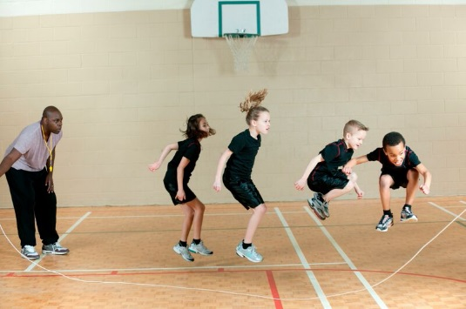
Recommended Changes and Anticipated Impacts: PHYSICAL ACTIVITY
Athletic facilities: Adjust square footage guidance to reflect capacity needs during school day (# of teaching stations per square footage per # of students)
Separately, address needs for sports teams, out-of-school time, and opportunities to expand community recreational use through shared use agreements
Active classrooms: Include guidance that supports active classrooms
Furniture
Configurable spaces
Flooring and acoustical materials
School grounds: Include guidance for natural
landscapes, green spaces, structured recess,
outdoor education
IMPACTS
Increased physical activity
Improved attentiveness and academics
Improved mental health & wellness

Slide 12
Project Impact: Early indicators
Engaged a broad group of influential stakeholders
All but one expressed an intention to use the HIA report to inform their work
Bring information to coalition or other meetings to advocate for changes in school construction and siting that support student health
Share within their professional organizations and agencies to generate dialogue, inform technical assistance and embed in training
Post report as a resource and encourage direct use in school districts
Sparked interest in nurturing policy champions on these issues
Identified data gaps that may inform future data collection
Raised awareness about using HIAs to inform educational decisions
Opened door to dialogue about incremental steps applicable to all schools
Increased partners’ capacity to conduct and/or collaborate on HIAs

Slide 13
Challenges & Lessons Learned
Conducting a complex, outside-the-box HIA in a sector that is relatively new to HIAs, and as our first HIA project, proved to be a formidable challenge
Steep learning curve
Meeting diverse group of stakeholders where they are
Engaging stakeholders across multiple sectors takes time & finesse to build trust and work toward/achieve consensus
With many different priorities and needs represented, need to be prepared for potential resistance or different stages of readiness to engage
Need to build institutional knowledge and support for commitment to HIA process within the key agency with decision-making power
A strong dissemination strategy is critical to HIA’s success
Actively engage steering committee in dissemination steps
Try to mesh dissemination strategy with agency priorities (win/win)

Slide 14
Technical Assistance
Arielle McInnis-Simoncelli
Celia Harris
This project was supported by a grant from The Health Impact Project, a collaboration between The Pew Charitable Trusts and the Robert Wood Johnson Foundation, with additional funds provided by Blue Cross and Blue Shield of Minnesota Foundation.

Slide 15
THANK YOU!
Susan Weisman JD
Scott Kelly JD (Sept. 2013-June 2014)
Eamon Flynn MPH (Sept. – Dec. 2014)
Melanie Ferris MPH
Download the Report: http://publichealthlawcenter.org/buildinghealthyschools
For information: susan.weisman@wmitchell.edu
Ph. 651-290-7516

