Slide 1
Health Impact Assessment:
A tool to integrate health considerations into planning decisions
Aaron Wernham, M.D., M.S.
Director | The Health Impact Project
901 E Street, NW, Washington, D.C. 2004
p: 202.540.6346
e: awernham@pewtrusts.org
www.healthimpactproject.org

Slide 2
World Health Organization
Ottawa Charter for Health Promotion
Ottawa, 1986
The Prerequisites and prospects for health cannot be ensured by the health sector alone. More importantly, health promotion demands coordinated action by all concerned: by governments, by health and other social and economic sectors, by nongovernmental and voluntary organization, by local authorities, by industry, and by the media.

Slide 3

  The public’s health
  10 % “health” care
  30 % genetics
  5 -25% “environmental factors”
  15 % social circumstances
  40 % “modifiable” behavior:
  Diet, but…
Exercise …
-food pricing, school nutrition programs, food deserts, advertising, etc…
-mechanization, lack of walkable urban environments, danger, time constraints…

Slide 4
“Health is the responsibility of all sectors”
How do we put this into practice?
  No common language:
    transportation engineers don’t understand health data.
    public health professionals don’t understand the constraints and limitations of the planning process
  Few routine/formalized requirements
  No funding for new public health activities
  Going out on a limb:
    Public health is science-driven, and policy and planning are governed by many other considerations: economics, politics, technology, deadines, etc …

Slide 5
Important points to clarify in developing an HIA proposal
Timing:
HIA should be done early enough to inform design & decision-making
Developers may prefer to have health criteria available at the outset of their planning.
2. Stakeholder engagement and participation (see next slide)
Engaging stakeholders (project proponents, affected communities, and decision-makers) is essential
Clear plan for how input will be solicited, and how the HIA will respond to input
3. Recommendations: effective recommendations must take into consideration the political, regulatory, practical, and economic context, not only health concerns.

Slide 6
Health Impact Assessment
A combination of procedures, methods and tools that systematically judges the potential effects of a policy, programme or project on the health of a population and the distribution of those effects within the population. HIA identifies appropriate actions to manage those effects.
(IAIA 2006, adapted from world health organization, 1999)
A practical approach for collaborating with other sectors, translating public health research into predictions and reasonable recommendations that policy makers can use to ensure that new public decisions contribute to healthier communities.
Notes:
HIA defines health broadly. They are a flexible approach for translating public health data into practical recommendations that decision makers can use to ensure that their policies contribute to healthy communities.
Health Impact Assessments:
Acknowledge the trade-offs and potential costs and benefits of various choices, and outline opportunities to maximize health gains, minimize adverse effects and improve health for everyone in the affected community;
View health from a broad perspective, taking into account a wide range of environmental factors, such as housing conditions, roadway safety, and social and economic variables;
Consider whether there are subgroups within an affected population that may be more vulnerable to a given impact;
Promote civic engagement by engaging community members and other stakeholder groups who will be affected by a decision; and
Present an impartial, science-based appraisal of the risks, benefits, trade-offs and alternatives involved in the decision.
Look across the entire spectrum of factors, such as economy, housing, employment, environmental conditions, and social factors that drive community health.

Slide 7
The HIA Process
Screening –is HIA feasible and likely to add value?
Scoping – determine the important health effects, affected populations, available evidence, etc
Assessment – analyze baseline conditions and likely health effects (qualitative or quantitative)
Recommendations, Implementation and Advocacy
Reporting – disseminate the report to the public, stakeholders, solicit input
Monitoring and Evaluation

Slide 8
Analytical Approach
Proposed policy, project, program | Determinants of health | Health outcomes
Broad framework: considers multiple determinants and dimensions of health
Considers direct and indirect pathways
Qualitative and quantitative methods common
Focus: predicting outcomes, in order to manage effects
There may be conflicting influences on a health outcome: predicting the outcome may be less important than identifying the various influences on it, and managing them

Slide 9
HIA is NOT…
Evaluation: not best for looking at effects of an existing policy or program, or evaluating the impacts of a past action
Risk assessment: HIA should not be used to look at one narrow subset of issues. Best when it starts by asking “what are the potential direct and indirect impacts on health”
Exhaustive: should not catalogue every hypothetical risk. Instead focus on the most important effects, those of greatest concern to the impacted community, and those best supported by evidence
Focused on quantifying risk: the most important task is to use reasoned judgment about risk to promote sound management strategies

Slide 10
Types of HIA
Rapid Comprehensive
Voluntary Regulatory
Retrospective Prospective
Initiated/conducted by:
Community Industry Agency

Slide 11
Health Impact Assessment
Current Applications:
Canada and Australia: considerable work, both within EIA and for other policies and projects.
EU: common use of HIA
  broad applications in policy-making, land-use, etc
  variety of governance structures
U.S.: 80+ HIAs to date:
  Sporadic, often funded by foundations
  Other than some EIA laws, no formal requirements

Slide 12
Health Impact Assessment
International business is starting to use it.
World Bank and IFC: part of evaluation standards for large development loans
(IFC Guidance Note 4: http://www.ifc.org/ifcext/enviro.nsf/Content/GuidanceNotes)
Equator Principles: ratified by the majority of large lending banks worldwide, the Equator Principles delineate ethical requirements for large development loans: they refer to IFC standards
(http://www.equator-principles.com/principles.shtml )

Slide 13
Completed HIAs in the United States
1999–2009 (N = 54)
WA 4
MT 1
MN 5
OR 2
MI 1
PA 1
MA 2
OH 1
NJ 1
CO 2
CA 25
MD 1
GA 4
FL 1
AK 3
Notes:
Although we know of 64 HIA-type projects, only 48 have been totally completed.
As for the others:
6 HIAs are in progress
4 are not actually HIAs (yet, but could eventually be so we are tracking them)
2 are HIA “checklists” and not HIA projects/programs/policies
2 HIAs were cancelled
2 HIAs have an unknown status- we have abstracts for the “Injury Liability Protection for Physical Activity” out of Los Angeles, but there have been no reports published. The status of the Tacoma/Pierce County South Hill Neighborhood Plan HIA is also unknown. The contact information we have for people associated with the project (Rick Porso and Beth Glynn) no longer work. Arthur or Andy, do you know anything about these two projects?
Also, Andy, I only have 3 HIAs in Minnesota and Alaska, but your map listed 4…

Slide 14
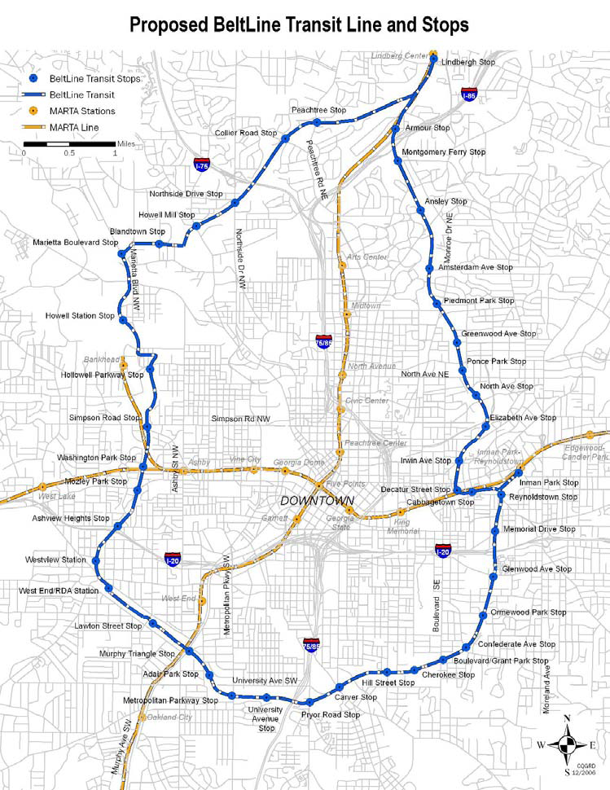
HIA Examples:
Atlanta Beltline
Decision: Planning for an extensive new transit corridor, paths, open-space, and redevelopment
HIA identified vulnerable communities, health risks, and many opportunities for health benefits (safety, exercise, air qual.)
Outcomes to date:
  Public health now formal part of planning: new open space, transit, etc
  $1 million EPA grant to speed development (health benefits cited)

Slide 15
HIA examples: Humboldt County General Plan
Alternative growth scenarios
3 Alternative growth scenarios:
Focused infill: infill development – limited to current municipal boundary, locations where there is existing infrastructure
Moderate growth: infill development, and limited expansion
Expanded development: minimally restricted expansion outside current municipal border
Human Impact Partners -- http://www.humanimpact.org/HumboldtGPU.html
Notes:
Over the last 15 years, public testimony on EISs for expanded oil and gas development in the region reveals a growing public concern regarding a range of health issues.

Slide 16
Humboldt County General Plan HIA
Examples of health determinants
Indicator | Description | Alter-native A Impact | Alter-native B Impact | Alter-native C Impact
ST.4 | Proportion of households with 1/4-mile access to local bus | + | ~ | -
ST.5 | Proportion of average income spent on transportation expense | + | ~ | -
ST.6 | Ratio of miles of bike lanes/pedestrian facilities to road miles | + | - | -
ST.7 | Proportion of commute trips and trips to school made by walking or biking | + | ~ | -
Notes:
I think the font needs to be pumped up a bit, especially the +, -, and ~ symbols. How about + - ~ in bright red?

Slide 17
Humboldt County General Plan HIA
Examples of health determinants
Indicator | Description | Alter-native A Impact | Alter-native B Impact | Alter-native C Impact
ST.8 | Number and rate of bicycle/pedestrian injury collisions | To be determined | To be determined | -
ST.9 | Proportion of population living on residential streets with <35 mph speed limits | + | ~ | -
ST.10 | Percent of population who have access to pedestrian facilities | + | ~ | -
Notes:
I think the font needs to be pumped up a bit, especially the +, -, and ~ symbols. How about + - ~ in bright red?

Slide 18
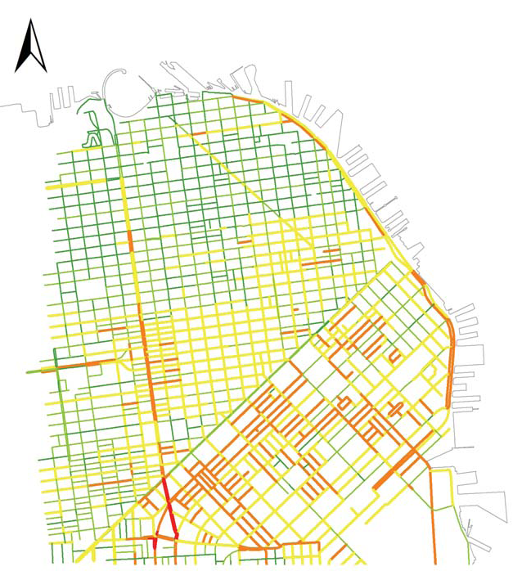
HIA examples: San Francisco
New housing development near congested roads
Decision: new zoning for a large housing development. HIA done by SFDPH, with Planning Dept
Impacts:
-Air modeling showed air pollution “hot spots” close to major roadway
-Noise modeling showed unhealthful exposure
Outcome: new buildings required to include particulate air filtration, noise reduction design features.

Slide 19
Assessment:
Basic steps
Describe the baseline health status, and factors that influence health. Typically quantitative
Analyze the impacts. Can be qualitative or quantitative
  Is the focus on predicting outcomes, or identifying pathways to facilitate better management?

Slide 20
Assessment step 2:
Analyze the impacts
Impact assessment in HIA can be:
Quantitative
Qualitative or descriptive:
  Nature -Probability/likelihood
  Direction -Strength of evidence
  Literature review
  supporting the
  analysis
  Expert opinion
Standards of evidence: scientific vs. legal
 |  | Severity
 |  | Beneficial | Mild Problem | Moderate problem | Severe/life-threatening
Probability/ Frequency | Unlikely/ rare
 | Uncertain
 | Likely/ common
Notes:
For example, this pathway analysis allows measures to minimize caribou displacement, such as raising pipeline heights and limiting seismic to certain seasons, and measures to maximize potential gains, such as establishing community subsistence funds to support families in need of equipment, fuel, hunting assistance, etc.

Slide 21
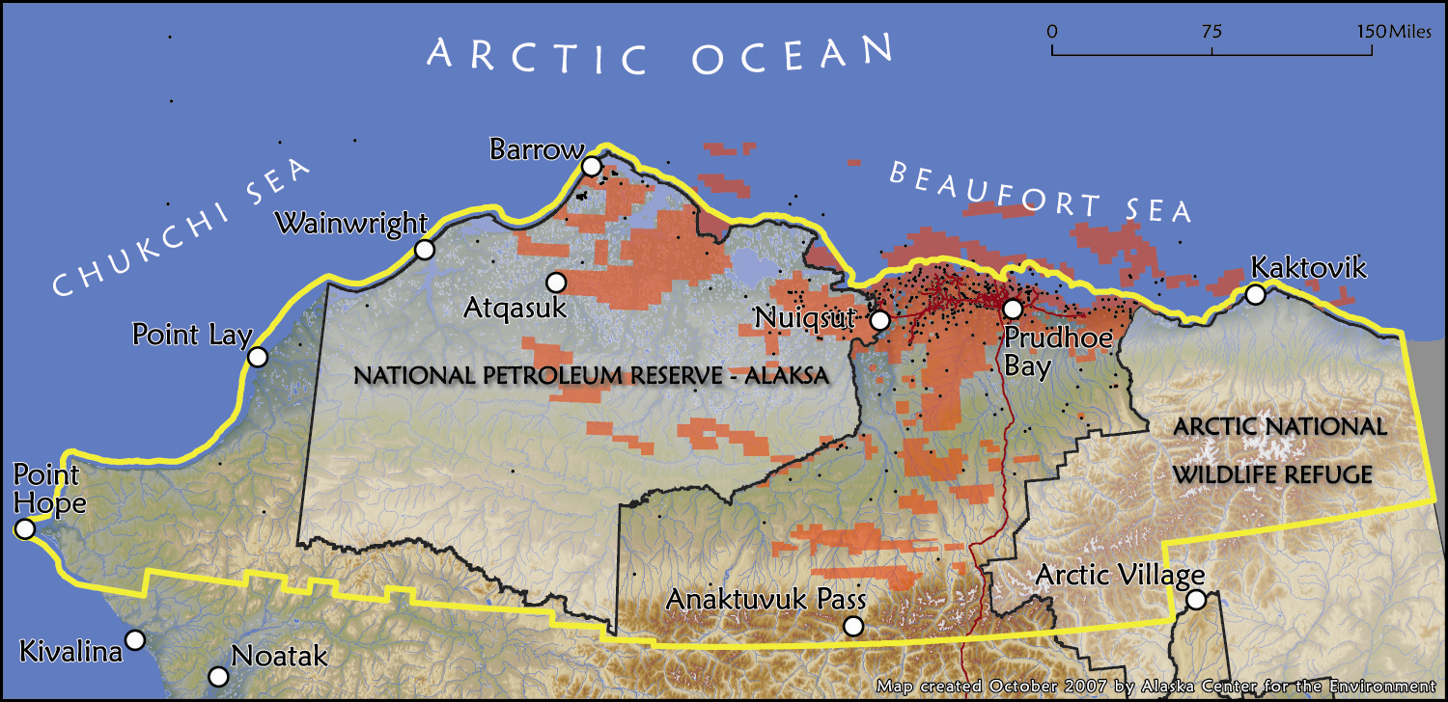
Oil leasing on Alaska’s North Slope
Notes:
Over the last 15 years, public testimony on EISs for expanded oil and gas development in the region reveals a growing public concern regarding a range of health issues.

Slide 22
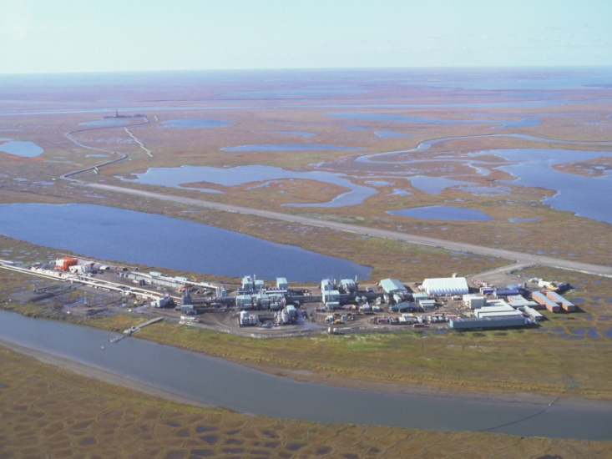
Nuiqsut, Alaska
  A small Inupiat community 7 miles from large oil development.
Over 10 years,
communities raised a
wide range of health
concerns as proposed development drew nearer to the community
Notes:
Concerns in the village of Nuiqsut, which lies closest to active oil and gas development, range from classic environmental contaminant concerns such as cancer and asthma, to social and psychological problems and sexually transmitted illnesses related to the sociodemographic changes experienced by these communities as industrial development brings large numbers of non-resident workers to the community.

Slide 23

The First Federal HIA/EIS:
Oil and gas leasing in the National Petroleum Reserve
Local government became a “cooperating agency” – a role defined by NEPA through which local governments can formally participate in an EIS
The community health agency drafted an HIA through this role
The lead federal agency (BLM) incorporated the HIA into the EIS

Slide 24
Result of the NPR-A HIA?
Mitigation measures in the Northeast NPR-A EIS
General Outcome:
This was a very contentious leasing proposal. Community engagement via the cooperating agency relationship and HIA process resulted in:
Improved relationships between the community and the agency
A compromise leasing plan that was widely accepted on both sides

Slide 25
Result of the NPR-A HIA?
Mitigation measures in the Northeast NPR-A EIS
Health Concern | Mitigation Measure
Need to address health in planning future projects | BLM will consult with relevant health agencies in the development of future proposals in Northeast NPR-A
“Social ills”: alcohol, STIs, | Expand cultural orientation for workers
Air pollution | Additional baseline, modeling, and monitoring above CAA requirements.
Contamination of local food sources | Baseline levels and ongoing monitoring

Slide 26
Assessment
Your data are incomplete, your predictions are uncertain…
What to do?? …
Adaptive Management

Slide 27
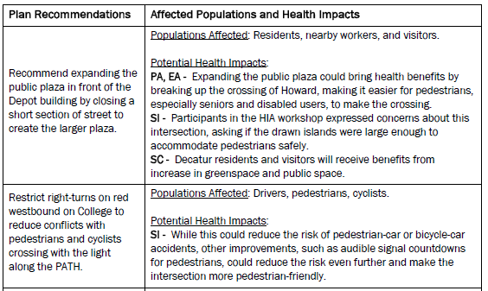
Decatur, GA Comp Plan http://www.cqgrd.gatech.edu/projects/decatur_transportation_plan/index.php
http://carbon.ucdenver.edu/~kkrizek/pdfs/EIARinpress.pdf

Slide 28
What are the elements that define HIA?
Forward-looking: addresses a possible decision that hasn’t occurred yet
Seeks to inform decision-making
Follows 6 steps (5 in some texts)
Broad framework: considers social, economic and environmental influences on health
Broad definition of health
Participatory process
Focus on vulnerable populations/equity
Cross-disciplinary engagement

Slide 29
“HIA 2.0” – beyond project-specific applications
Should a new HIA be done for each new project or program?
Can HIA be a formative learning tool that results in adoption of new “healthy by design” principles that obviate the need for HIA on every projects?

Slide 30
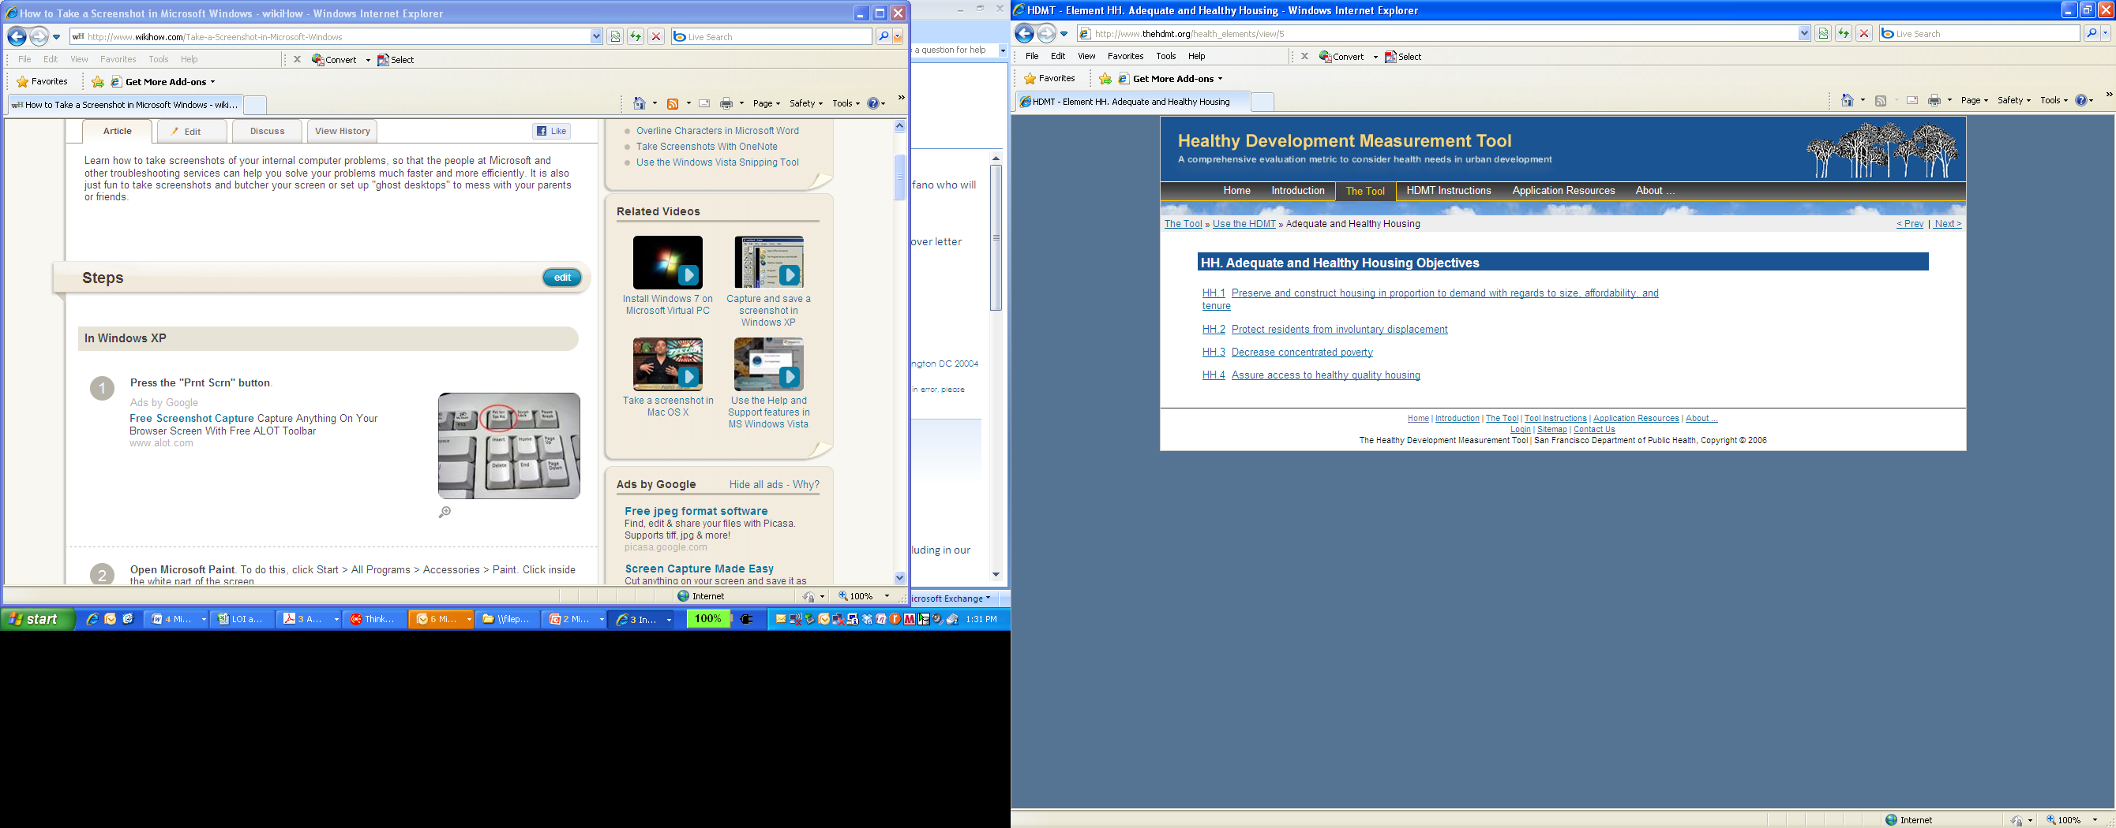
“HIA 2.0” – beyond project-specific applications
The Healthy Development Measurement Tool

Slide 31
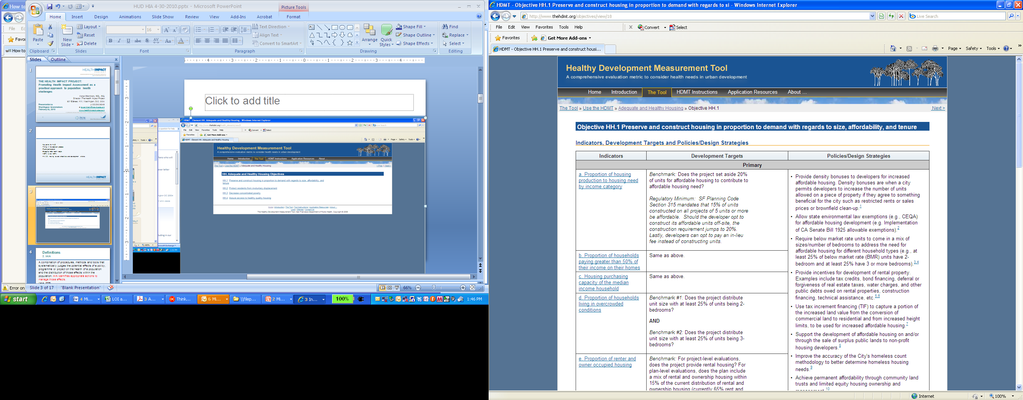

Slide 32
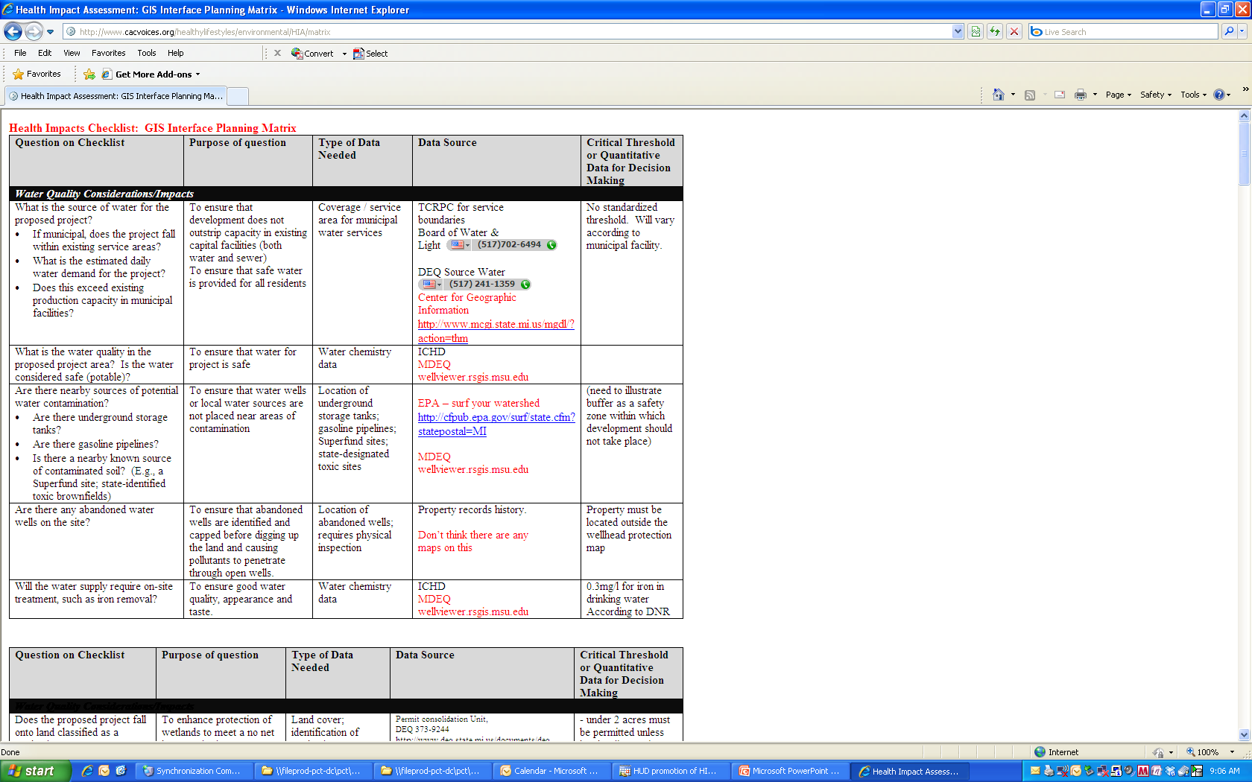
Ingram County, MI (Lansing):
Local health dept now using “HIA Checklist”
This Website has case study and link to the checklist:
http://www.cacvoices.org/healthylifestyles/environmental/HIA/

Slide 33
Tradeoffs between HIA and Checklist approaches:
 | Checklist | HIA
 | Influence project design at an earlier phase Take time to develop, but may reduce time demands in the long run Developers may favor a static checklist approach for predictability But…may sacrifice project-specific detail | Public engagement process Requires interagency collaboration, with many benefits: insight into the project, public education, new collaborative relationships, building public trust, etc

Slide 34
The Health Impact Project:
A collaboration of the Robert Wood Johnson Foundation and The Pew Charitable Trusts
    Overall Objective: To promote and support the use of HIA as a tool to ensure that decisions in non-health sectors, whether at the local, state, tribal, or federal level, are made with health in mind.
Visit www.healthimpactproject.org

Slide 35
The Health Impact Project CFP
Funded Projects
State Budget Process: New Hampshire Center for Public Policy will address the NH budget
  State Cap-and-Trade regulations: CA DPH an HIA to inform the rulemaking process for California’s carbon cap and trade rule
  3. Agriculture Policy: Kohala Center, a nonprofit in HI, will do an HIA to inform HI County’s A non-profit would engage in a county agricultural plan that will shape the local economy, land use patterns, and diet.
  Wilshire Transportation Corridor, LA: LA DPH and UCLA will do an HIA of planned transportation corridor in LA
  Farm to School Legislation: a non-profit in OR will do an HIA to inform deliberations on a farm to school bill.

Slide 36
The Health Impact Project:
A collaboration of the Robert Wood Johnson Foundation and The Pew Charitable Trusts
    1. A national Center to support the field:
      grant initiatives
      A website with resources, training materials, case studies, policy briefs
      Forming a community of practice: both online and in-person meetings
      Convening trainings, meetings, and policy-oriented discussions
      Collaborating with and supporting current centers with established expertise in the field
      Supporting agencies new to HIA

Slide 37
The Health Impact Project:
A collaboration of the Robert Wood Johnson Foundation and The Pew Charitable Trusts
    2. Building the case for HIA:
      Funding a series of demonstration projects that address real-time decisions on proposed policies, programs, and projects at the local, state, and tribal level: see the CFP at www.healthimpactproject.org
      Building a technical assistance network to support new HIA practitioners
      A “rapid response” fund to allow local health departments or others complete rapid HIAs of smaller-scale, shorter-term decision making.

Slide 38
The Health Impact Project:
A collaboration of the Robert Wood Johnson Foundation and The Pew Charitable Trusts
    Are there existing regulations, policies, and standards that support the inclusion of health considerations?
      Review existing legal constructs that may support the inclusion of health – zoning laws, growth plans, regulatory impact analysis, etc.

Slide 39
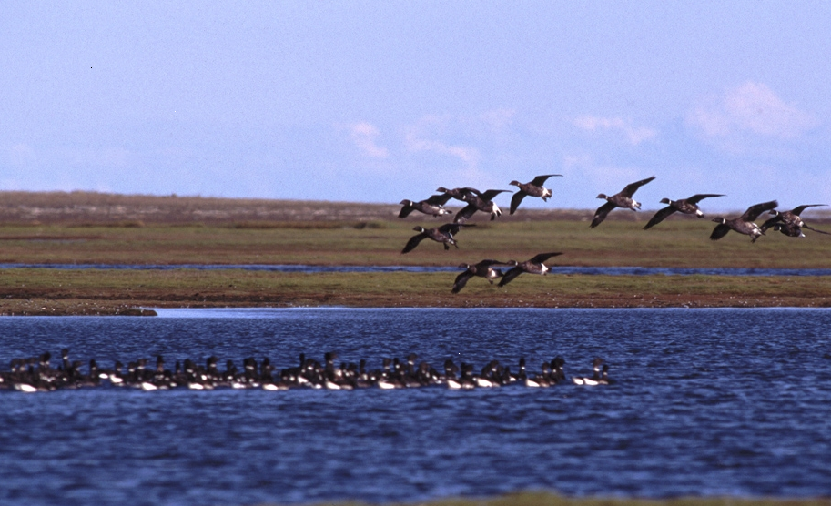
Discussion?

Slide 40
Subject Area

Slide 41
Proposals from 43 States

Slide 42
HIA: the stages from the standpoint of effective cross-sectoral engagement
HIA Stage | Eg. of cross-sectoral strategy
Screening | Early discussion of HIA, HIA training for all stakeholders
Scoping | What are policymaker’s constraints, concerns, practical limitations?
Assessment | What information do other sectors bring? AQ? Traffic models? Do they understand our data?
Reporting | Peer review by other stakeholders, policymaker: honest efforts to address all concerns
Recommendations | What can policymaker do, practically? Why are some options more or less viable
Monitoring and Evaluation | Can policy maker require monitoring? Are there funding streams from outside public health?

Slide 43
Northeast NPR-A Example: hunting and diabetes
Baseline:
Type 2 diabetes prevalence low: ~2.5%
Diet: ~50% “wild foods” – caribou, salmon, marine mammals
Impact Assessment:
Pipelines
Displace caribou farther from village
Dietary Change
Diabetes Risk
“Seismic”
Fuel & equipment for hunting
Revenue

