Slide 1
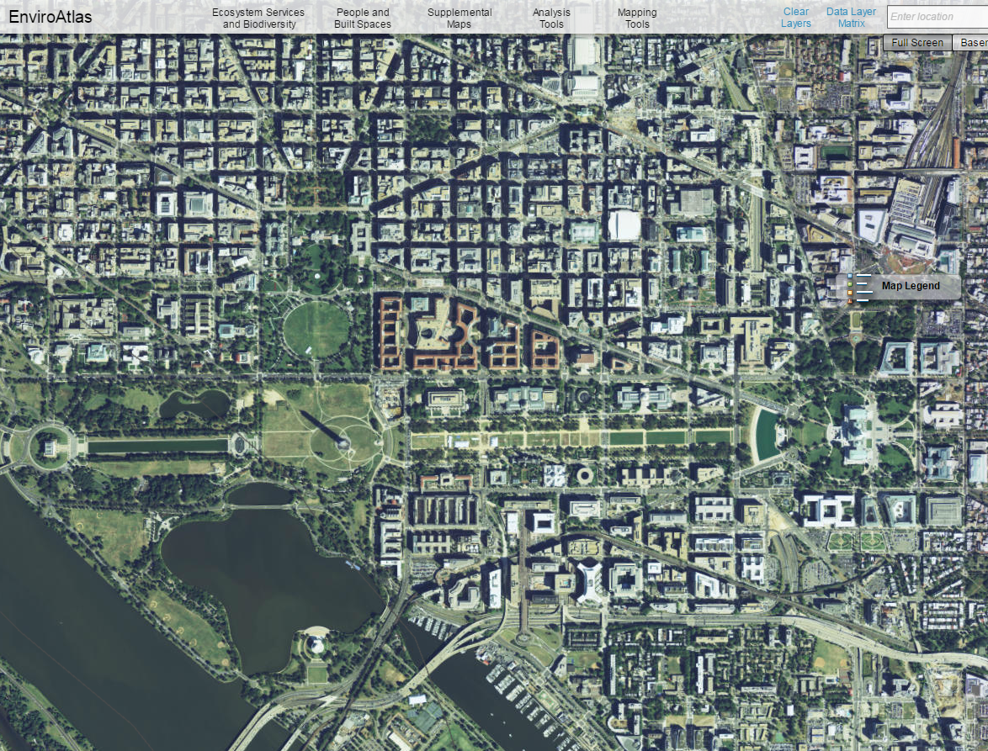
Integrating Ecosystem Services into HIA:
Tools and Examples
6/6/15
Leah Yngve
ASPPH/EPA Environmental Health Fellowship Program Participant
Hosted by the U.S. EPA Office of Research and Development
Sustainable and Healthy Communities Research Program
EnviroAtlas Project

Slide 2
This presentation was supported by Cooperative Agreement Number X3-83555301 from the U.S. Environmental Protection Agency and the Association of Schools and Programs of Public Health. The findings and conclusions of this report do not necessarily represent the official views of EPA or ASPPH.

Slide 3
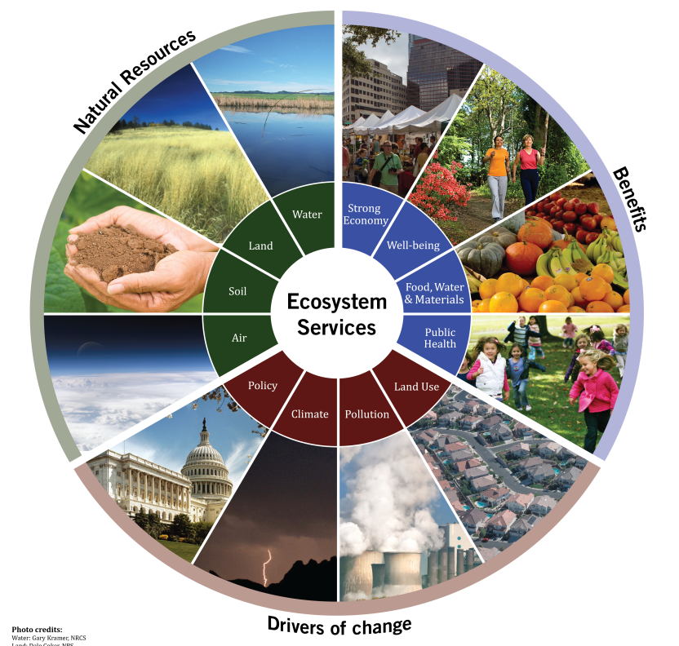
EnviroAtlas is…
An online decision support tool for viewing, analysing, and downloading geospatial data related to ecosystem services
Maps, data, tools and information about the supply, demand, drivers, and social benefits of ecosystem services
Population and climate scenarios
Reference data (e.g., boundaries, land cover, soils, hydrography, impaired water bodies, wetlands, demographics)
Analytic and interpretive tools
Free & open access as of May ‘14
Ecosystem services = benefits that humans receive from nature
Developed through cooperative effort
among multiple Federal agencies, universities, and other organizations

Slide 4
Ecosystem Services as Health Determinants:
Unrealized Assets = Unintended Consequences
Approach: Demonstrate Multiple Benefits of Green Infrastructure,
Clean air
Clean & plentiful water
Natural hazard mitigation
Climate stabilization
Recreation, culture & aesthetics
Food, fiber & materials
Biodiversity conservation
  …and How They Relate to Human Health & Well-Being
  Air and water pollutants removed by neighborhood tree cover
  Homes and schools near busy roadways
  Extreme heat events
  Opportunities for physical exercise, social engagement, outdoor experience, and play
  Distributions of vulnerable populations
Related concepts:
“benefits from nature,” “green infrastructure,” “our life-support system,” “positive environmental exposures”
Notes:
My/EPA’s approach has been oriented towards decision-support. Includes measures of the built environment.

Slide 5
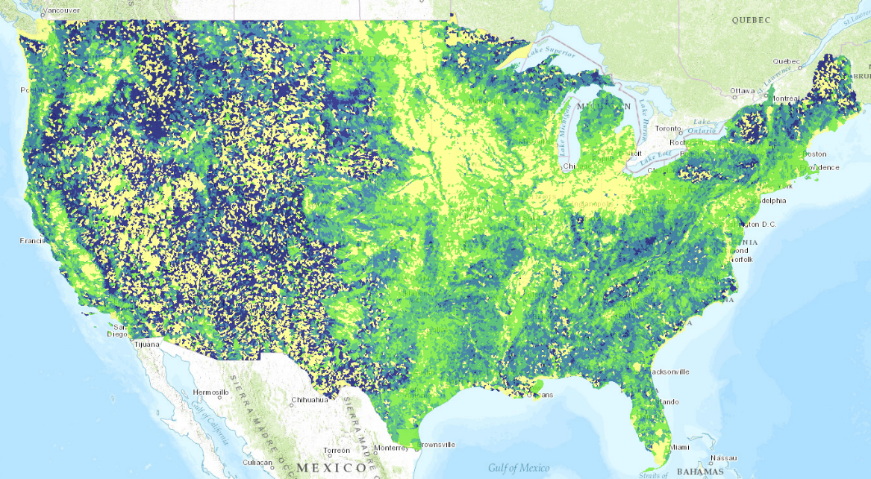
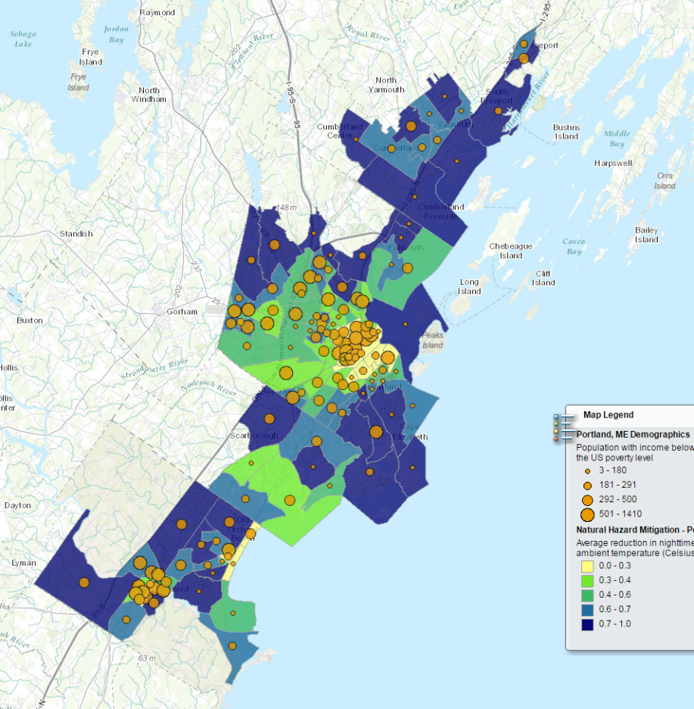
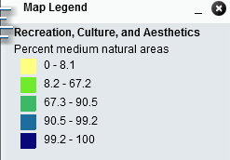
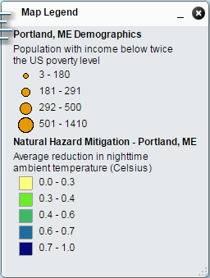
EnviroAtlas is Multi-Scaled
300+ map layers available online in the Interactive Map
National: Wall-to-wall coverage for coterminous US; summarized by ~90,000 drainage basins
(12-digit HUCs). 160+ data layers
(500 – 25,000 ac)
Community: High resolution component for 50 populated places; summarized by US census block group. 100+ data layers
Pictured: Greater Portland, ME
http://enviroatlas.epa.gov/

Slide 6
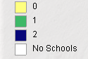
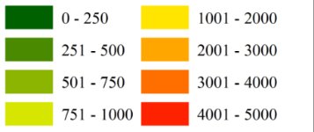
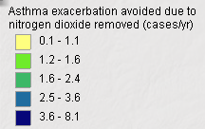
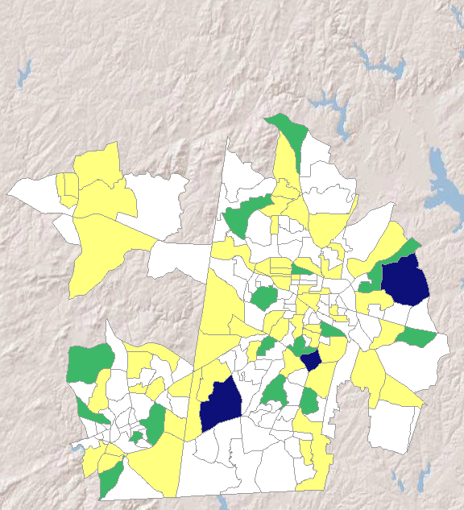
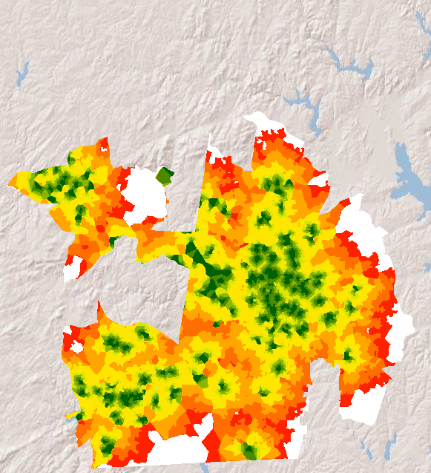
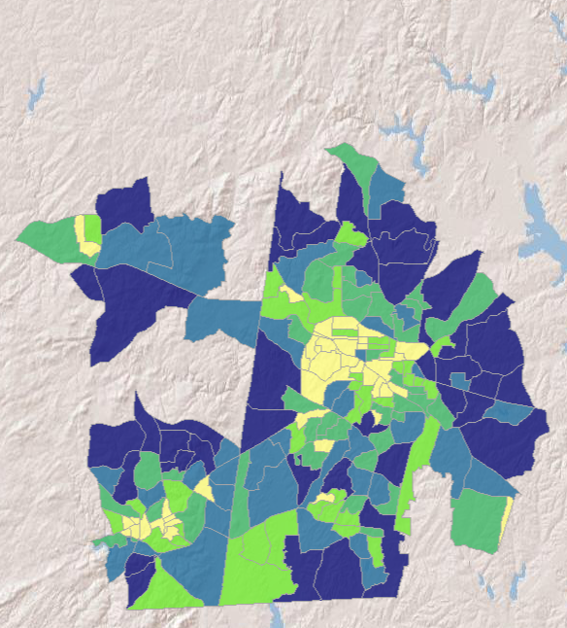

Community Information to Assist Decision-Making
e.g., health interventions, public infrastructure, social equity
Asthma exacerbation avoided due to nitrogen dioxide removed (cases/yr)
K-12 schools with <25 percent green space in viewshed
Walking distance from a park entrance (m)
Opportunities for physical activity, engagement with nature, & social interaction
Estimated reductions in adverse respiratory health events due to ambient air filtration by trees
Potential to improve school performance through cognitive restoration & stress reduction
Pictured: Greater Durham-Chapel Hill, NC

Slide 7
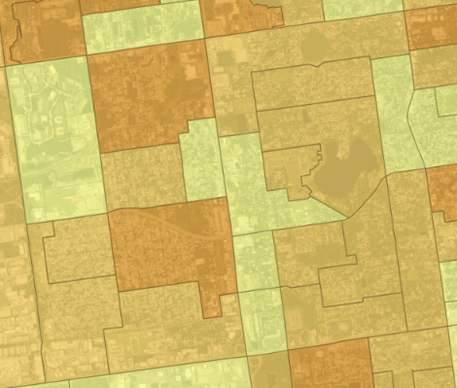
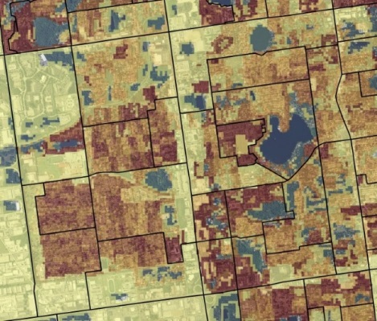
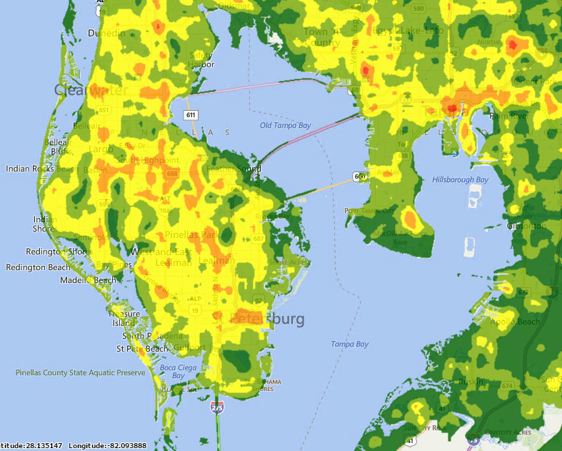
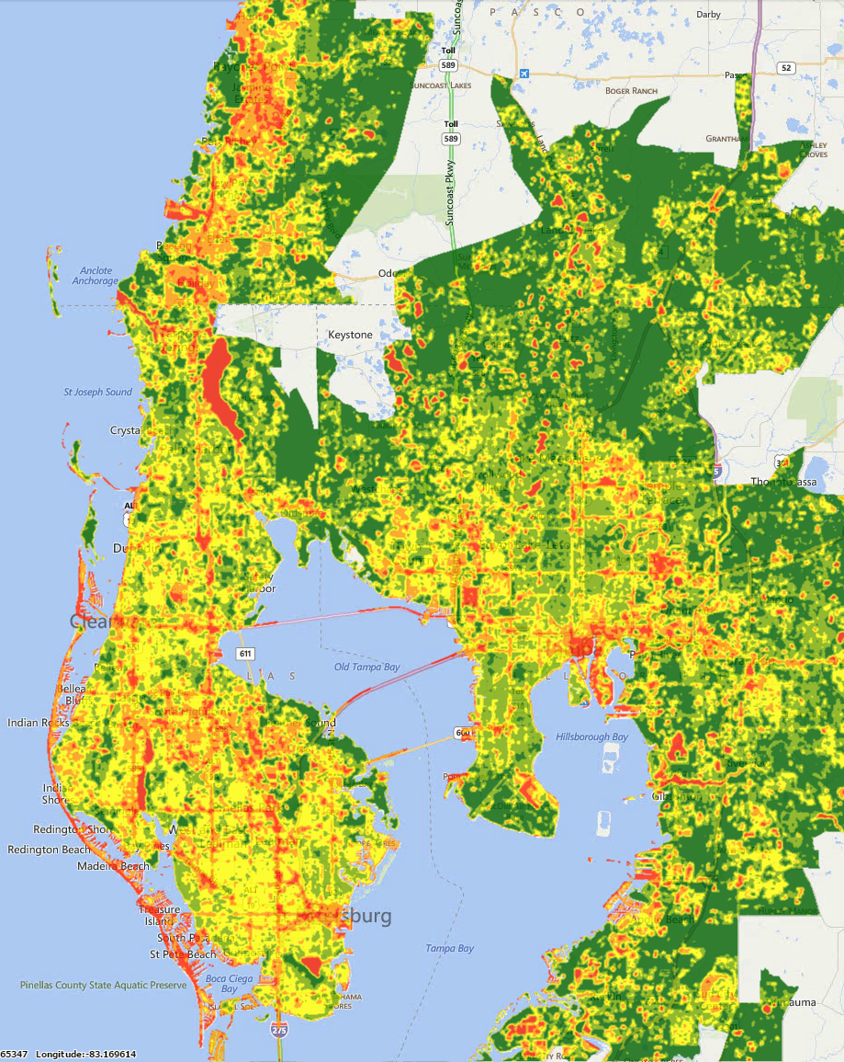
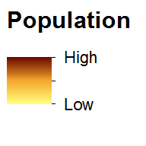
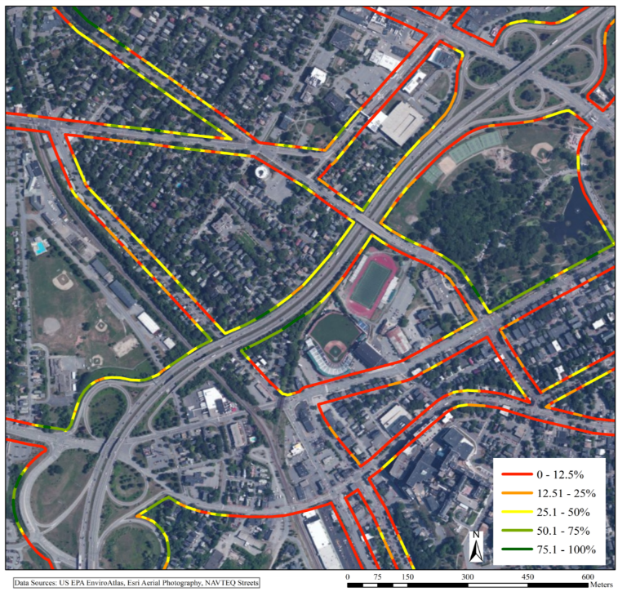
All Data are Downloadable & Accessible via Web Services
(incl. fact sheets for general users and technical metadata)
Downscaled (30-meter) U.S. Census
population grid
Precise maps of tree cover
along local roads & streams
Heat maps

Slide 8
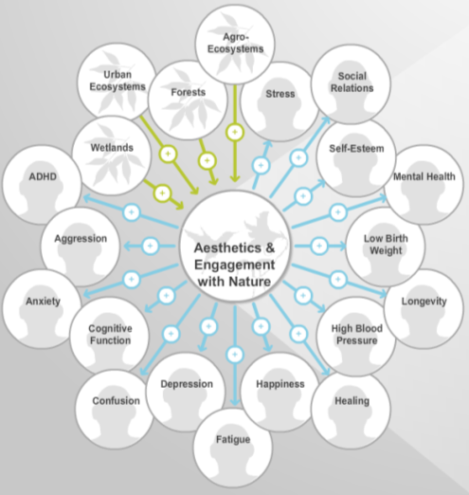
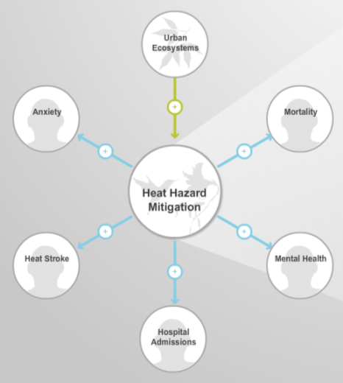
The Eco-Health Relationship Browser
4 ecosystems:
Forests
Urban Ecosystems
Wetlands
Agro-Ecosystems
30+ health outcomes:
Asthma
ADHD
Cancers
Cardiovascular diseases
Heat stroke
Healing
Low birth weight
Obesity
Social relations
Stress
… many more
        6 Ecosystem Services:
Health promotional services
Aesthetics & Engagement with Nature
Recreation & Physical Activity
Buffering services
Clean Air
Clean Water
Heat Hazard Mitigation
Water Hazard Mitigation

Slide 9
The Eco-Health Relationship Browser
Based on Literature
Review, 1990 - 2012
Number of relevant articles found
Journals publishing the most articles identified in review
Jackson et al. 2013. International Journal of Public Health. DOI: 10.1007/s00038-013-0482-1.

Slide 10
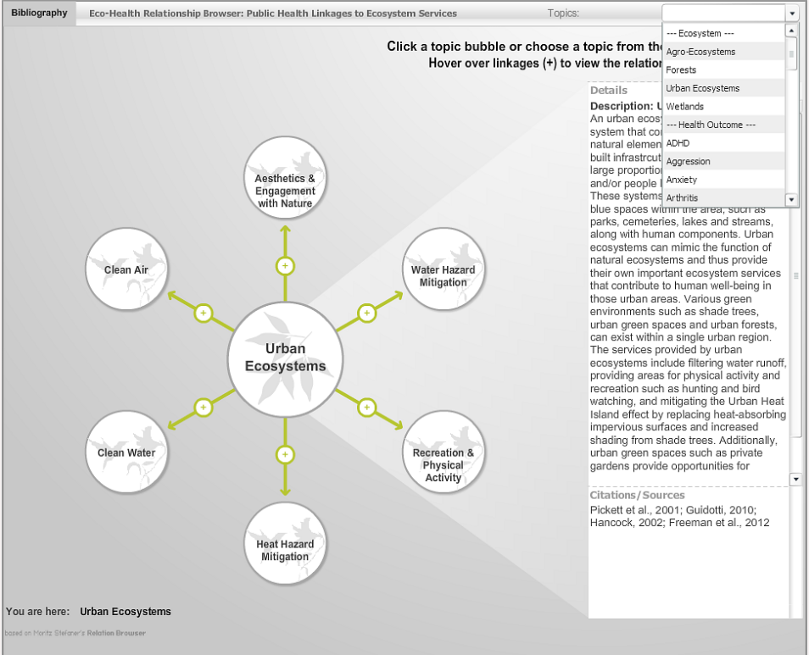

Slide 11
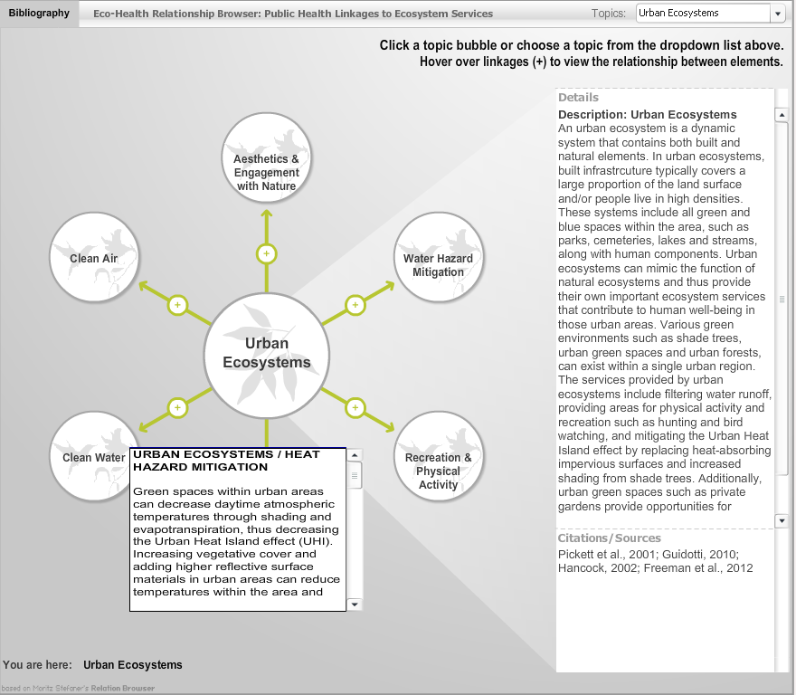

Slide 12
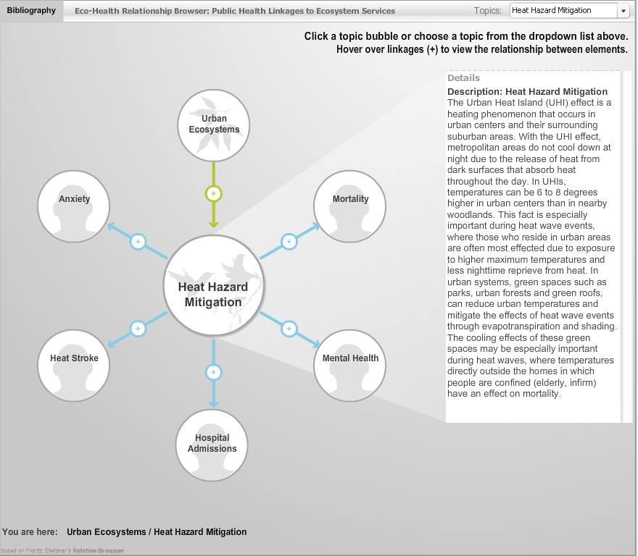

Slide 13
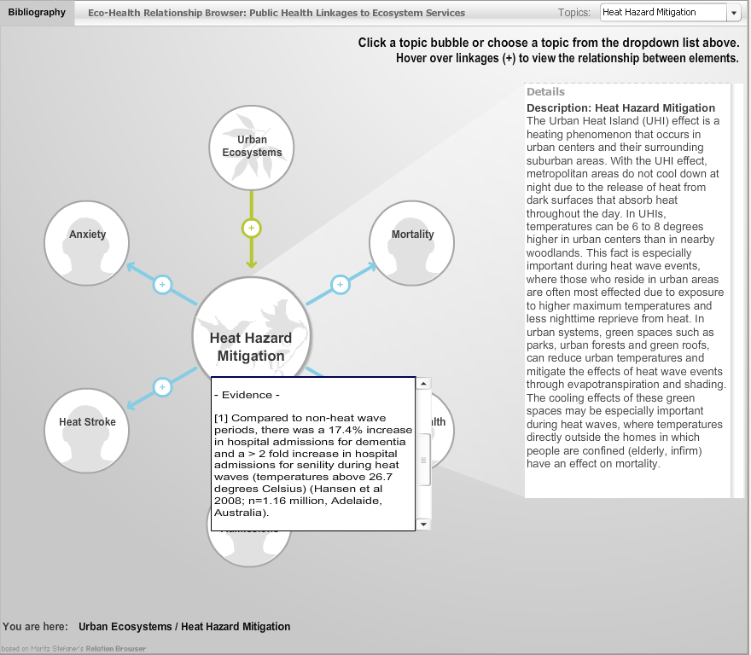

Slide 14

EnviroAtlas and HIA
EnviroAtlas Tools | Interactive Map | Eco-Health Relationship Browser | Fact Sheets | Case Studies & Use Cases | Mapping & Analysis Tools | GIS Tools | Metadata/ Data Download
HIA Steps
Screening
Scoping
Assessment
Recommendations
Reporting
Monitoring & Evaluation

Slide 15
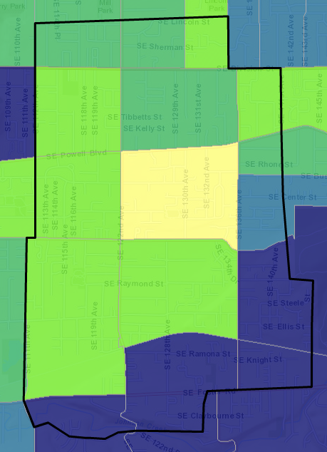
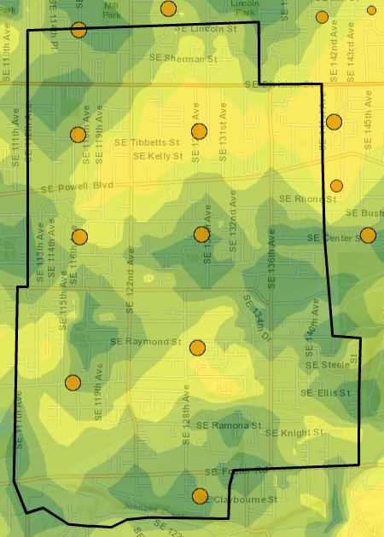
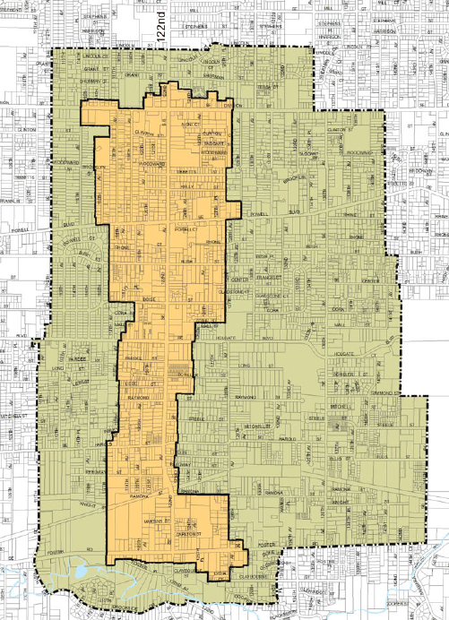
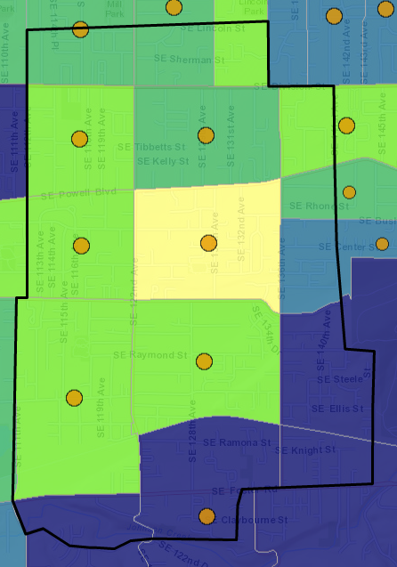
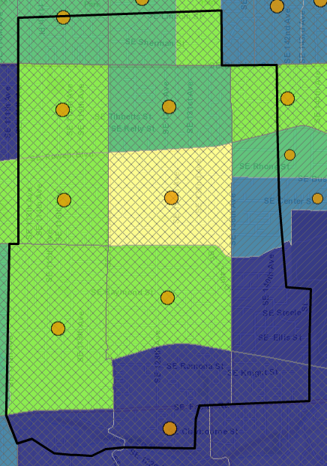
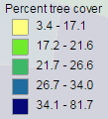
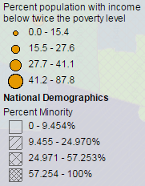
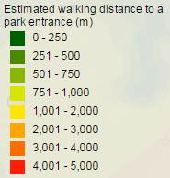


Ex: SE 122nd Ave HIA, Portland, OR*
HIA Goal: “explore ways to help create a 20 minute neighborhood by addressing land use, transportation, connectivity, and development design issues in the study area”
Percent tree cover
Estimated walking distance to a park entrance + population <13
Study Area
+ % population with income < 2xpoverty level
+ % minority
*Completed in 2011 by Oregon Public Health Institute

Slide 16
SE 122nd Ave HIA: Assessment
Five health determinants were assessed with a focus on vulnerable populations:
Opportunities for physical activity
Opportunities for accessing healthful foods
Opportunities for social engagement/cohesion
Bicycle and pedestrian traffic safety
Exposure to outdoor air pollutants

Slide 17
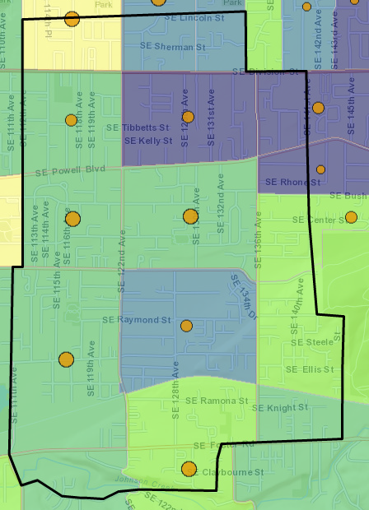
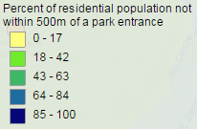
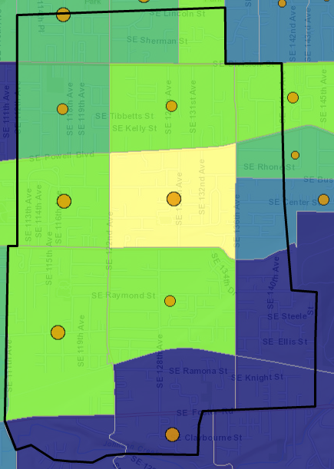
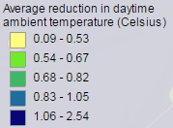
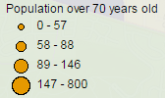
SE 122nd Ave HIA: Assessment
Five health determinants were assessed with a focus on vulnerable populations:
Opportunities for physical activity
Opportunities for accessing healthful foods
Opportunities for social engagement/cohesion
Bicycle and pedestrian traffic safety
Exposure to outdoor air pollutants
% residential population not within 500m of a park entrance
Average reduction in daytime ambient temperature

Slide 18
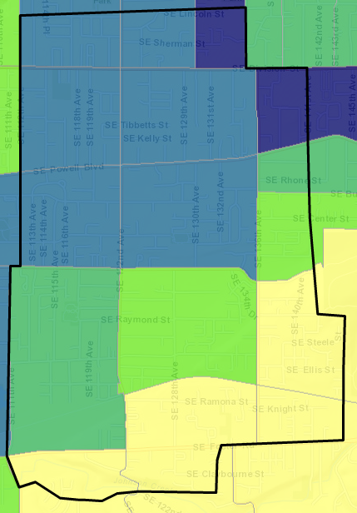
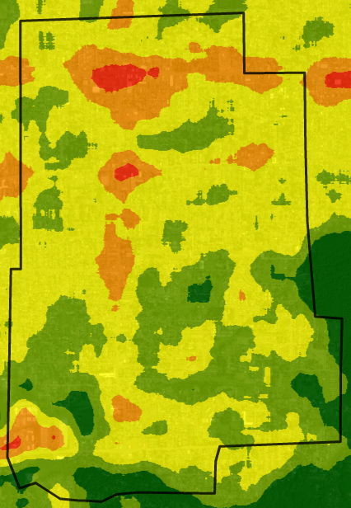
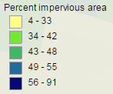
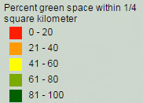
SE 122nd Ave HIA: Assessment
Five health determinants were assessed with a focus on vulnerable populations:
Opportunities for physical activity
Opportunities for accessing healthful foods
Opportunities for social engagement/cohesion
Bicycle and pedestrian traffic safety
Exposure to outdoor air pollutants

Slide 19
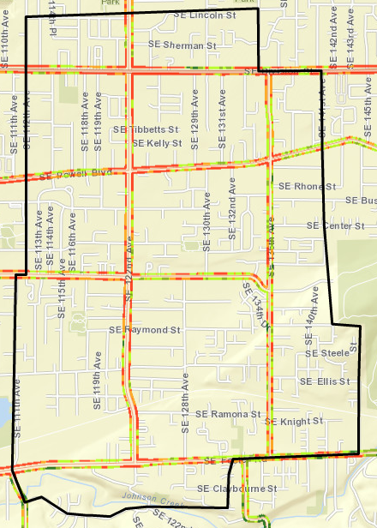
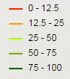
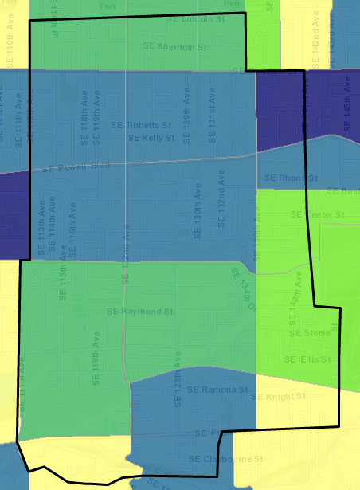
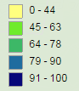
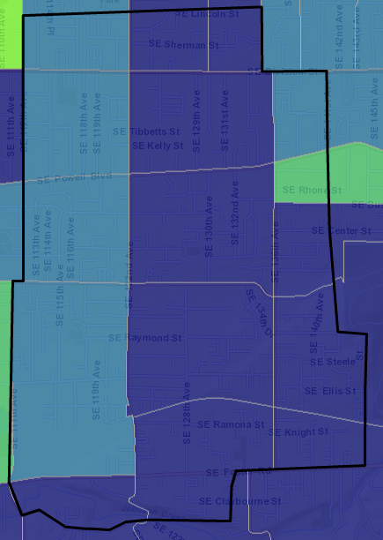
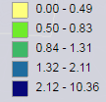
SE 122nd Ave HIA: Assessment
Five health determinants were assessed with a focus on vulnerable populations:
Opportunities for physical activity
Opportunities for accessing healthful foods
Opportunities for social engagement/cohesion
Bicycle and pedestrian traffic safety
Exposure to outdoor air pollutants
Estimated % of tree cover within 26m of a road edge
% of residential population within 300m of a busy roadway
Asthma exacerbation avoided due to nitrogen dioxide removed (cases/yr)

Slide 20
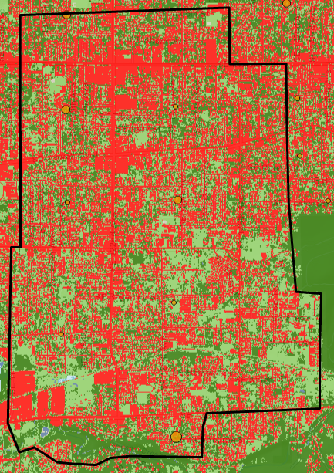
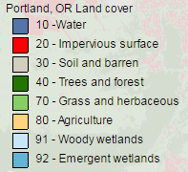
SE 122nd Ave HIA: Assessment
Five health determinants were assessed with a focus on vulnerable populations:
Opportunities for physical activity
Opportunities for accessing healthful foods
Opportunities for social engagement/cohesion
Bicycle and pedestrian traffic safety
Exposure to outdoor air pollutants
1-meter resolution land cover circa 2012
Maps of your own creation:
Trees/green space around schools or summarized by your own boundaries (parcels, etc)
Trees by bus stations
Trees along roads
Agricultural/community garden potential

Slide 21
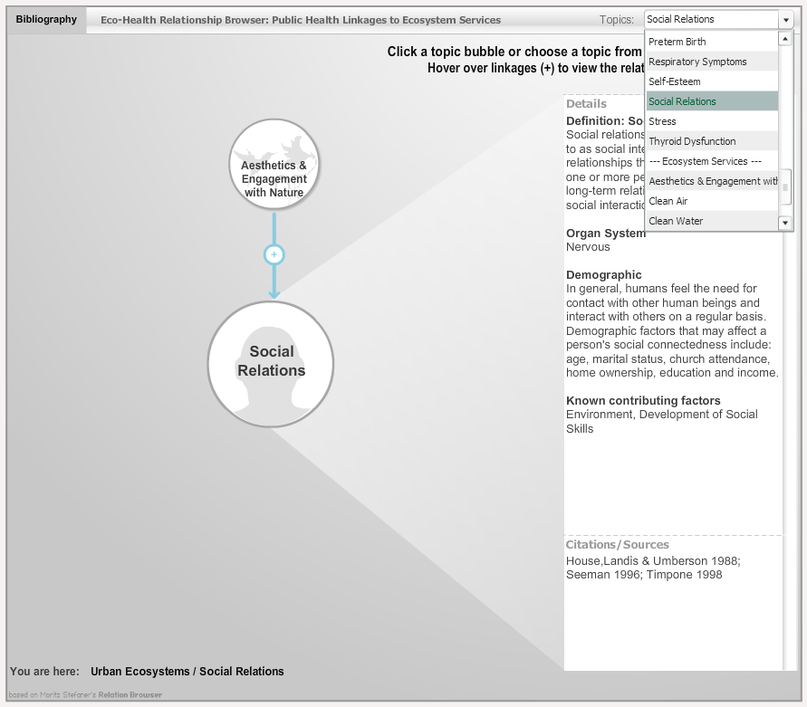


SE 122nd Ave HIA: Recommendations
Evidenced based interventions are referenced in the Eco-Health Relationship Browser.

Slide 22
SE 122nd Ave HIA: Report
Your data (shapefiles) can be uploaded into the Interactive Map or EnviroAtlas data can be downloaded and combined with your local data (sidewalks, parcels, building footprints, etc) for final map manipulation and creation.
Other resources:
Fact sheets for each layer contain valuable information about the topic
Metadata for each layer demonstrates the methods used to create EnviroAtlas data
Case studies and use cases provide examples of how EnviroAtlas has been or can be used
Downloadable GIS tools are available for more in-depth analysis

Slide 23
Explore it yourself: enviroatlas.epa.gov
General EnviroAtlas info: EnviroAtlas@epa.gov
Questions for me: Yngve.Leah@epa.gov
Questions?

