Slide 1
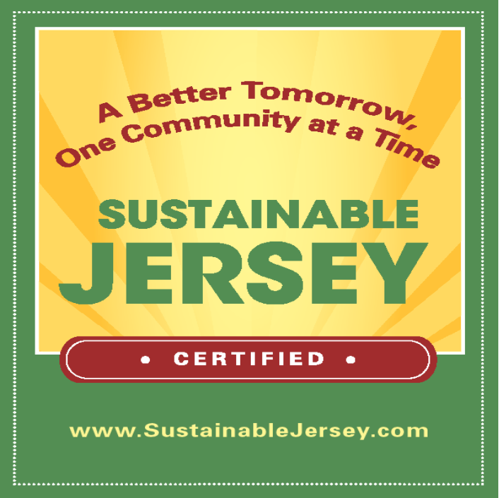

Slide 2
Approaches to operationalize HiAP:
Using a Sustainability Certification framework to advance Health In All Policies Integration
Donna Drewes, PP/AICP
Co-Director
Sustainable Jersey
Sustainability Institute at TCNJ

Slide 3
Implementing Health in All Policies
Sustainable Jersey Certification Program-Framework for Progress
Program Strategies
Building cross- sector relationships
Incorporating health into decision-making
Benefits multiple partners, robust stakeholder engagement
Supports structural change
Coordinates funding

Slide 4
What is Sustainable Jersey?
Sustainable Jersey coordinates priorities, resources, and policy among public and private, state and local actors to help communities and schools achieve their sustainability goals. Capped by prestigious certification, the program has three components.
Sustainable Jersey:
Identifies actions to help municipalities and schools become more sustainable
Provides tools, resources, and guidance to make progress
Provides access to grants and funding for municipalities and schools

Slide 5
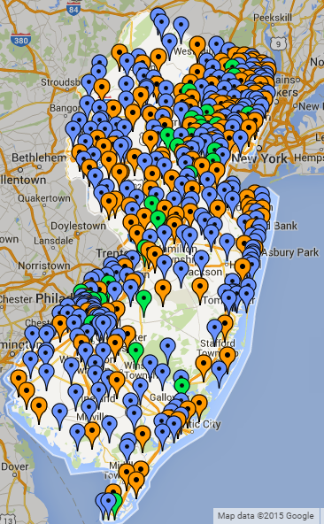
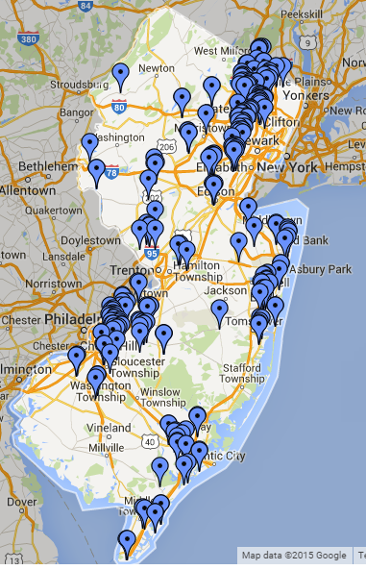
Sustainable Jersey
423
Municipalities
76
School
Districts
208
Schools

Slide 6
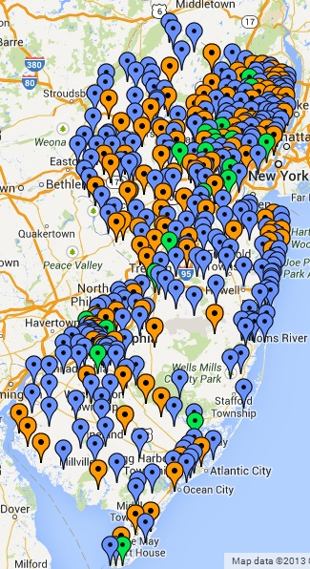
Participating Communities
Program start: February 2009
423 (75%) NJ municipalities participating
86% of NJ’s population lives in these
communities
177 municipalities certified:
149 towns at bronze level
28 towns at silver level

Slide 7
Program Metrics
423 | Registered Municipalities (75% of State)
33% | Communities Certified in New Jersey
23 &10 | Municipal & School Task Forces (over 300 organizations participating)
7,000+ | Actions completed (since 2009)
 | Policies/Ordinances (Complete Streets, Outdoor Smoking, Urban Ag, Parking, Healthy Food)
 | Programs (Mayors Wellness, Safe Routes to Schools, Breakfast after the Bell, healthy food access, School Wellness Councils, Indoor Air Quality, School Health Assessment, lead education and training)
 | Projects (farmers markets, Anti-idling education, school & community gardens, access to water, tree planting, outdoor classrooms)
 | Plans (Bike/Ped Plans, Sustainability Elements, Farmland Preservation, tree canopy, open space, Resiliency, Extreme Temperature, Coastal Flooding and Sea level rise)

Slide 8
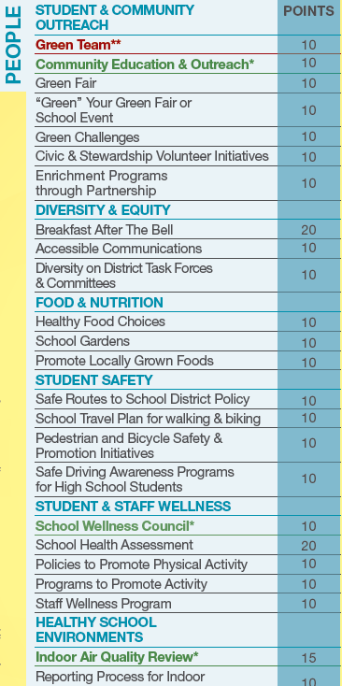
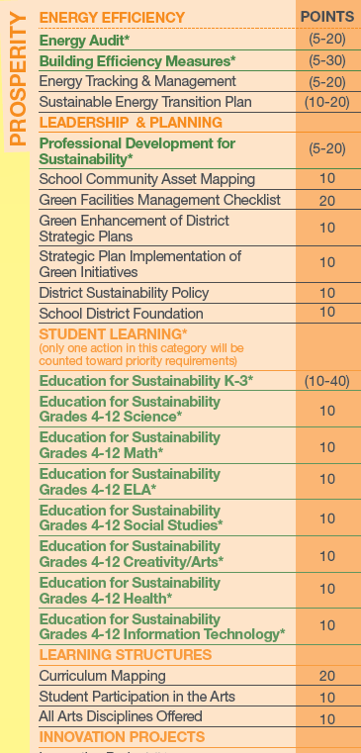
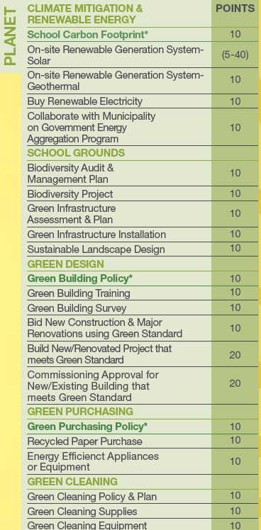
Actions: Prosperity, Planet, People
Notes:
Each of the Sustainable Jersey actions that towns do to become certified are divided into the Prosperity, Planet and People categories. Each action comes with a fully resourced tool which includes: What is it? Why is it important? Who should be involved? How long will it take and what will it cost? In addition, there are resources in the tools themselves. And a “spotlight” section on successful communities.
The technical content of the program’s actions are developed with the help of 22 task forces that comprise New Jersey state local officials, experts, non-profit groups, and members of the business community. Recommended best practices/actions are vetted with local government officials.

Slide 9
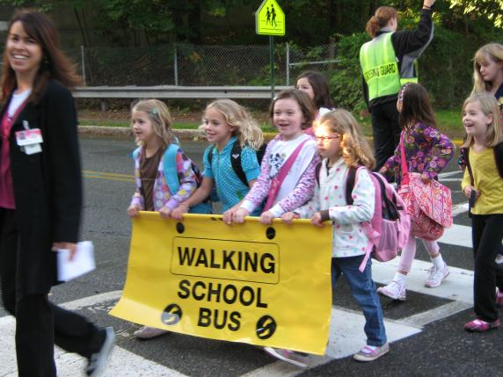
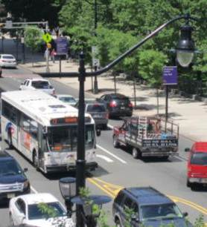
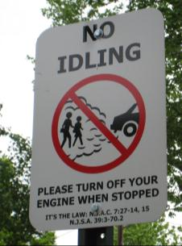
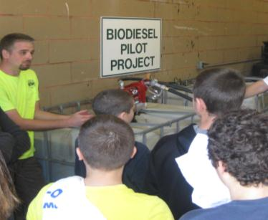
Certification Benefits
Recognition
Save Money, Get Money
Access to Training and Guidance
Promote your community
Advance Sustainability
Notes:
Just to recap – here are a few of the certification benefits.
Save money. Get money. Sustainable Jersey includes actions that can help you improve efficiency and cut waste.
Gain access to training, tools and expert guidance.
Get recognized. Promote your town.
Conserve valuable resources. Protect the environment.

Slide 10
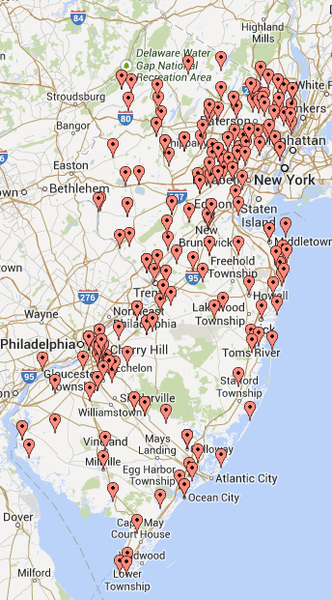
Small Grants Program
Awarded Grant Locations
Since 2009 Sustainable Jersey has awarded 340+ grants ranging from $2,000 capacity building grants to $35,000 model project grants. To date, over $2,300,000 has been awarded.
Funding Provided By:
Walmart
PSEG Foundation
New Jersey Department of Health
Gardinier Environmental Fund
NJ Education Association

Slide 11
Who Creates The Actions/Standards?
To create rigorous and broadly accepted standards and actions we convened Task Forces on 33 different issues in both school and municipal programs
Task Forces utilize 300 volunteer leaders from:
Academia
Non-profit sector
Business community
State, local, federal, and county government
Task Forces identify best practices, develop new models, support training and leverage resources from state agencies, NGO’s, regional and the corporate sector

Slide 12
Advancing Health in All Policies
Two Prong Approach
Encourage Professional Development and Training on HIA’s
Develop new or update existing Actions to incorporate health in all policies focus
Technical Leadership:
NJ Health Impact Collaborative-Rutgers University
PEW –Health Impact Project and RWJ
Georgia Health Policy Center

Slide 13
Advancing Health in All Policies
New HIA Training Action– will award points for municipal planners, planning board members or health professionals that attend training
Updates/Revisions Underway:
Extreme Temperature Planning
Bicycle and Pedestrian Audits
Bicycle and Pedestrian Plans
Complete Streets Policy and Program Integration monitoring
Notes:
Discuss HiAP updates for each of the actions.

Slide 14
Advancing Health in All Policies
Next Steps and Timeframe
New or Updated Actions and associated toolkits incorporated into program early fall
Outreach, education & training
Highlighted at workshops at NJ League of Municipalities, NJ American Planning Association, other health and transportation

Slide 15
Lessons Learned
Collaboration critical- but need to spend time to build base knowledge to make progress
Be strategic and focused when selecting initial HiAP initiatives, look for those with high probability of success. Best practices need to be backstopped by multi-agency/organizational support, technical services, training, and optimally funding
Curb or manage enthusiasm - change needs to be structurally supported, so go slow

Slide 16
Thank you!
Sustainable Jersey website
www.sustainablejersey.com
www.sustainablejerseyschool.com
Donna Drewes PP/AICP, Co-Director
Sustainable Jersey
Sustainability Institute at The College of New Jersey
drewes@tcnj.edu

